Slide 1
Trends in Data Science Careers
Exploring the field of Data Science with Indeed’s Job Market Data
Chris Lindner, Ph.D.
Product Science Manager, Indeed

Slide 2
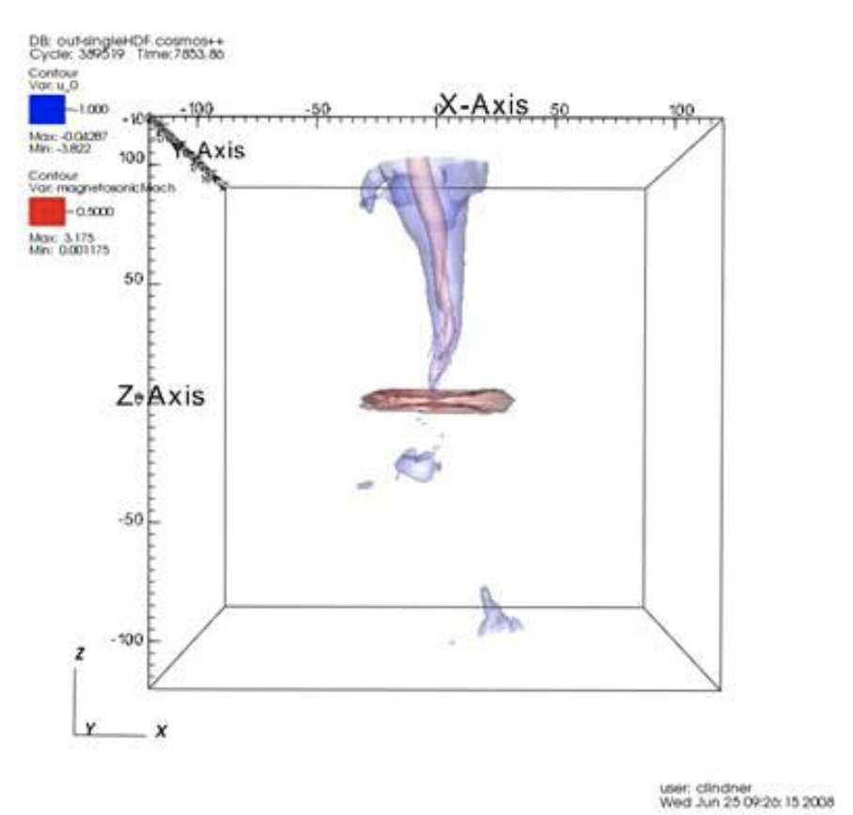
Who am I?
≅2011
Started thinking about DS
August 2017 Began work at Indeed
Oct 2014
Began work at Civitas Learning
+ Interviewed people in DS
+ Started DS Study Group
+ Education technology startup
+ Promoted to DS manager
+ Hired as a product science manager
+ Grew team from 5 to 25 in 1.5 years!
2008
Started @ UT Austin
Astronomy
July 2014
Ph.D.
May 2017 Left Civitas Learning
+ Didn’t apply to any academic jobs
+ Took ~3 months to finish interview processes and get hired
Knew I 100% was going to be a professional astronomer.
+ Took a 3 month travel / poker sabbatical

Slide 3
Who is Indeed?
Indeed is the world’s #1 Job Site
250 million unique visitors each month across 60+ countries
25 million active job postings
150 million resumes
Basically, we have a ton of data on jobs

Slide 4
https://www.hiringlab.org/2019/01/17/data-scientist-job-outlook/

Slide 5
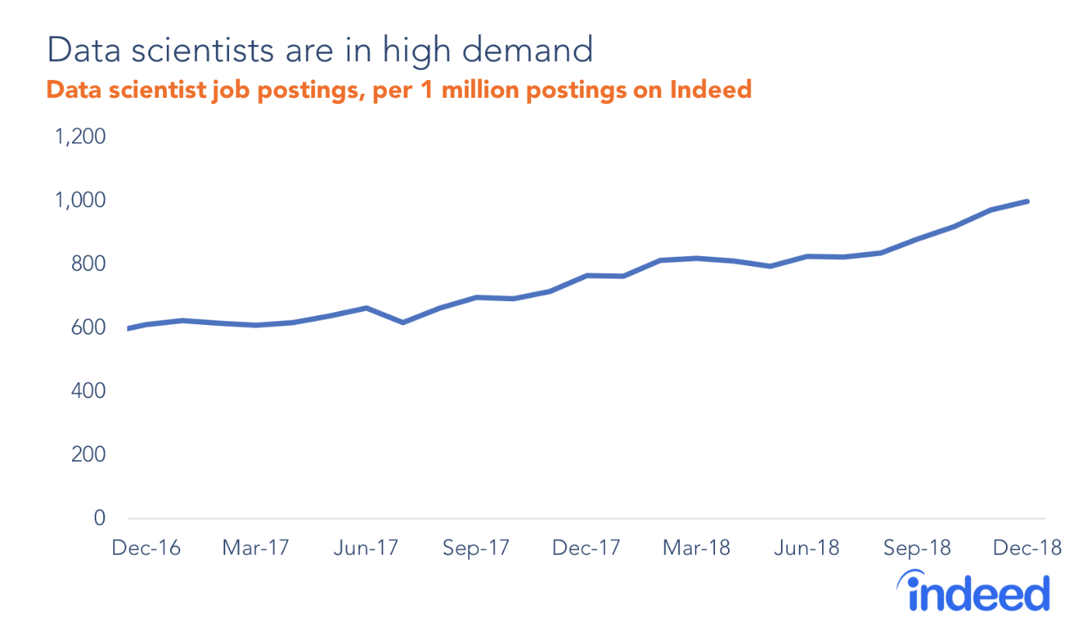
Employer Demand for Data Scientists
The number of data scientist job openings continues to rise
Since 2013, DS job postings have increased by 256%
In 2018, we saw a 31% increase in DS job postings YoY

Slide 6
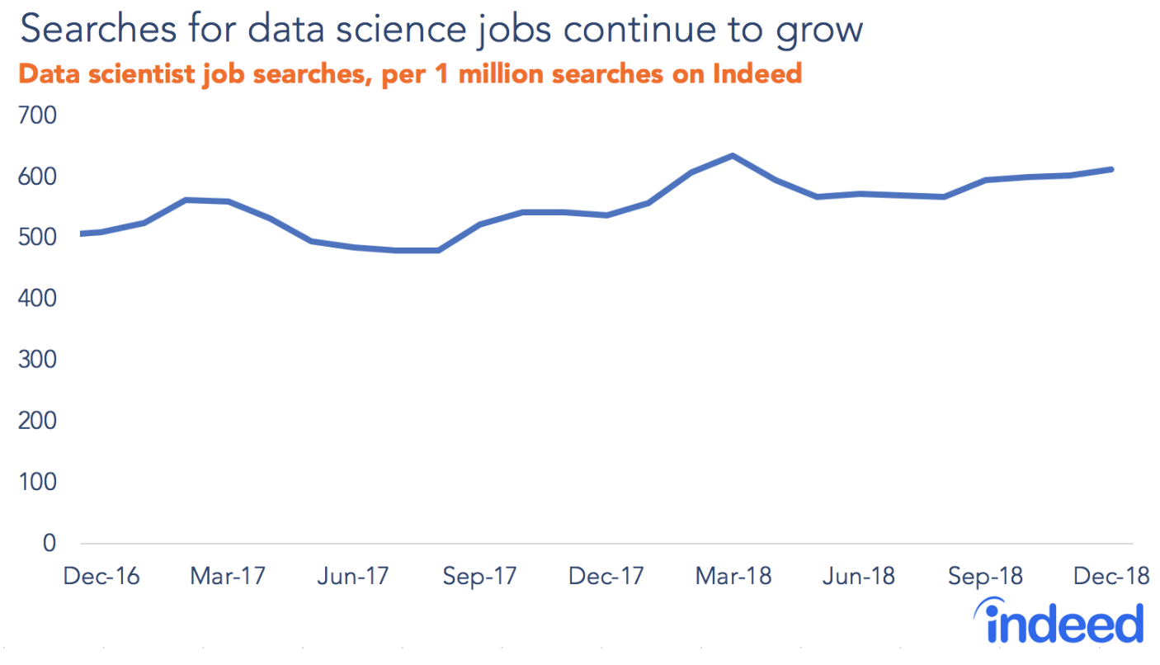
Jobseeker Supply of Data Scientists
More jobseekers are looking for DS jobs every year
In 2018, we saw a 14% increase in DS job searches YoY
While increase in the supply of DS candidates is substantial, the growth of supply is being outpaced by the growth in jobs

Slide 7
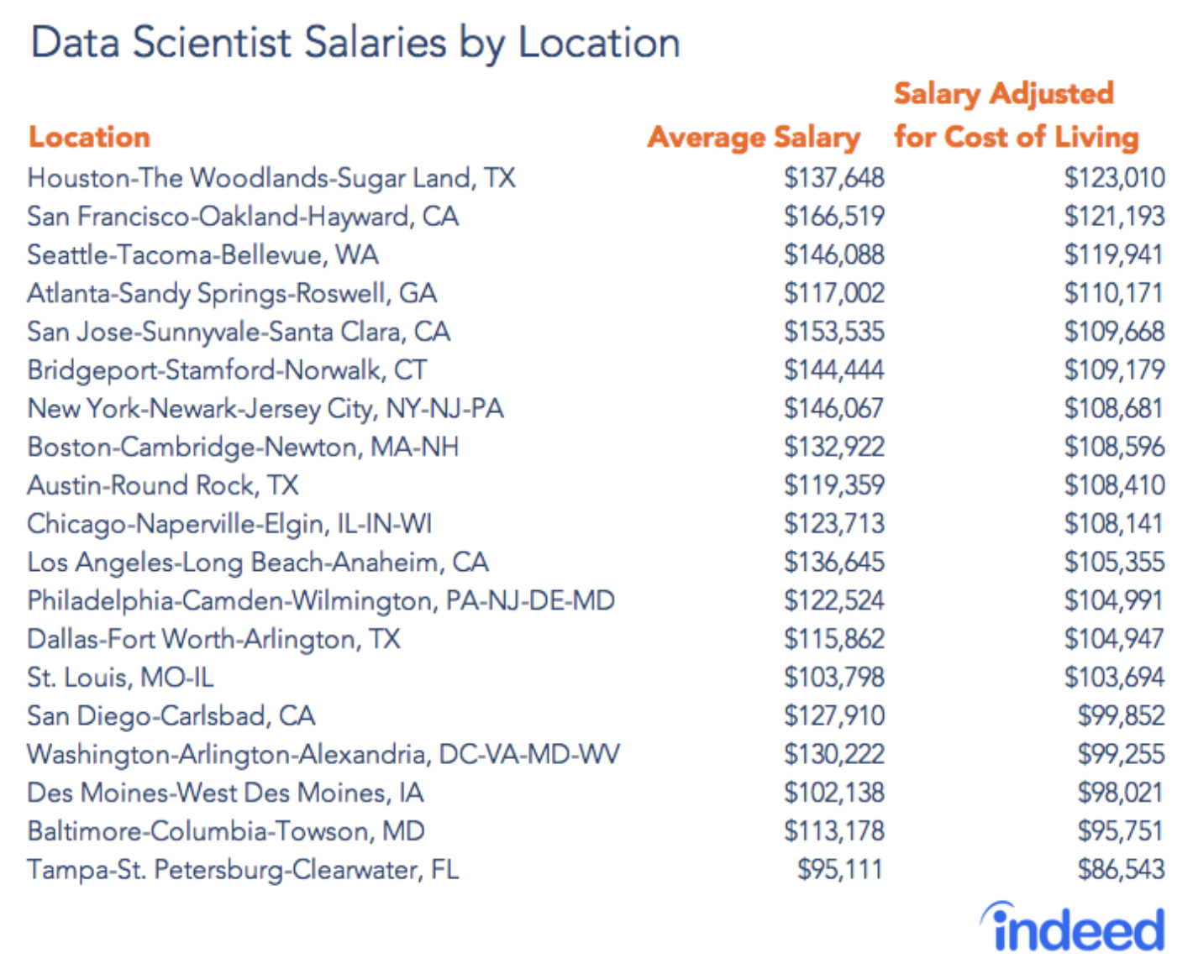
Where is the best pay?

Slide 8
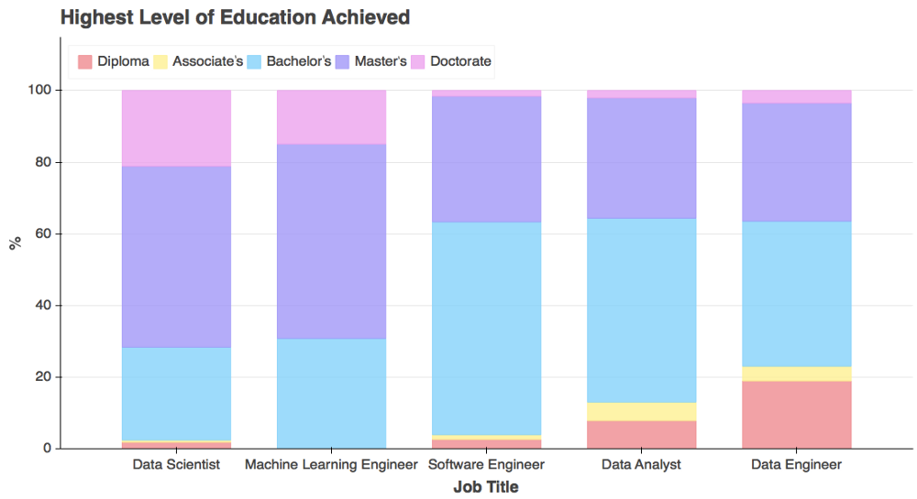
Education - Who are these “data scientists?”
Data Scientists have the most PhDs and the most graduate degrees (20% PhD, 55% Masters)
ML Engineers are similar to DS in degree level
Software Engineers, Data Analysts, and Data Engineers primarily have Bachelor’s degrees
Where Do Data Scientists Come From?
(2011-2018 data)

Slide 9
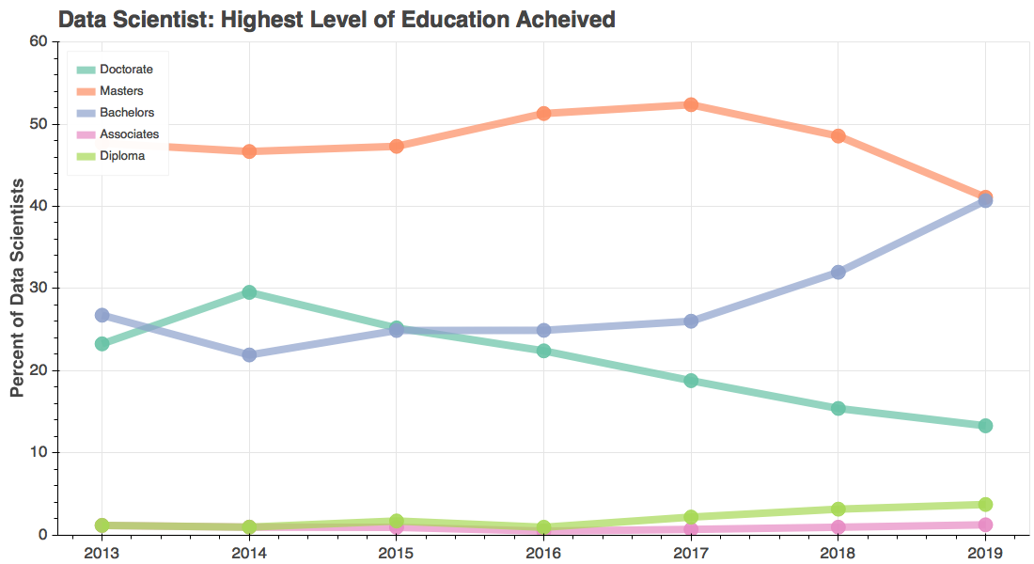
Trends in Data Science Education: The rise of the Bachelors Data Scientist
Since 2013, we’ve seen an over 52% increase in DS in the share of data scientists with Bachelor’s degrees

Slide 10
Is the rise in bachelors a result of job title dilution?
We conducted qualitative interviews with Data Science employers working with Indeed
We found many employers have simply renamed what used to be called a Data Analyst, Business Analyst, or a Business Intelligence Analyst to “Data Scientist”
In other cases, “Data Scientist” indicates a need for more advanced skills, including predictive analytics, data modeling, natural language processing, and data visualization.
“Sometimes I think [hiring managers] are just throwing that title [data scientist] out to make it a sexy title so people will apply to it. What they really need is a business intelligence type of role.”
Michelle Peterson - Hiring Data Scientists

Slide 11
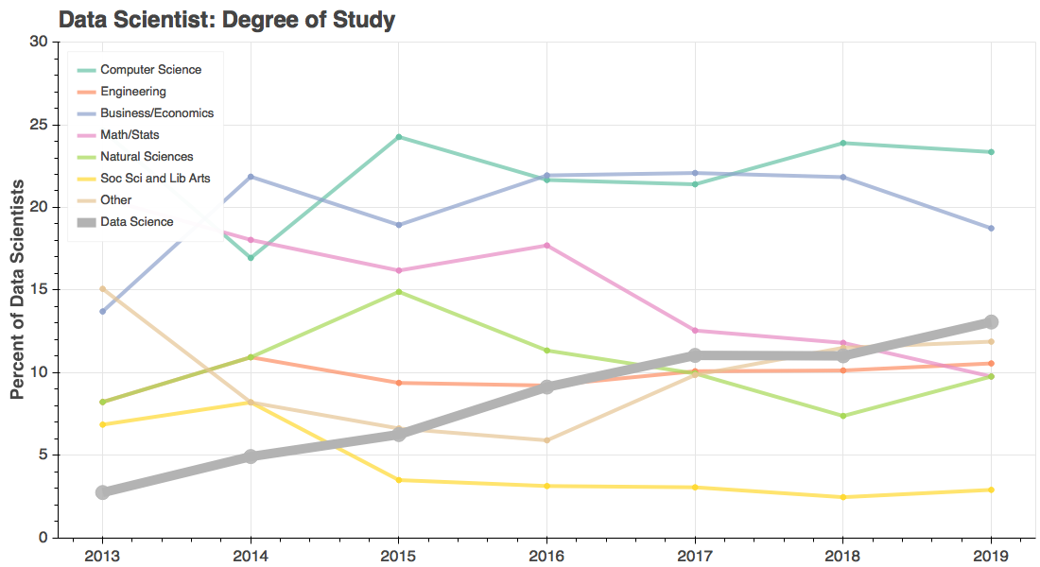
Trends in Data Science Education: The rise of the Data Science Degree
Since 2013, we’ve seen an over 5x increase in the number of data science degree holders getting DS jobs

Slide 12
Conclusions
Demand for data scientists is growing at a faster rate than DS jobseekers
DS pay is good basically everywhere, but less conventional markets like Houston might provide a better cost of living
The majority of data scientists hold graduate degrees, but bachelors are quickly on the rise
There has been rapid growth in DS degrees over the past 7 years

Slide 13
Indeed is hiring!
clindner@indeed.com
Indeed is hiring data scientists, product scientists, software engineers, and pretty much everything else
Offices in Austin, Seattle, San Francisco, Tokyo, and Hyderabad
I have experience interviewing over 200 candidates for DS roles - come talk to me!

