Slide 1
Automating your machine learning pipelines: what could possibly go wrong?
Kevin Moore
Lead Data Scientist, Salesforce

Slide 2
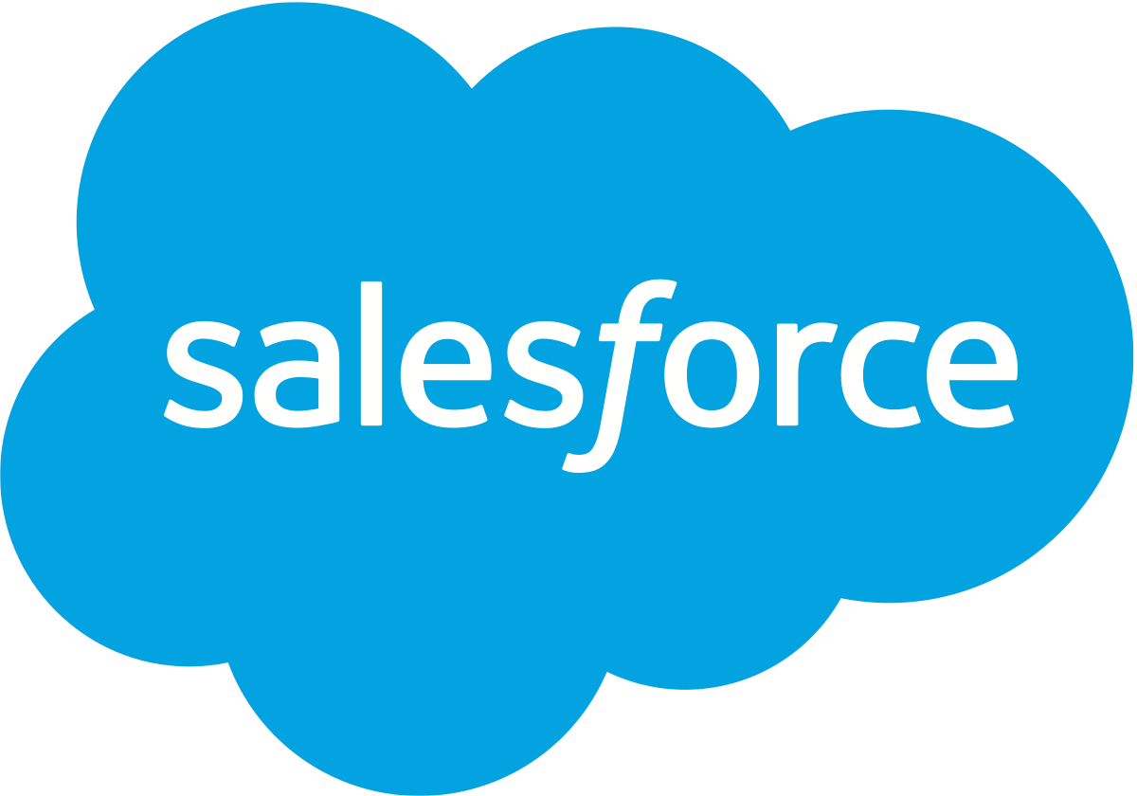
My background
Research Area: Modeling how stars evolve and explode in various ways
Lots of math and programming, very little “software engineering”
PhD, UCSB -> Postdoc, UCSC -> Professor, Claremont Colleges
Insight Data Science Fellowship (Summer 2016)
Data Scientist @ Salesforce (Fall 2016 - ) Closer to a “machine learning engineer” - building our AutoML platform

Slide 3
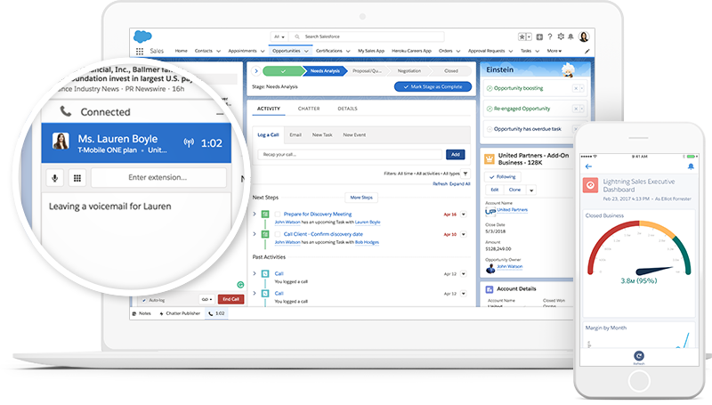
What does Salesforce do?
Notes:
I didn’t really know what Salesforce did before I demoed there
It is a cloud supported software suite for running any part of your business.
Data isn’t limited to one type of business - non profits, foundations, for profits, small businesses and they store all sorts of data

Slide 4
24 Hours in the Life of Salesforce
Scale
B2C
B2B
Scale
888M commerce page views
44M reports and dashboards
3B Einstein predictions
41M case interactions
260M social posts
3M opportunities created
4M orders
2M leads created
1.5B emails sent
8M cases logged
Source: Salesforce March 2018.
Notes:
People want predicted intelligence imbedded in all of these things
Lots of repetition in designing machine learning models
Doing the same ETL processes, data has a fixed schema, this could all be done by hand “artistinally” by a DS team.
Some of these are similar enough, all this repetition created a really interestig DS problem which was how can we build a platform to factor out the repeated stuff into best practice
THIS IS AUTOMATING ML PIPELINES

Slide 5
What does our team work on?
Building a platform to automate training, deploying, and serving custom ML models trained on customers’ own data (all structured, tabular data)
Several products already released on this platform
Marketing - predict who are good candidates to send product emails
Lead scoring - predict whether a lead is likely to convert (eg. buy something from you)
Case classification - suggest priority of a support ticket when it’s created
Prediction builder - predict a specific field from other fields in your object
Eg. likelihood to remain enrolled in college, churn prediction, lead scoring as special cases
Several more being built right now!
Notes:
Our team is working on the automl pipeline, I have worked on a lot of parts by now but mostly focus on

Slide 6
What goes into a machine learning platform?
https://developers.google.com/machine-learning/crash-course/production-ml-systems

Slide 7
What makes automation hard?
How can you tell if you’re doing a good job making models for a wide range of predictions?
Cold-start issues & when to switch over to a “warm” model?
How to communicate the output of machine learning model to non-experts?
(so many more, but I’ll just focus on these)

Slide 8
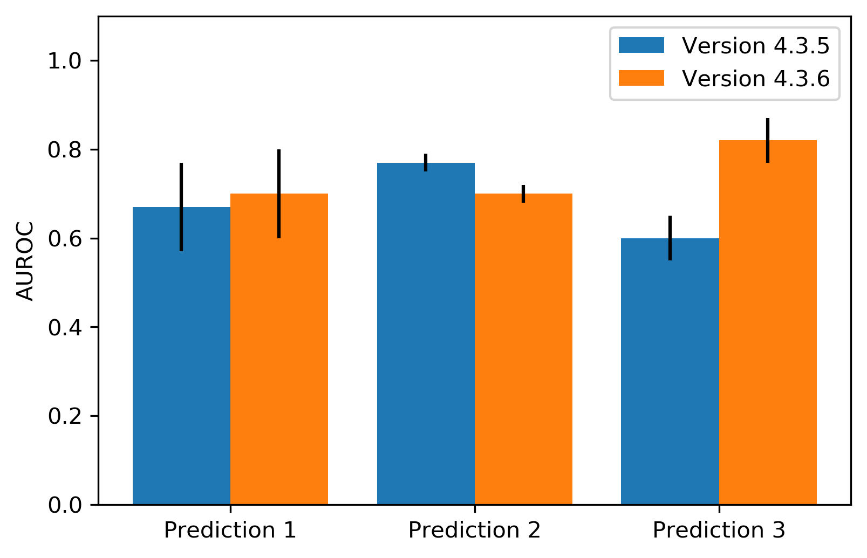
How to tell if you’re doing a good job
Use a test suite!
Many fixed datasets - variety of data types and problems
Make the tests part of your release process - compare new code to old
What if one prediction improves at the expense of others?
How to balance real vs. synthetic data?
Notes:
This is a pretty typical mixed result, quality increased on some datasets but decreased on others.
Most of the time, things look like the first case where the difference is in the noise. However, with enough comparisons, you’ll see

Slide 9
How to tell if you’re doing a good job
Customer data is essential, but synthetic data can often be better for testing
Can isolate a specific data issue (eg. dealing with signal in high-cardinality categorical variables) so it’s easier to detect improvements with isolated changes
Allows you to test feature importances as well since you know what features have real signal
We can keep synthetic data around as long as we want

Slide 10
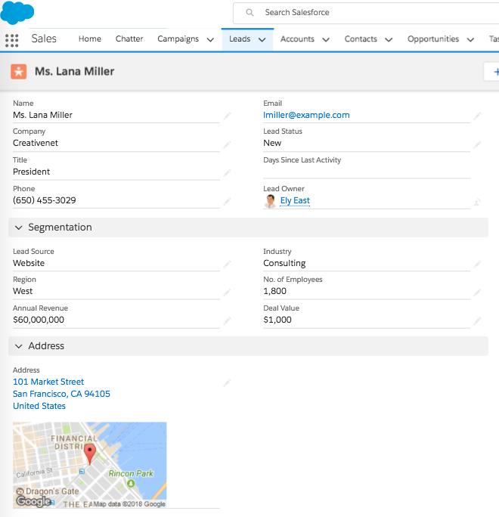
Cold start issues - label leakage
Lead Before Conversion
Lead After Conversion
Notes:
The first example is that of hindsight bias (aka label leakage or data leakage). Here is a snapshot of a lead before and at conversion. Each field in this lead is a feature fed to the machine learning algorithm as a part of the training data. The algorithm tries to find predictive signals in these fields which can help classify a lead as likely to convert. However, if you observe the two snapshots closely, you would see that there is one field/feature called deal value which is not filled up prior to conversion but gets filled up at conversion. Such features leaks information about the label into the training data causing the ml model to perform surprisingly well in research environments, but very poorly in production with real data.
This is a super trivial example just to illustrate the point. We see this in many degrees of severity, sometimes it causes the model to only learn the leakage signal (in the worst case), but most of the time is just makes the top features look untrustworthy.

Slide 11
Cold start issues - label leakage
ML algorithms will automatically pick up on leakers and use them to make models that look like they have very good performance metrics
We use a few strategies to remove leaky features
Look for “too strong” relationships between fields and the label
Correlations for numeric fields and null indicators, Cramer’s V for categorical fields
Compare feature distributions between training and scoring sets
How do fields differ between records that have the label filled out (training set), and those that don’t (scoring set)

Slide 12
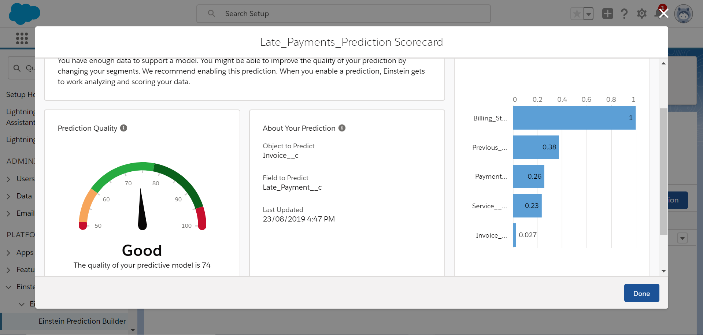
How to communicate models to non-experts?
Notes:
Model interpretability is a big concern for us.
Most of the consumers of our models are not machine learning experts, but will have some domain knowledge about their data.
Interpretable models are important for two reasons
They help data scientists on our team debug whether a model is actually doing what we want it to on known datasets
They help build confidence in the users of the model
Interpretability can be difficult for a few reasons
Hard to evaluate model interpretability during model selection (typically select on which model fits the data the best)
Hard to

Slide 13
How to communicate models to non-expert
Interpretable models are important for two reasons
They help data scientists on our team debug whether a model is actually learning what we want it to learn on known datasets
They help build confidence in the users that the model is useful
Many concerns
Should we only use certain types of models?
Should we only use certain types of feature encodings?
Eg. avoid embeddings, PCA, and other hard to interpret transformations?
Should we use free model-dependent feature importances or calculate more expensive model-independent feature importances?
Lots of research going on in this space!

Slide 14
Thank You!
The machine learning pipelines I’ve talked about are all built on top of SparkML using our open-source library, TransmogrifAI (https://github.com/salesforce/TransmogrifAI)
We’re hiring more data scientists & data engineers! Come talk to me or reach out at kevinmoore@salesforce.com

Slide 15
Bonus Slides!

Slide 16
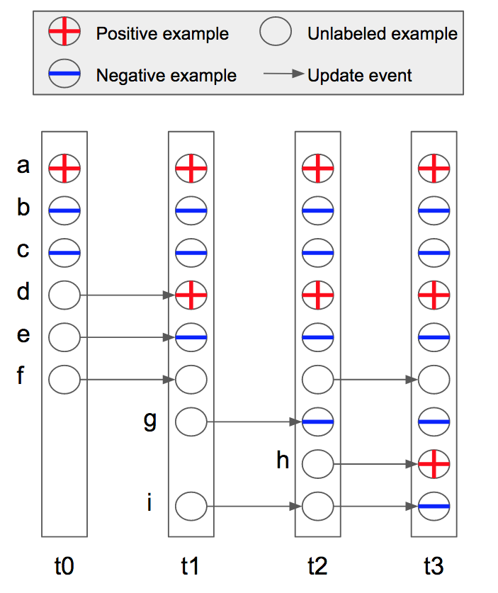
Cold start issues - label leakage
Once we start the modeling process for a specific customer’s prediction, we pull incremental changes to the records
Can eventually use this time-separated data for model training
We also use it for model evaluation and in our synthetic test data generation

Slide 17
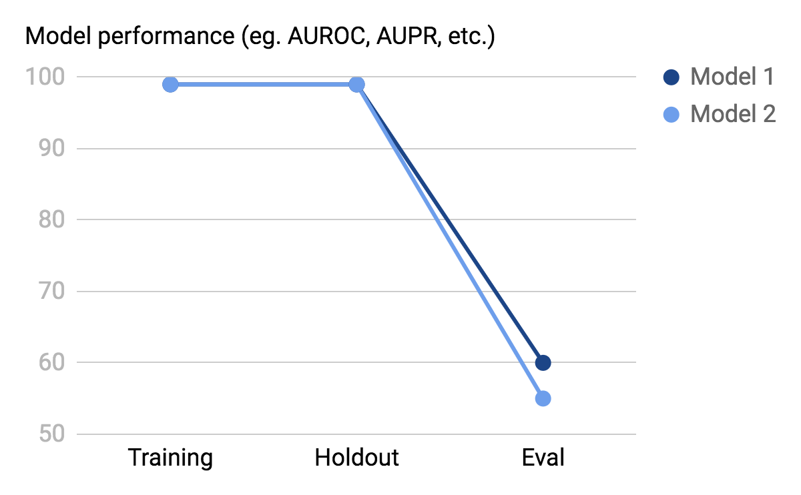
Cold start issues - label leakage

Slide 18
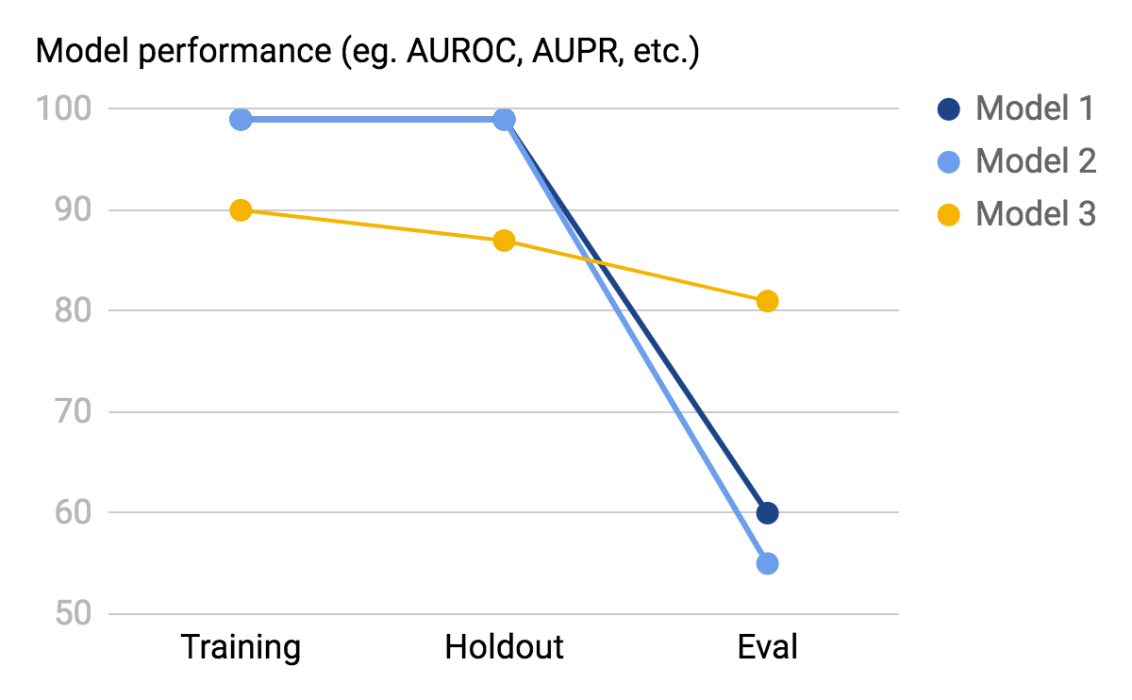
Cold start issues - label leakage

