Slide 1
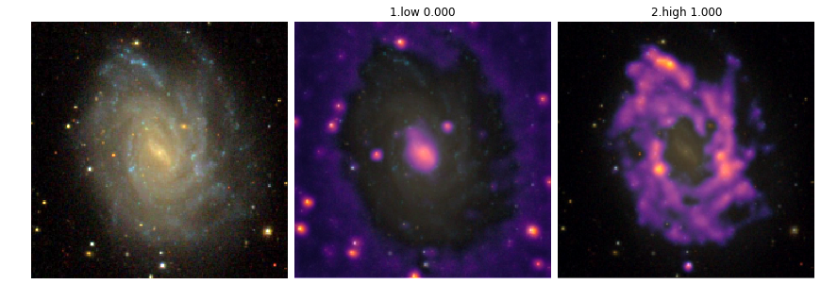
Insights on galaxy evolution
from computer vision
John F. Wu
January 5, 2020 ATDS@AAS235

Slide 2
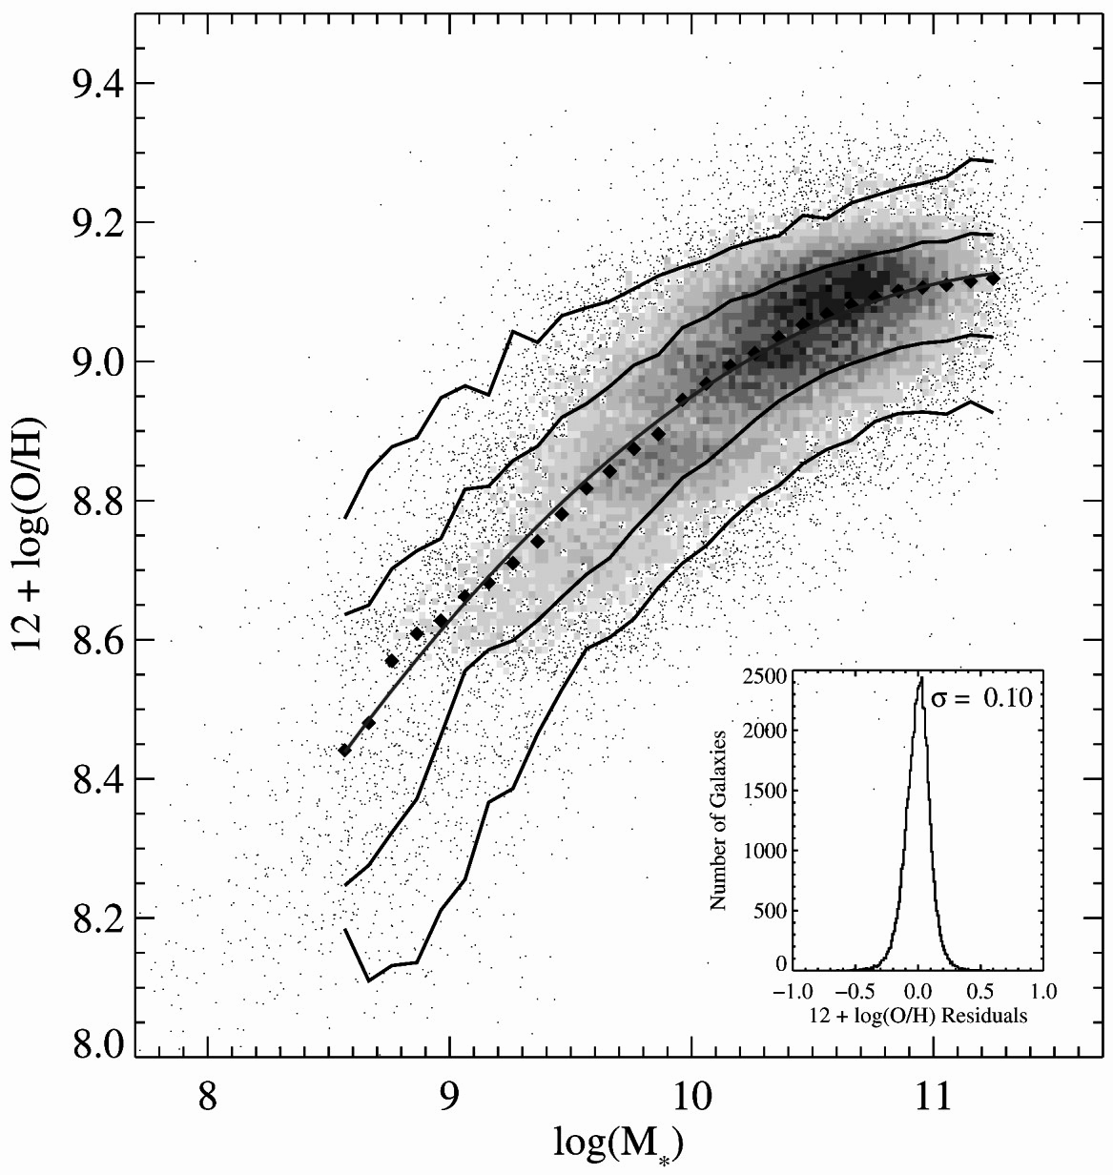
Galaxy evolution: the mass-metallicity relation (MZR)
Stellar mass, M★
Metallicity, Z = 12+ log(O/H)
MZR ~ 0.1 dex scatter
Metallicity
Stellar mass
Tremonti et al. 2004

Slide 3
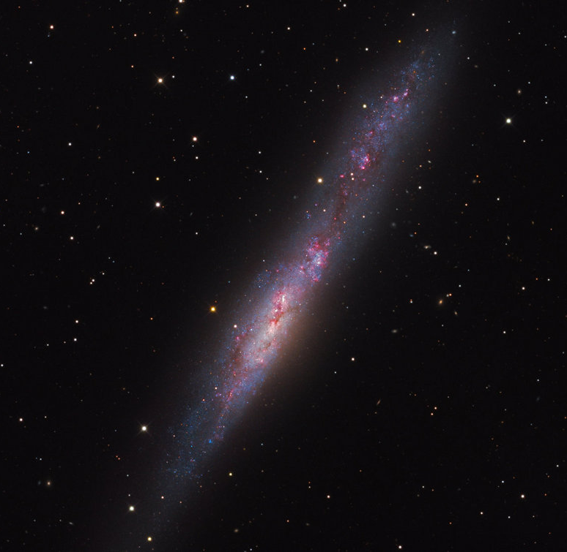
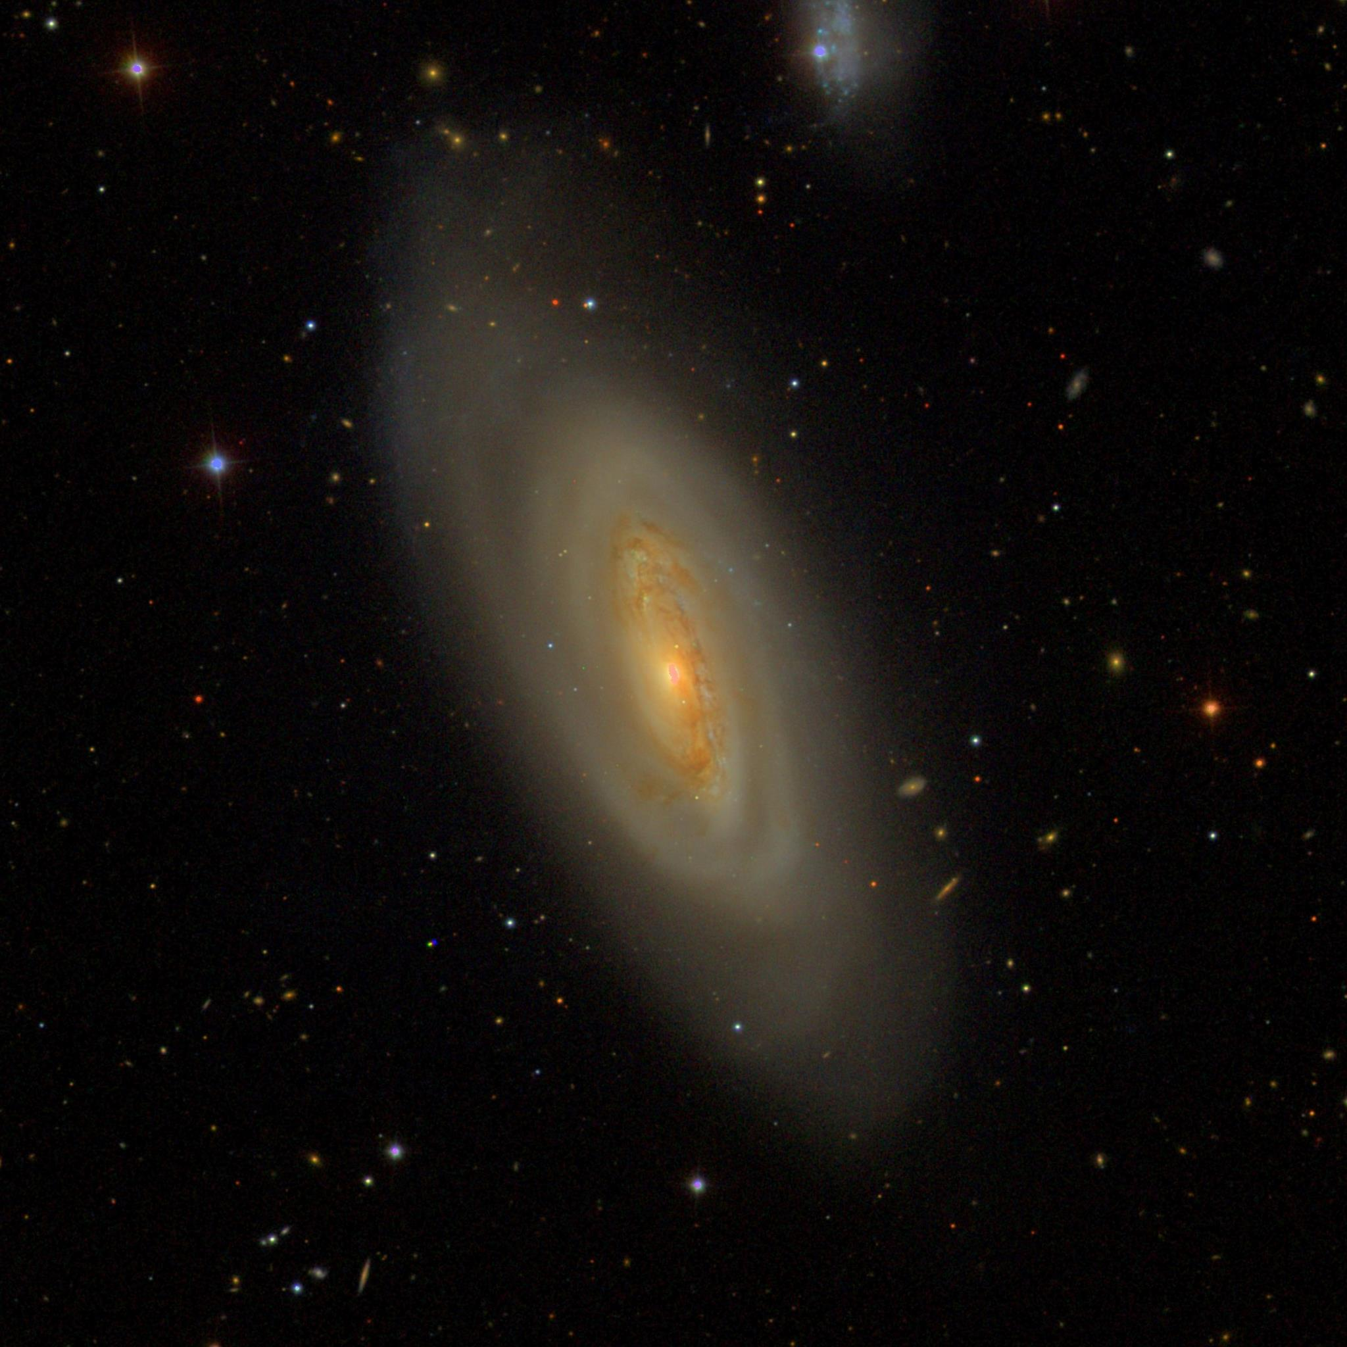
NGC 55 (Martin Pugh)
NGC 4569 (SDSS DR14)
2 kpc
10 kpc
Can we learn a galaxy’s metallicity from its optical imaging?
Galametz+11
Hunt+19
Lee+ 06
M★ = 3 x 10⁸ M_{sun}
Z = 8.05
M★ = 2 x 10¹⁰ M_{sun}
Z = 9.3

Slide 4
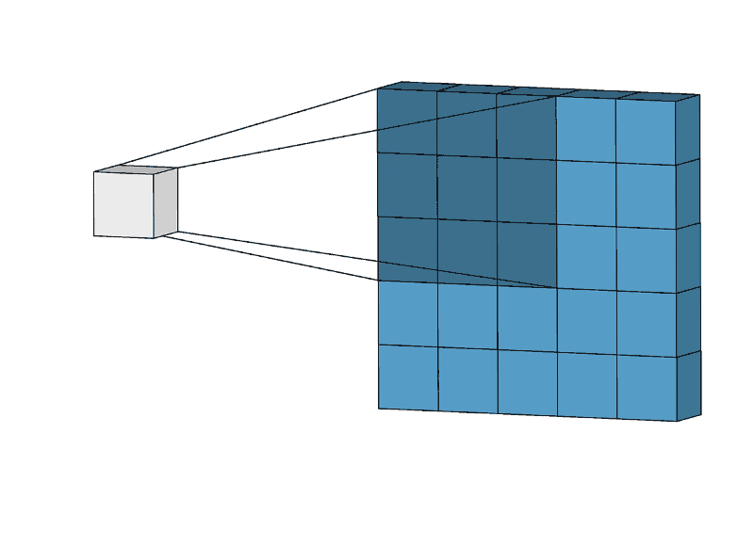
Convolutional neural networks (CNNs) can encode multi-channel image features via convolutional layers.
C - convolutional layer
D - dense layer
A convolutional filter
Dumoulin & Visin 2016

Slide 5
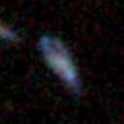
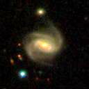
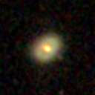
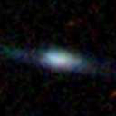
Training: minimize difference between Z_{pred} and Z_{true}
Z_{true} = SDSS gas-phase metallicity
error = RMSE
Z_{pred}
Update the CNN (resnet-34) weights:
w ← w + (step size) · ∇ (contributed error)

Slide 6
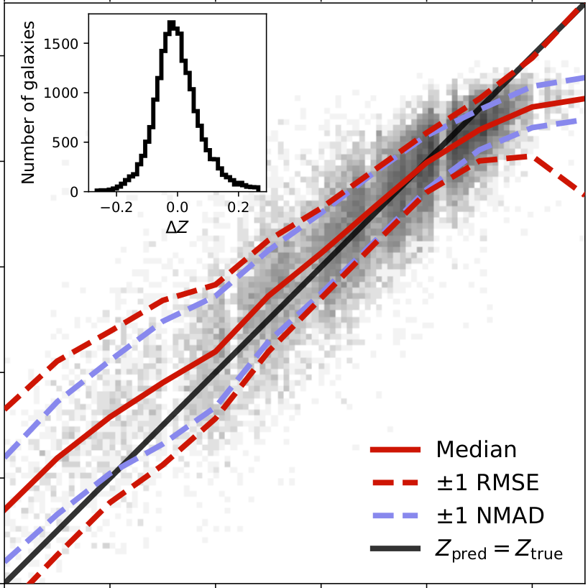
Results
We find that the deep CNN can recover the gas metallicity to
RMSE = 0.085 dex
ΔZ
Z_{pred}
Z_{true}

Slide 7
Results
github.com/jwuphysics/galaxy-cnns

Slide 8
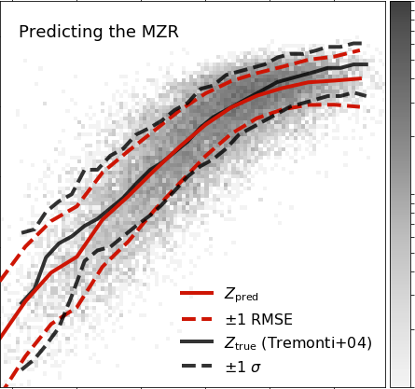
100
Mass-metallicity relation
(MZR)
Metallicity estimated using only…
SDSS spectroscopy
(Tremonti et al. 2004)
machine learning + SDSS gri images
(Wu & Boada 2019)
Metallicity
10
Number of objects
CNN
spectroscopy
1
Stellar mass
arXiv: 1810.12913

Slide 9
Mass-metallicity relation
(MZR)
CNN-reconstructed MZR has even lower scatter than observed MZR for well-represented objects
Metallicity
CNN
spectroscopy
Stellar mass
Stellar mass
Wu & Boada 2019
arXiv: 1810.12913

Slide 10
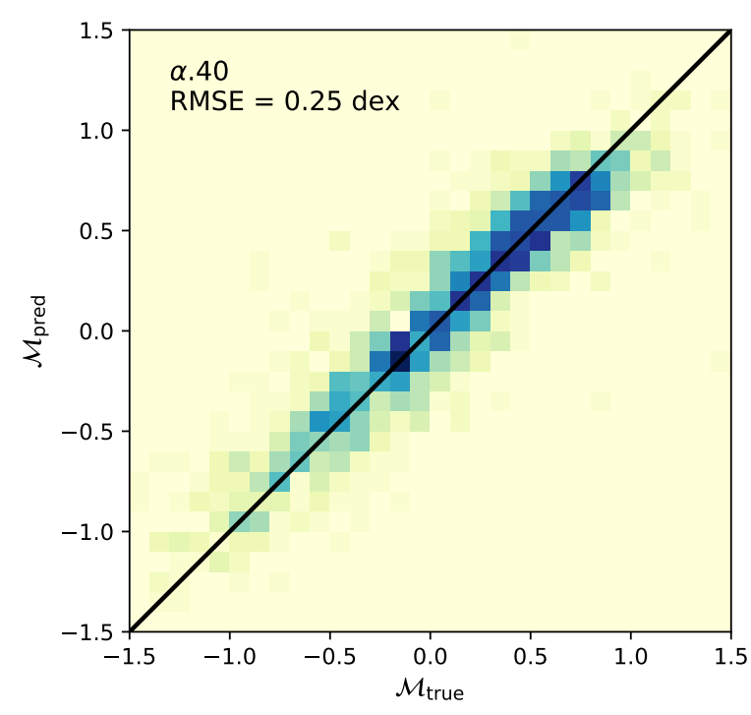
Predicting neutral atomic hydrogen (HI) mass fraction
Predicted
M_{HI} / M🟊
HI mass fraction
Measured
Wu 2020
arXiv: 2001.00018
github.com/jwuphysics/HI-convnets

Slide 11
We can accurately predict galaxy properties from optical imaging by using deep CNNs!
What does a CNN see in order to make predictions?
Cosmological redshift
(Pasquet et al. 2019)
Gas metallicity
(Wu & Boada 2019)
Neutral hydrogen content
(Wu 2020)
SDSS g r i bands
from photometry (cheap!)
Measured via spectroscopy (expensive!)

Slide 12
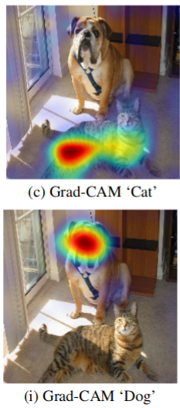
Visual interpretations
Pose question as a classification problem (gas-rich vs. gas-poor).
Can achieve up to ~99% accuracy even with a relatively simple CNN!
Use a “Class Activation Map” (Grad-CAM) on the trained CNN in order to highlight image features associated with high and low HI mass fraction.
Grad-CAM: “Cat”
CAM (Zhou et al. 2015)
Grad-CAM (Selvaraju et al. 2016)
Grad-CAM: “Dog”

Slide 13
AGC 4540
gas-rich
p = 0.817
gas-poor features
gas-rich features
AGC 6960
gas-poor
p = 0.992
gas-poor features
gas-rich features

Slide 14
xGASS 15570
gas-rich
p = 0.845
gas-poor features
gas-rich features
xGASS 26151
gas-rich
p = 0.827
gas-poor features
gas-rich features

Slide 15
xGASS 23761
gas-poor
p = 0.999
gas-poor features
gas-rich features
xGASS 4030
gas-poor
p = 0.979
gas-poor features
gas-rich features

Slide 16
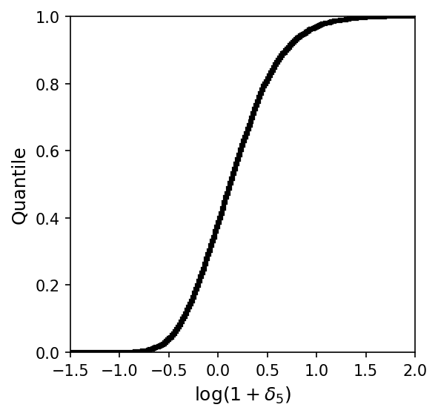
Using deep learning to probe latent variables
Instead of splitting our training and validation subsamples randomly…
Let’s split them by environmental parameter, δ₅, the normalized projected galaxy density.
Voids 🠄 🠆 Clusters
Environment of HI sources
(cumulative distribution)

Slide 17
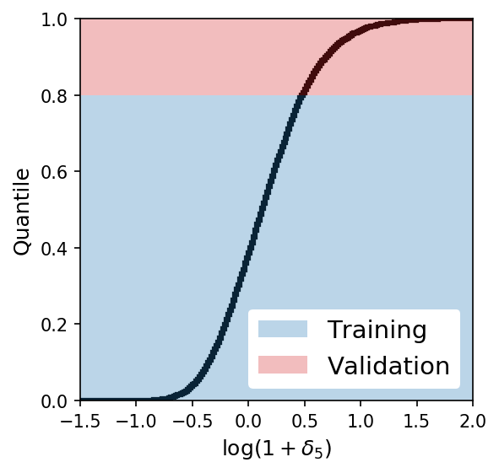
Using deep learning to probe latent variables
Instead of splitting our training and validation subsamples randomly…
Let’s split them by environmental parameter, δ₅, the normalized projected galaxy density.
For example, only train on galaxies in low- to medium-density environments, and then validate on the highly overdense environments.
Voids 🠄 🠆 Clusters
Environment of HI sources
(cumulative distribution)

Slide 18
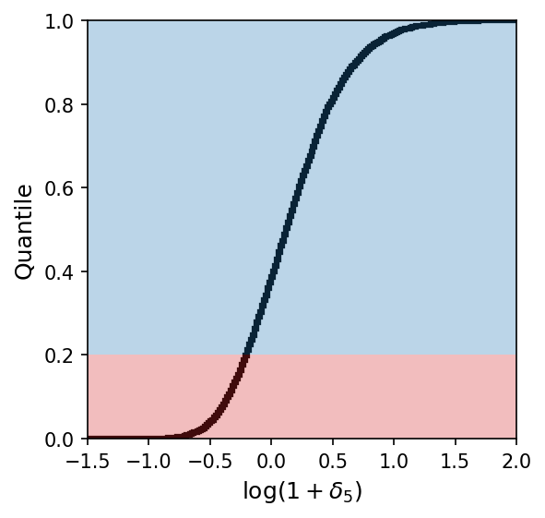
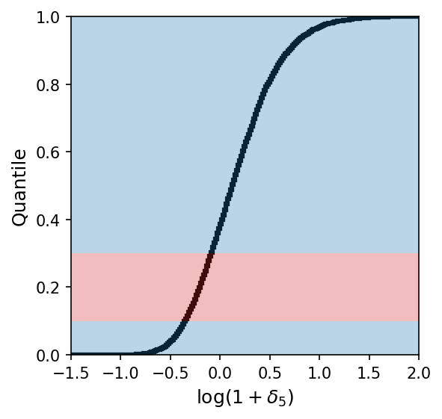
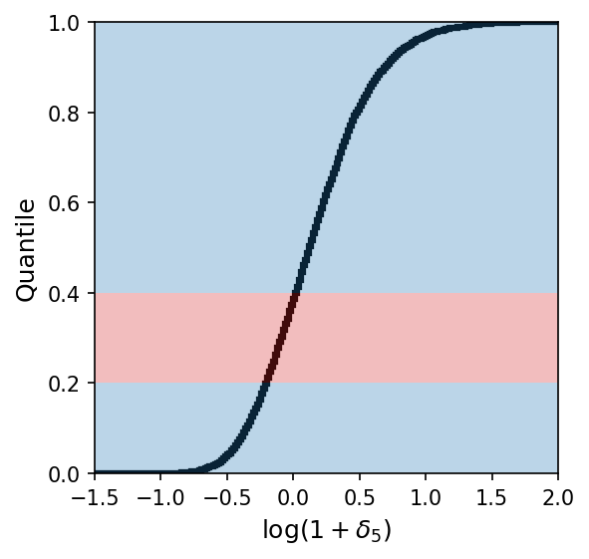
Repeat tests, stratifying HI sample by environment using training/validation split:
Training
Validation

Slide 19
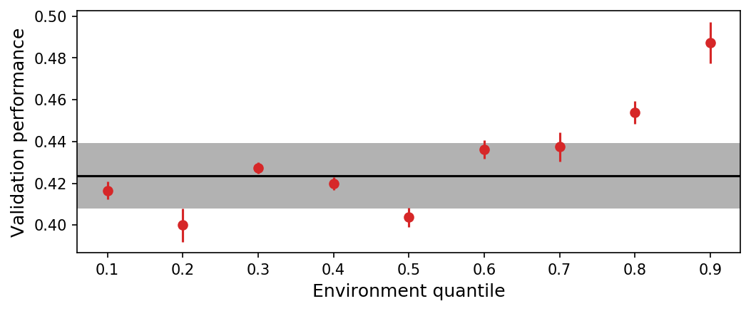
...
Random baseline

Slide 20
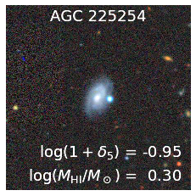
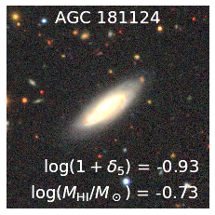
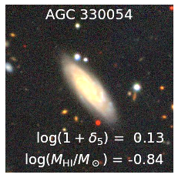
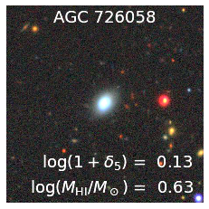
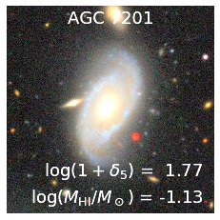
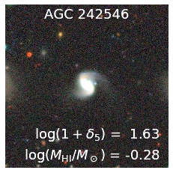
🠄 Voids Field Groups 🠆
Random baseline

Slide 21
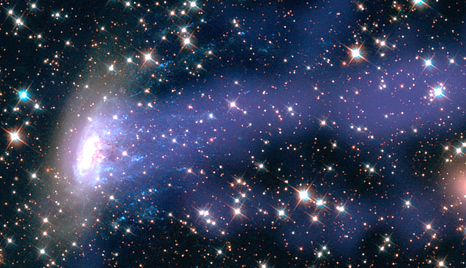
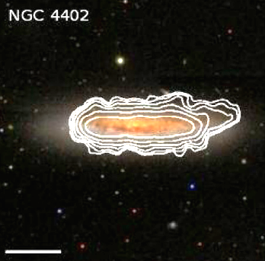
The physics that govern the HI-morphology relationship are different in overdense environments: ram pressure, tidal effects, and other gas depletion processes
Sun et al. 2006
Chung et al. 2009

Slide 22
Using computer vision, we can:
Predict galaxy properties from optical imaging directly
Mass-metallicity relation
(MZR)
Metallicity
Predicted
HI mass fraction
CNN
spectroscopy
Stellar mass
Measured

Slide 23
Using computer vision, we can:
Predict galaxy properties from optical imaging directly
Identify the morphological features that are most closely associated with gas-richness
AGC 4540
gas-rich
p = 0.817
gas-poor features
gas-rich features

Slide 24
Using computer vision, we can:
Predict galaxy properties from optical imaging directly
Identify the morphological features that are most closely associated with gas-richness
Probe the impacts of other variables such as environment

Slide 25
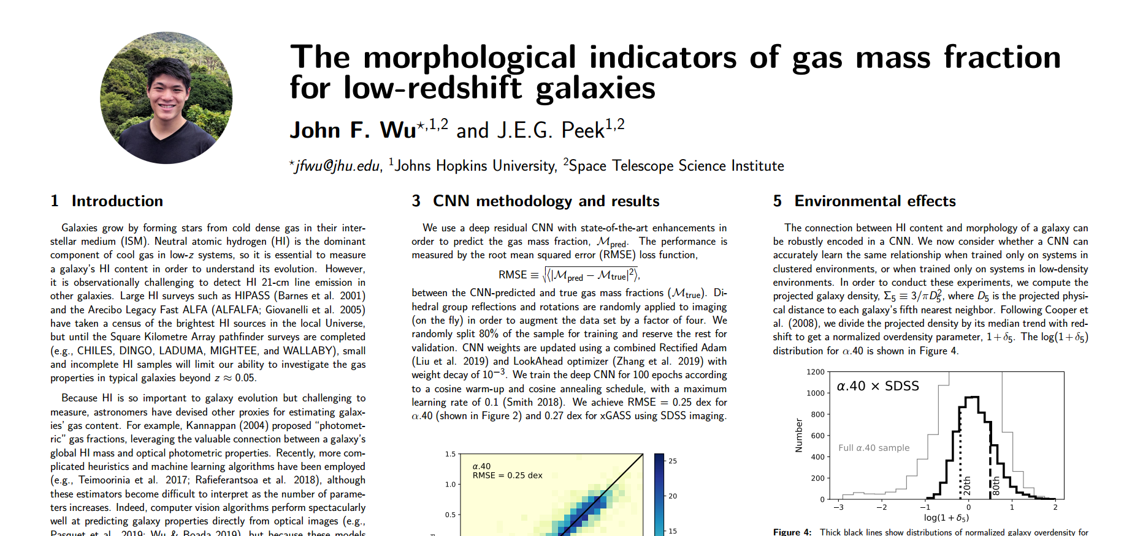
Using computer vision, we can study galaxy evolution.
Predict galaxy properties from optical imaging directly
Identify the morphological features that are most closely associated with gas-richness
Probe the impacts of other variables such as environment
github.com/jwuphysics
jfwu@jhu.edu
jwuphysics.github.io
Poster tomorrow!
208.14

Slide 27
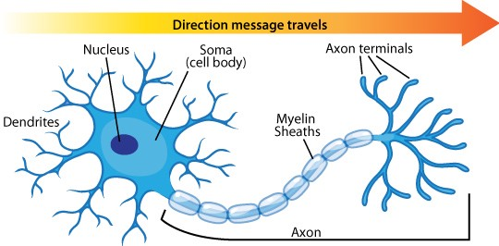
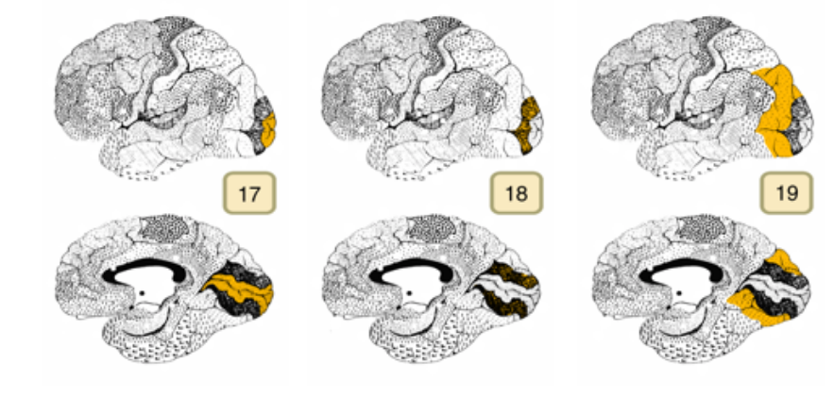
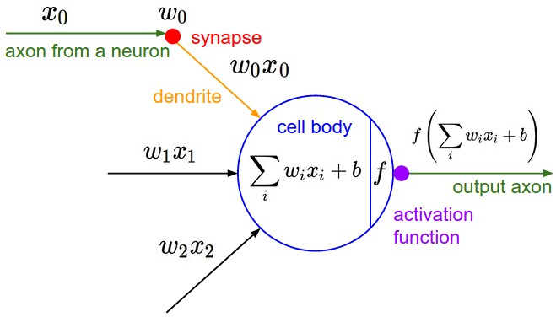
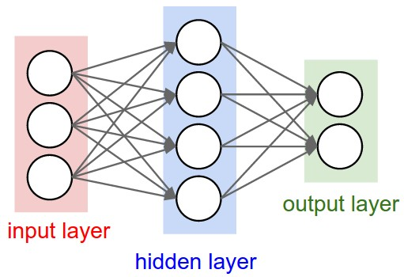
Kuzovkin et al. 2018; Oxford VGG; Stanford CS231

Slide 28
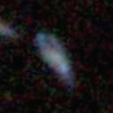
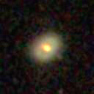
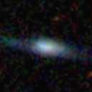
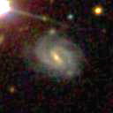
SDSS galaxy images
Use SDSS DR14 getjpeg command to obtain 130,000 gri images:
http://skyserver.sdss.org/dr14/SkyserverWS/ImgCutout/getjpeg?ra=114.829&dec=10.918&width=128&height=128
SDSS DR14 (York et al. 2000; Abolfathi et al. 2018)

Slide 29
SDSS galaxy images + JHU-MPA catalogs
Use SDSS DR14 getjpeg command to obtain 130,000 gri images:
and MPA-JHU DR7 catalog for Z = 12 + log(O/H), photometry, M★, SFR, redshifts, and other spectroscopic properties, with cuts (be wary of biases!):
z > 0.02 10 < ugriz < 25 reduced chi² < 2
Δz < 0.01 0 < u - r < 6
Brinchmann et al. 2004; Tremonti et al. 04

Slide 30
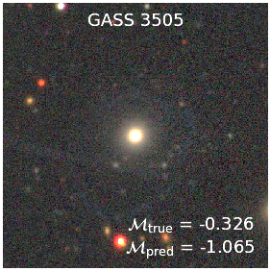
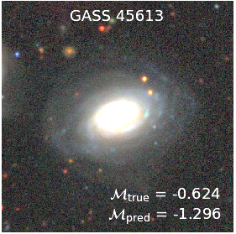
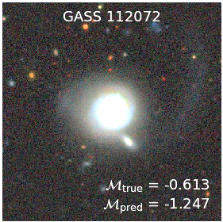
Galaxies with the most underpredicted HI masses
Predicted
M_{HI} / M🟊
HI mass fraction
Measured

Slide 31
Incorrect predictions: no trend with any other physical properties

Slide 32
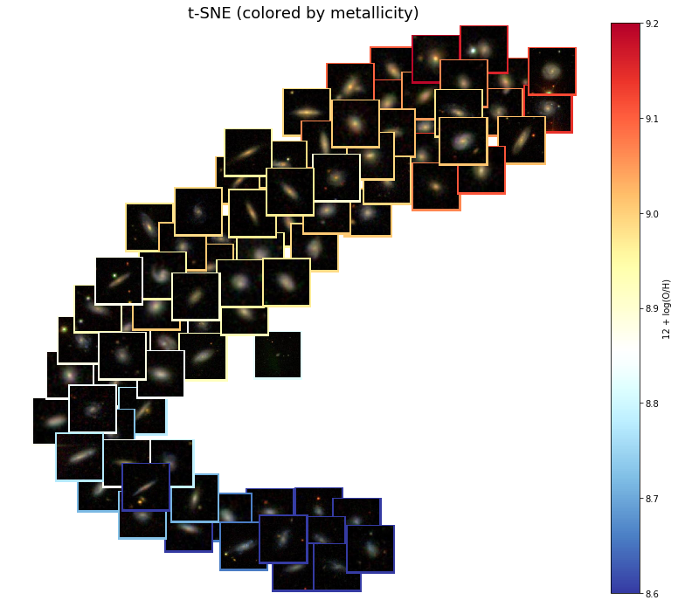
What does a CNN “see” in order to make predictions?
Distinguishing sub- and super- Alfvénic turbulence from simulations
Peek & Burkhart 2019
github.com/jwuphysics/galaxy-metallicity-convnet-visualization

Slide 33
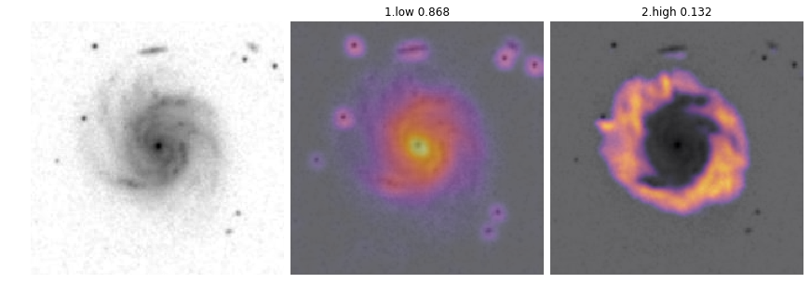
We can even use Grad-CAM for monochromatic images!
gas-poor features
gas-rich features
Combined g + r + i imaging

Slide 34
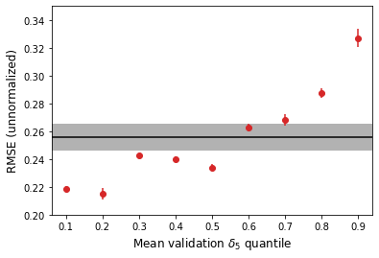
Validation RMSE
Validation RMSE normalized by σ of gas mass fraction

Slide 35
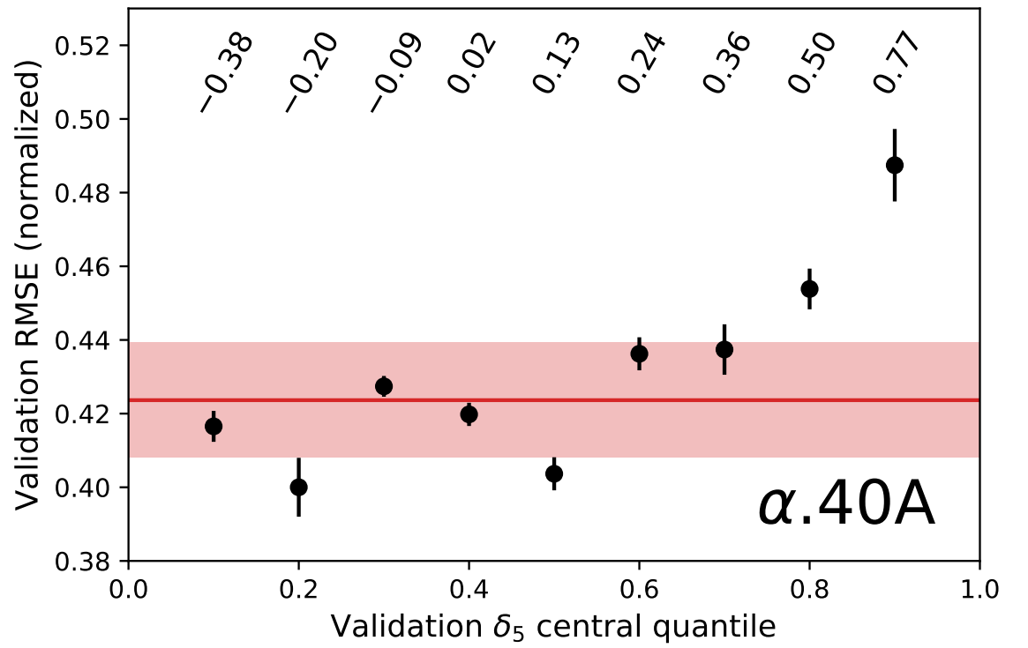
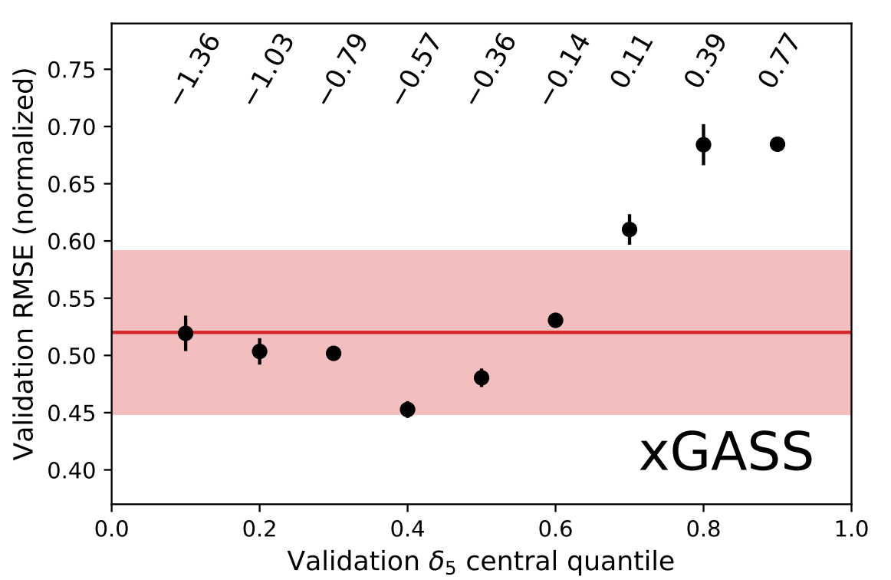
Environmental dependence for both HI data sets
log(1 + δ₅) values

Slide 36
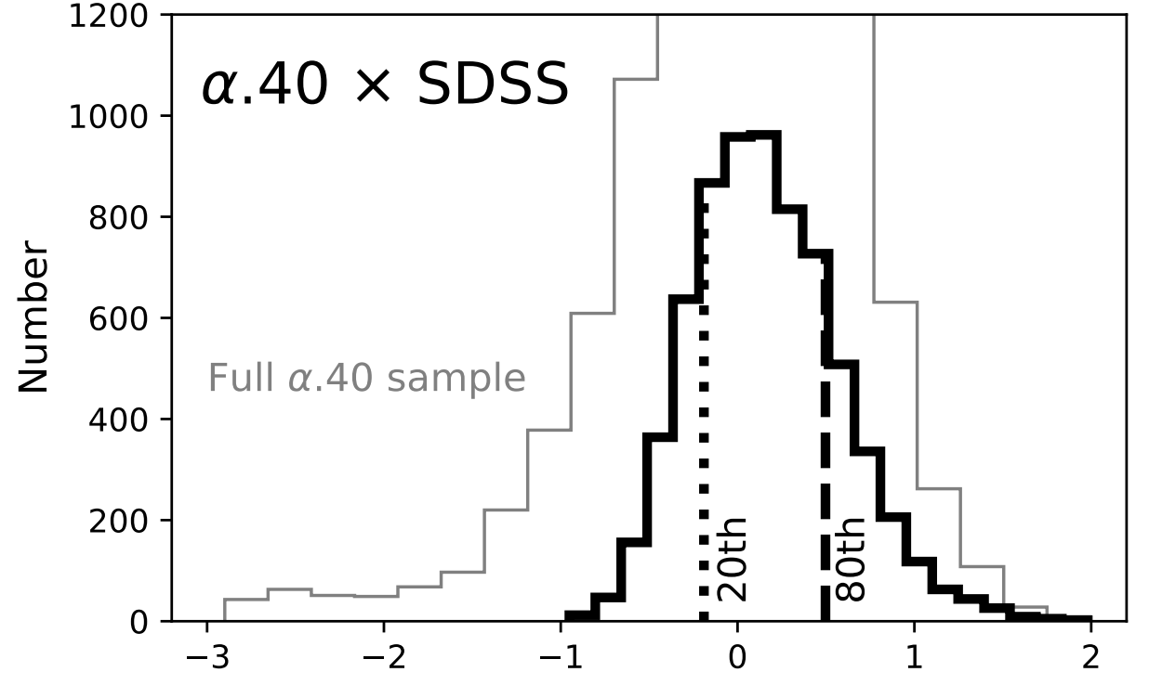
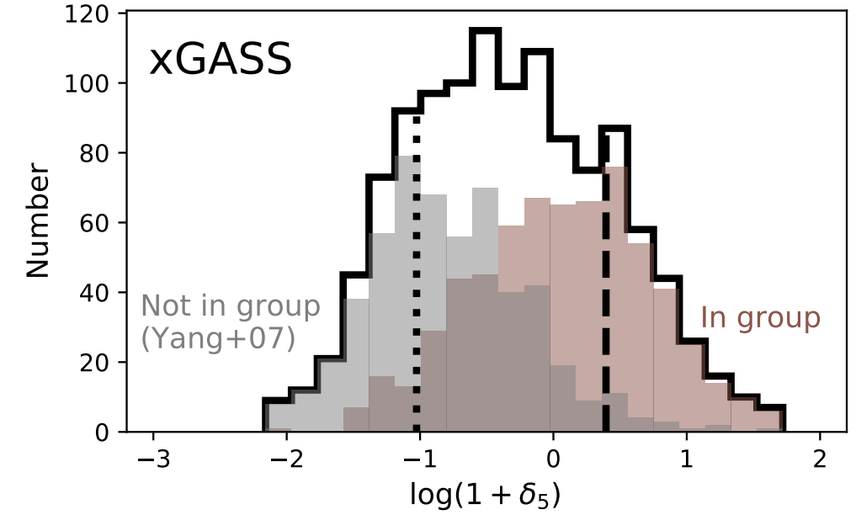
Environmental dependence
Cleaner signal with ALFALFA than with xGASS (because of larger sample and narrower δ₅ range)
xGASS extends to far lower projected galaxy density
Not much of a signal seen when dividing galaxies by group membership (xGASS)

