Slide 1
Data Science in Planetary Sciences
Padma A. Yanamandra-Fisher
Space Science Institute
padma@spacescience.org or
padmayf@gmail.com
Challenges for Planetary/Data Sciences
Potential Solutions
Science/Observations: gaps in knowledge (obs/data)
Consistent Observations, including legacy data (from various sources)
Common repository for data
Generate new data via Pro-Am collaborations; test models and new data (especially missions)
Integrate Data: legacy,; missions; lab measurements; models
“Borrow” from other fields: all fields of astronomy; statistics; large surveys; etc.
Propose Planetary Data Portal (PDP) for access to available data and associated toolkits (few exist).
Outreach: Meetings/conf; articles; internet radio; showcase collaborations; talks

Slide 2

What do you get when you mix independent communities?
Global Astronomical Event
(e.g. comets, eclipses,
volcanic eruptions, etc.)
=
Outreach
Curriculum
Citizen Science1
Data Scientist –connecting data trends & scientific research
New Knowledge
Next-level Pro-Am
Citizen Science2
Professional Community
Scientists
Missions
Ground-based Obs
Models
+
Non-Academic Public
Amateur Observers
Non-Scientific Community
Structured Audiences
Notes:
Good morning. I am going to talk about the new challenges facing scientific research when new dimensions are included vs. the standard accepted methods of acquiring
Data, model, minimize the residuals and repeat. Increasing collaborations with amateur astronomers; new methods and techniques to deal with the Big Data deluge,the boundaries between scientific research, outreach and data manipulation are becoming blurred, if not completely dissolved. I will focus my talk on the examples of pro-am
Collaborations over the past 5-6 years and are now almost the norm for new missions and continuity of observations when missions enc.

Slide 3
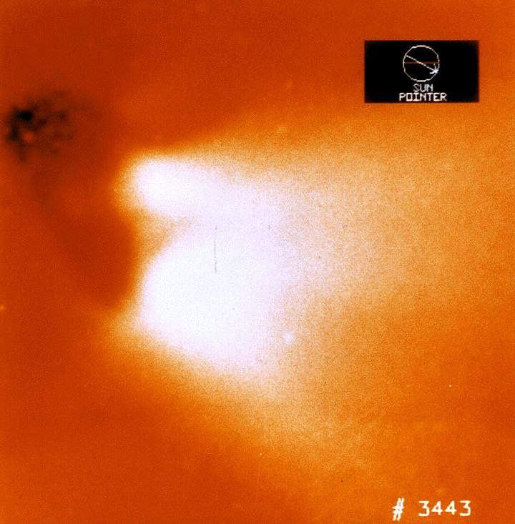
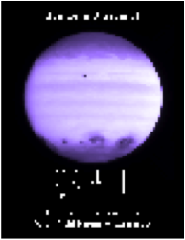
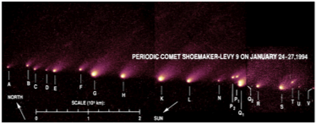
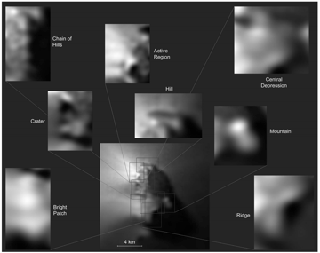
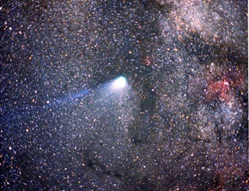
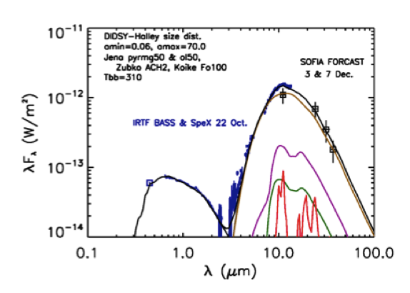
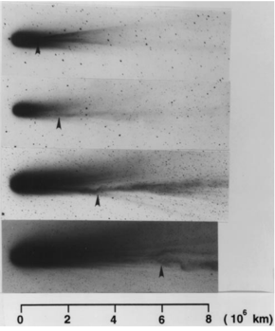
Pro-Am Synergy: Historical
The “First” Pro - Amateur Observer Campaign”
International Halley Watch (1985-86)
Planets
IHW: ”Halley” Armada (ESA/Giotto, JAXA/Suisei, Sukigawa; Russia’s Vega 1,2) + global ground-based pro-am observing
Observing modes: AstrometryPhotometry, polarimetry, Spectroscopy, Radio, Large scale phenomena, Infrared , meteors, and amateur observations (sketches, vis, CCD, spectra…)
Dedicated network: comet was located at southern latitudes
Other notables: 21P/Giaconi-Zinner; 26P/Grigg-Skjellerup; hibernation of s/c; discovery of heliocurrent sheath sector boundaries via disconnection events.
Disintegration of D/SL9; impact Jupiter
Monitoring of Jupiter; Saturn: record changes
Comets
The spectral energy distribution (SED): state of a comet

Slide 4
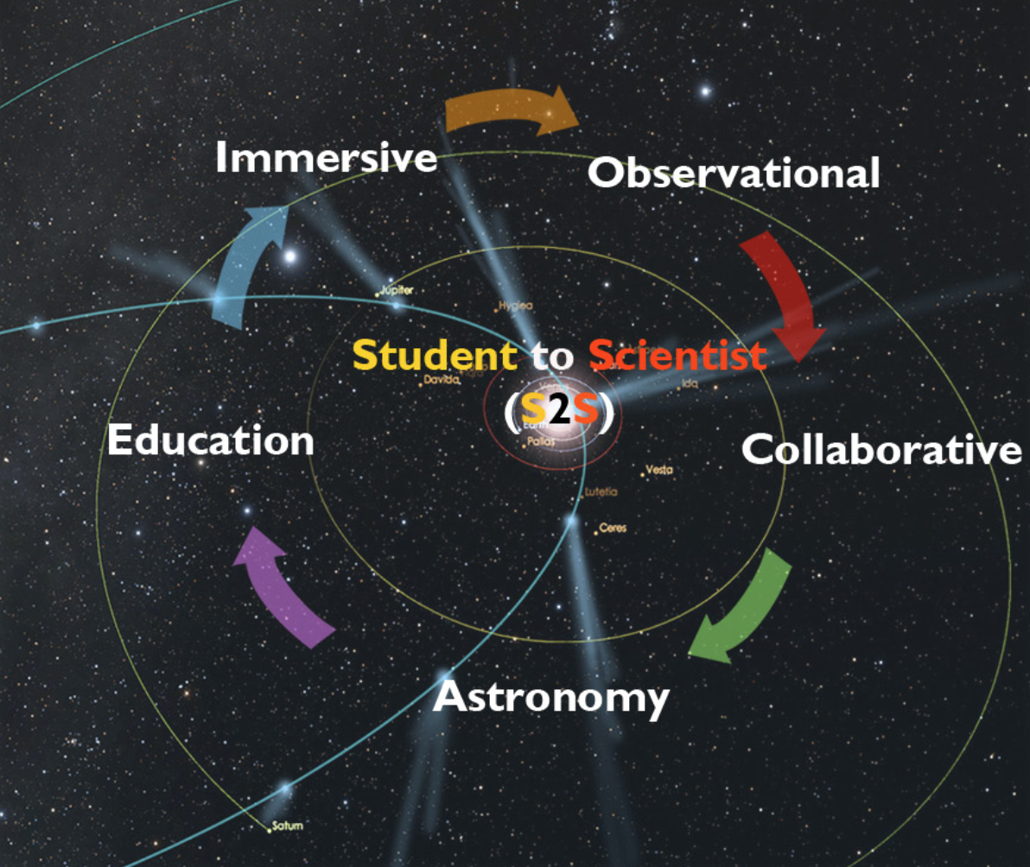
Cyclical Nature of PACA* Citizen Science:
Generation of Data
(PACA = Pro-Am Collaborative Astronomy)
Ongoing Campaigns:
Planets (JSUN);
Comets
Solar/Lunar Eclipses
Upcoming Campaigns:
Specific Comets (21P, etc.)
Polarization
Spectroscopy
Geo-mapping
“Large” data sets generated – how to explore?

Slide 5
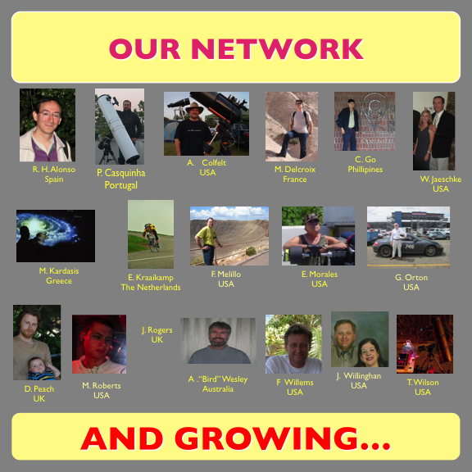
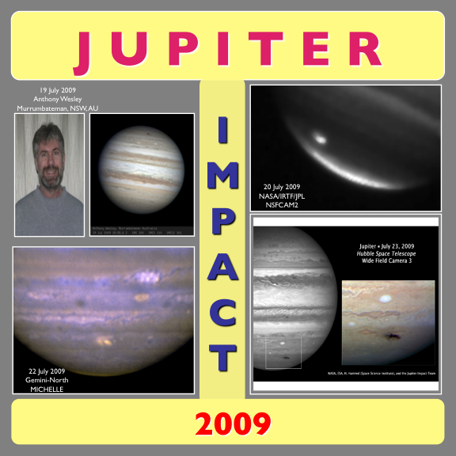
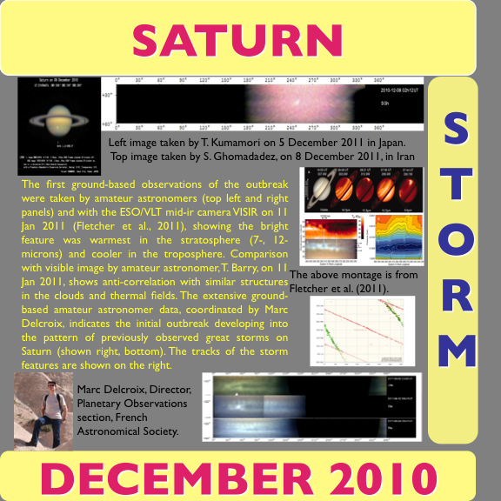
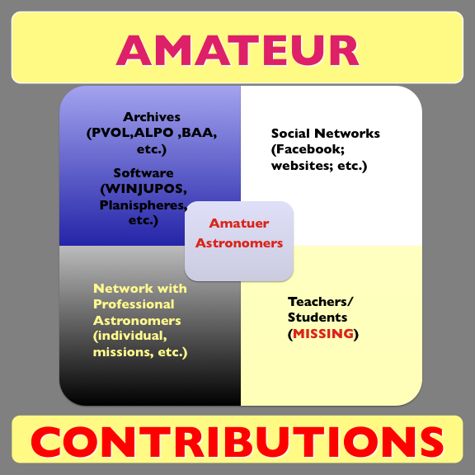
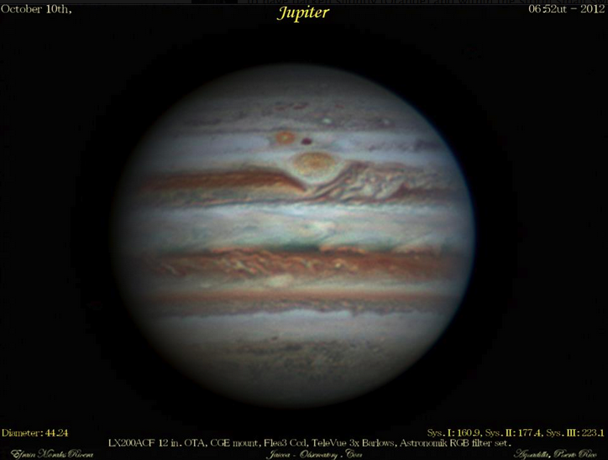
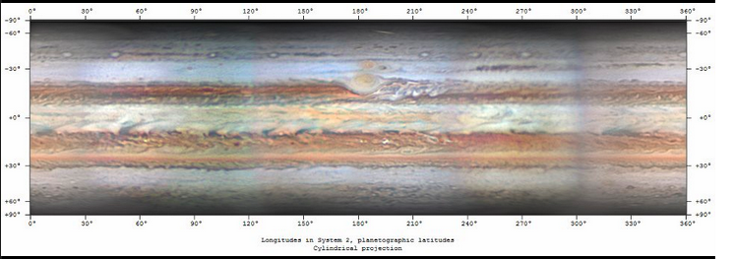
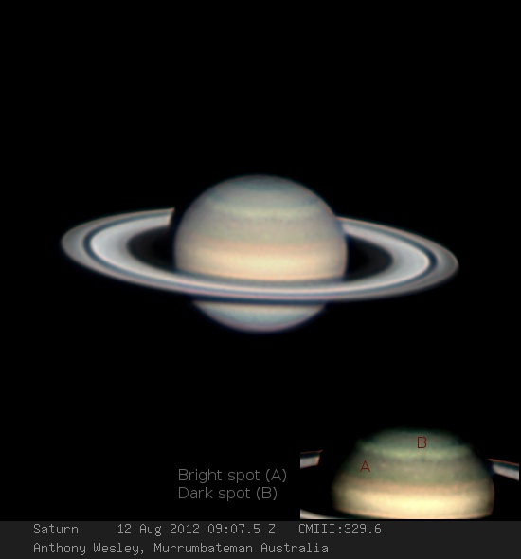
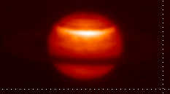
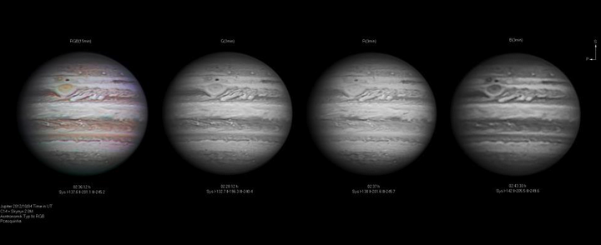
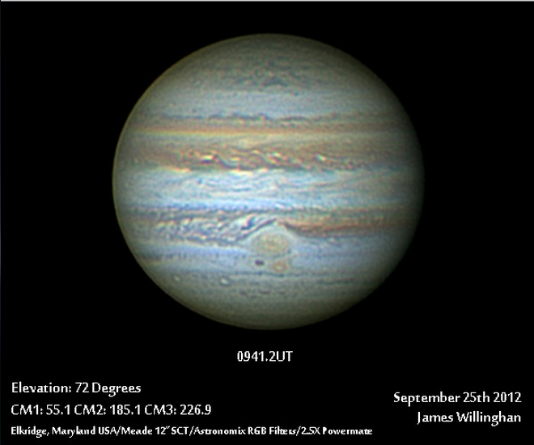
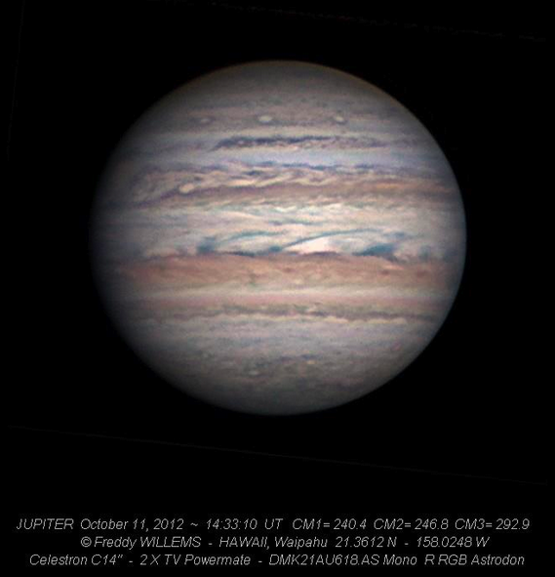
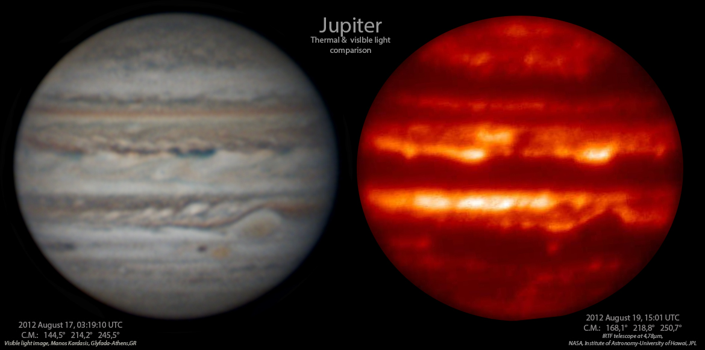
Partnerships between Professional and Amateur Astronomers: A Shift in Research Paradigm
Padma A. Yanamandra-Fisher¹,G. S. Orton², R. H. Alonso³, P. Casquinha⁴, A. Coffelt⁵, M. Delcroix⁶, C. Go⁷, W.
Jaeschke⁸, M. Kardasis⁹, E. Kraaikamp¹⁰, E. Morales¹¹, D. Peach¹², J. Rogers¹², A. Wesley¹³, F. Willems¹⁴, T. Wilson¹⁵
¹Space Science Institute, ²CIT/JPL, ³ESTI, Spain, ⁴APAA, Portugal, ⁵Atlanta Astronomy Club, ⁶French
Astronomical Society (SAF), France, ⁷University of San Carlos, Philippines, ⁸Johnson and Johnson, ⁹Hellenic
Amateur Astronomy Association, Greece, ¹⁰Workgroup Astrophotography, The Netherlands, ¹¹Sensormatic, ¹²BAA, United Kingdom, ¹³Canberra Astronomical Society, Australia, ¹⁴Hawaiian Astronomy Society, ¹⁵Boy Scouts of America.
When Amateur Astronomers Cross the Line:
Researchers or Teachers?
“Citizen Astronomy" can be thought of as the paradigm shift transforming the nature of observational astronomy. The emerging partnerships between professional and dedicated amateur astronomers rely on creating a niche for long timeline of multispectral remote sensing. The strong synergy between the two groups has produced scientific results, published in peer-reviewed journals. With the active inclusion and use of emerging social media (Facebook, Twitter, etc.), the near daily communication and updates, the partnerships between the two groups are becoming powerful tool for ground-based remote sensing. Most of the amateur astronomers are sophisticated tech-savvy, knowledgeable dedicated group of observers that provide a much-needed resource for professional observers: near-continuous, rapid response global observing network. Recent applications of Citizen Science are The Planet Hunters, Zoo Universe, which allows visual inspection of various astronomical data. Our Amateur Astronomers Network spans the globe; archives their data; develop and maintain software; assist with data comparison and visualization. How then do we characterize them –are they are self-taught astronomers or natural teachers or both?
However, what is sorely lacking in this paradigm is a bridge between the Amateur Astronomer Networks and the secondary and tertiary classrooms. Various STEM programs need to recognize these networks as local resources to integrate into their curricula, after-school programs, and guest speakers.. Similarly, community colleges should consider including them as Adjunct Faculty to collaborate lessons in various science and math fields. Finally, inclusion of the amateur astronomers in various observing programs, recognition of their efforts at scientific conferences are new bridges that need will provide high quality results for low cost investment of funds and time.
SOME RECENT DATA

Slide 6
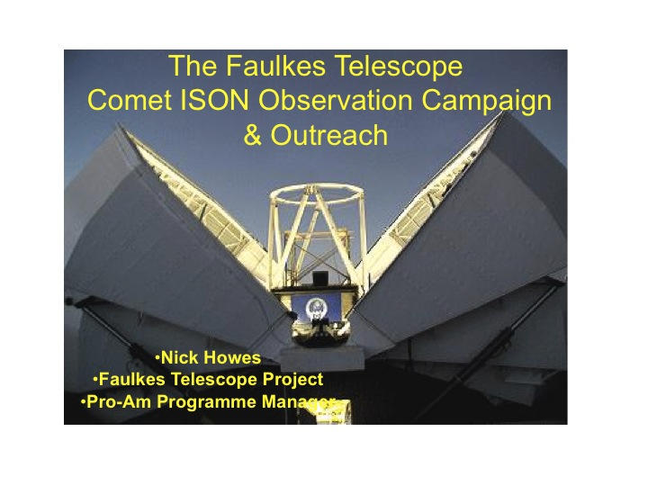

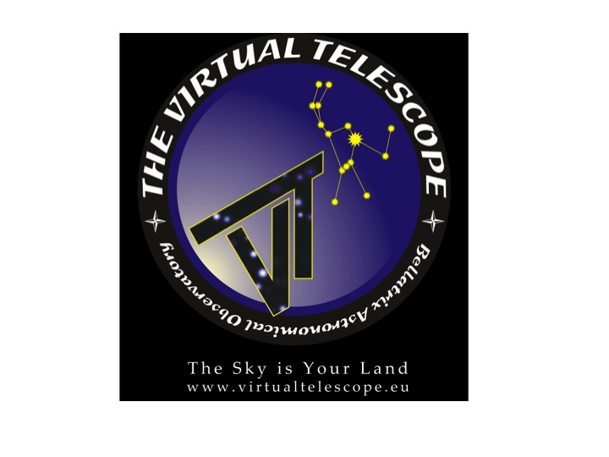
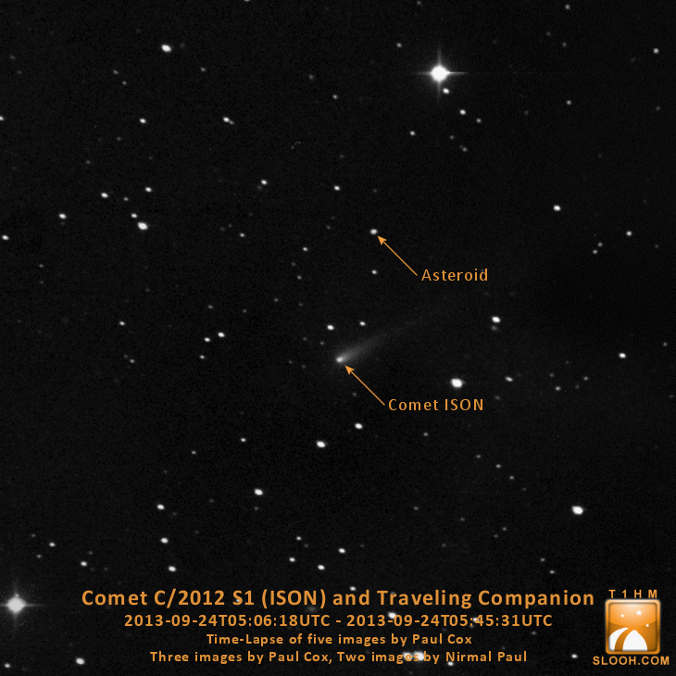
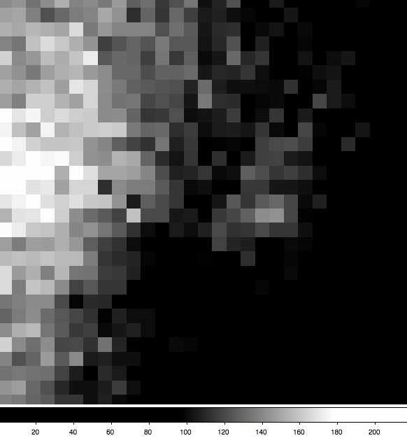
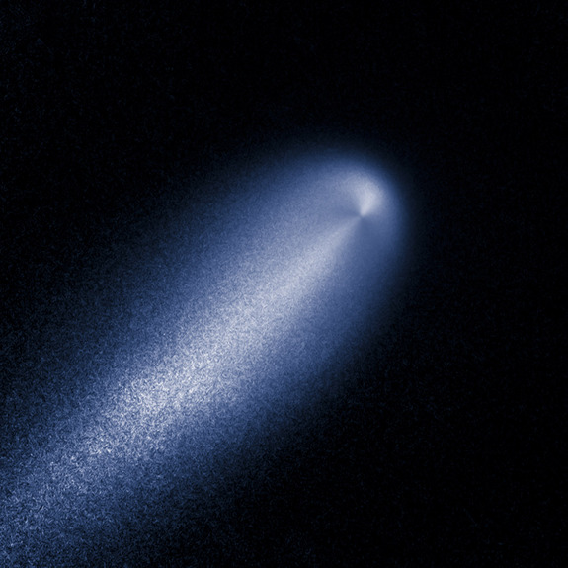

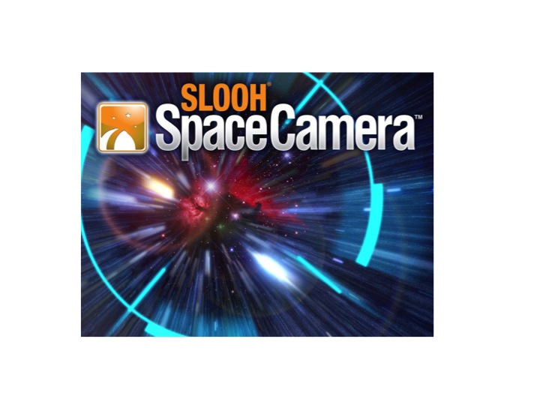
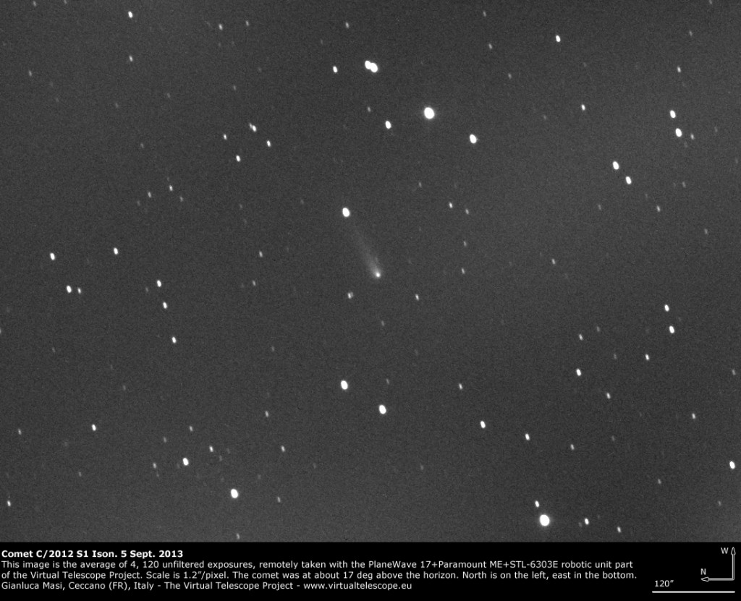
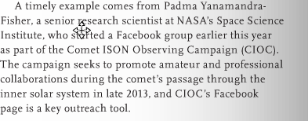
Robotic Telescope Networks/In-orbit Observatories/New Trends in Social Media
www.thevirtualtelescope.com (Gianluca Masi/Director)
Ground-based confirmation of jet seen in HST image (PI: Li)
www.slooh.com
(Paul Cox/Outreach Manager)

Slide 7
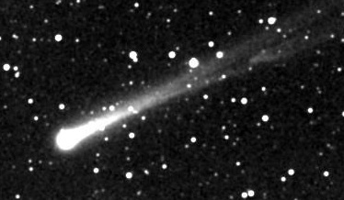
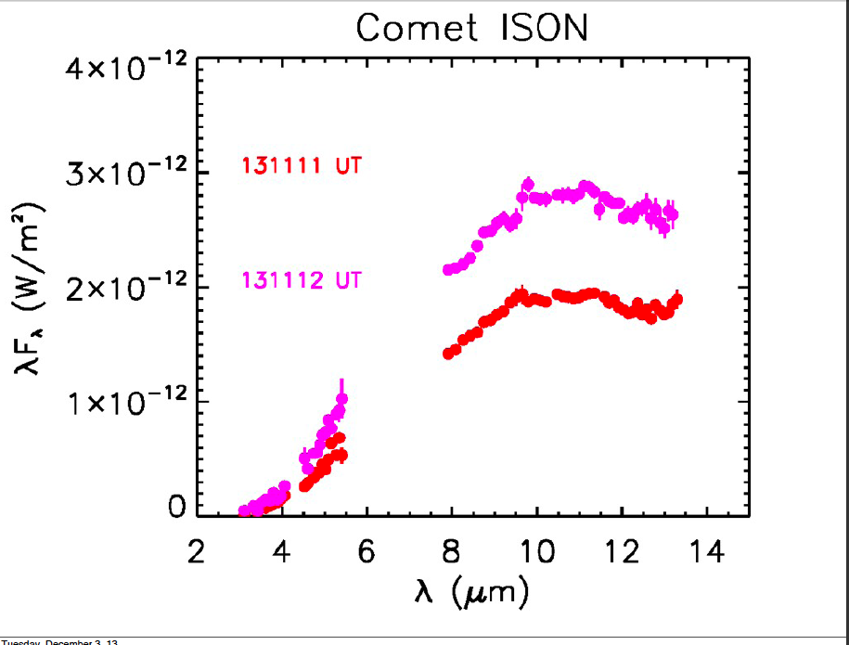
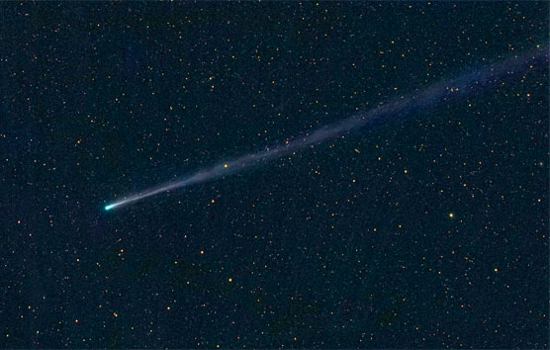
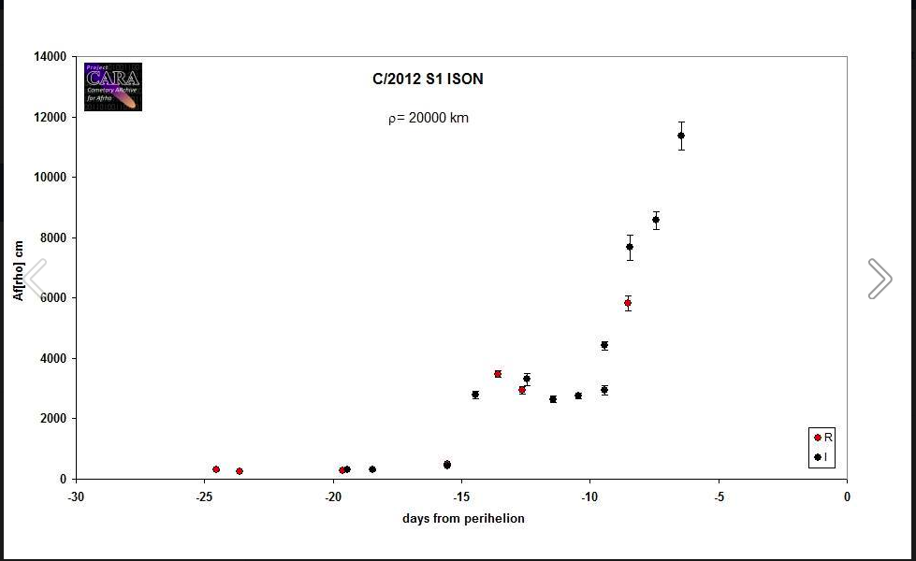
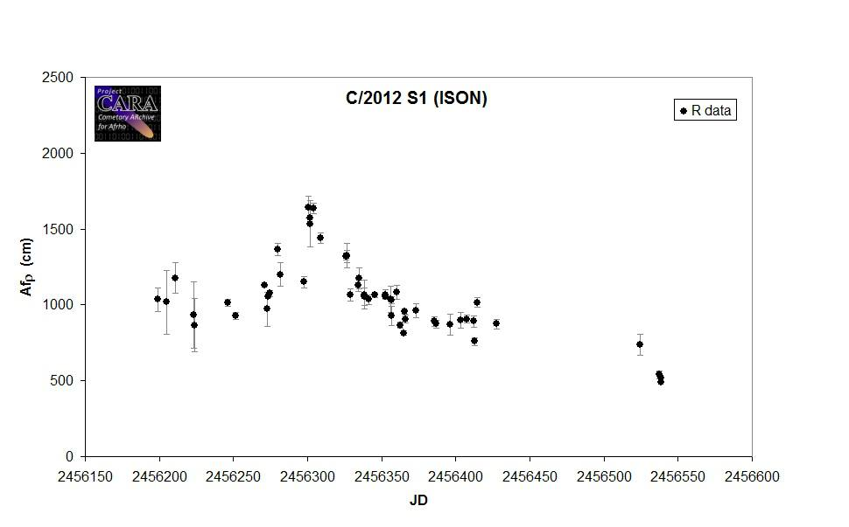
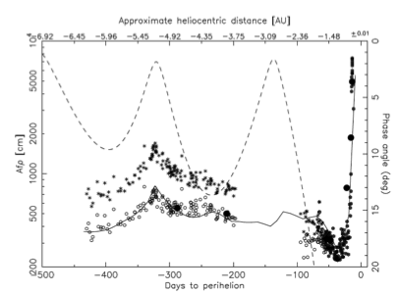
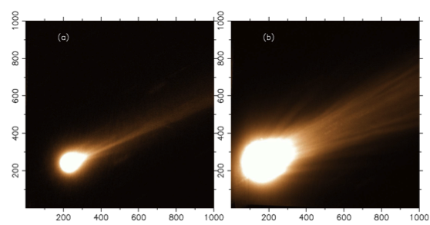
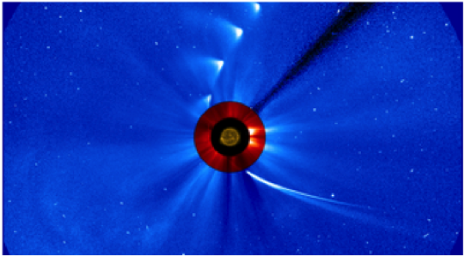
Comet C/ISON (2013): No S/C Mission
"Two tails look like beacons” T. Angel, Amateur astronomer, Granada, Spain
Sitko, Russell, Yanamandra-Fisher, NASA/IRTF/ BASS
The Dust Environment of C/ISON: Pre- and Post-Perihelion
Fernando Moreno and The Granada Team
Cometas-Obs and Amateur Astronomers
Padma A. Yanamandra-Fisher, Space Science Institute, U.S.A.
Accepted for publication; Ap J, July 2014
Afρ proxy of dust (A’Hearn et al., 1984)
Notes:
C/I2012 S1 or (ISON) was discovered on Sept 21, 2012, by two amatuer astronmers – perihelion 0.012 on 28 Nov; Mars: 0.072AU on 1 Oct;0.42AU on 26 Dec;

Slide 8

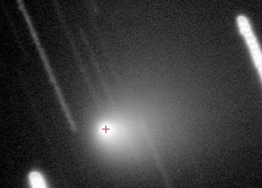
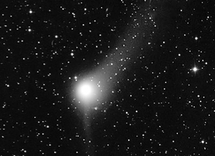
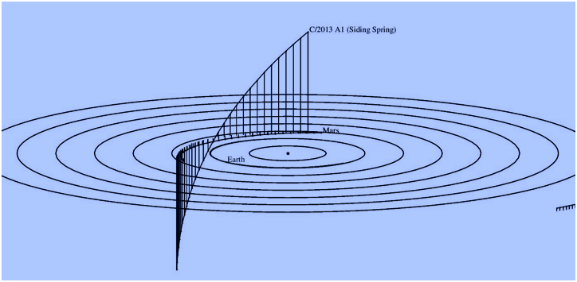
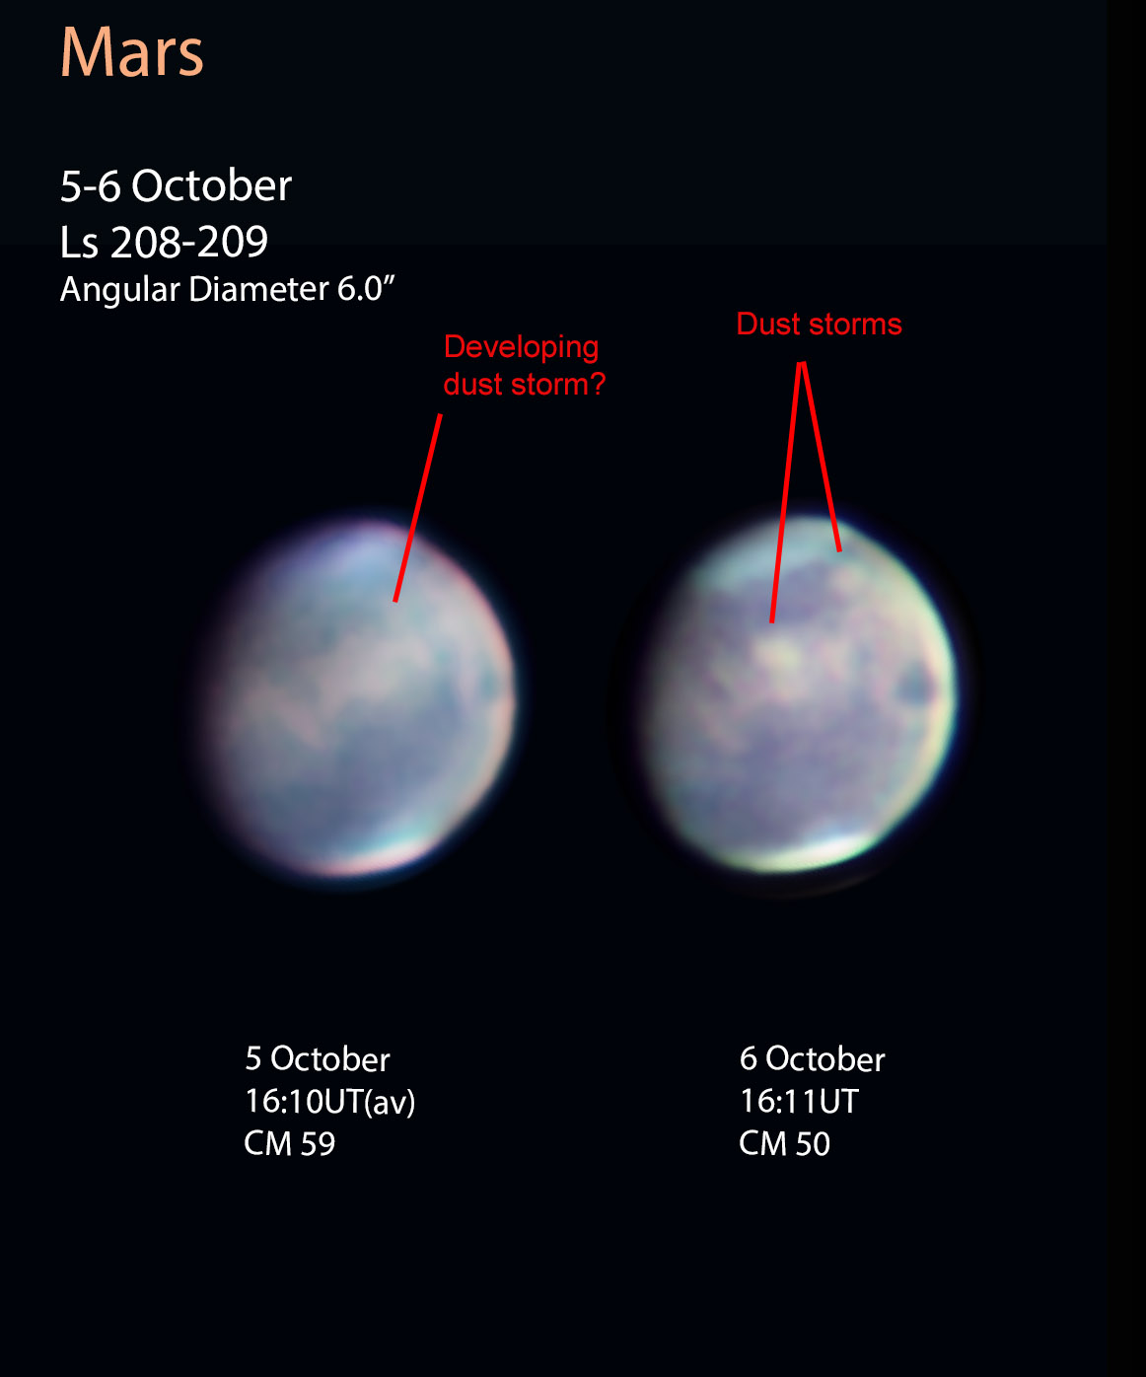
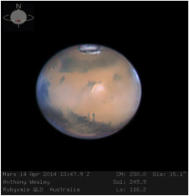
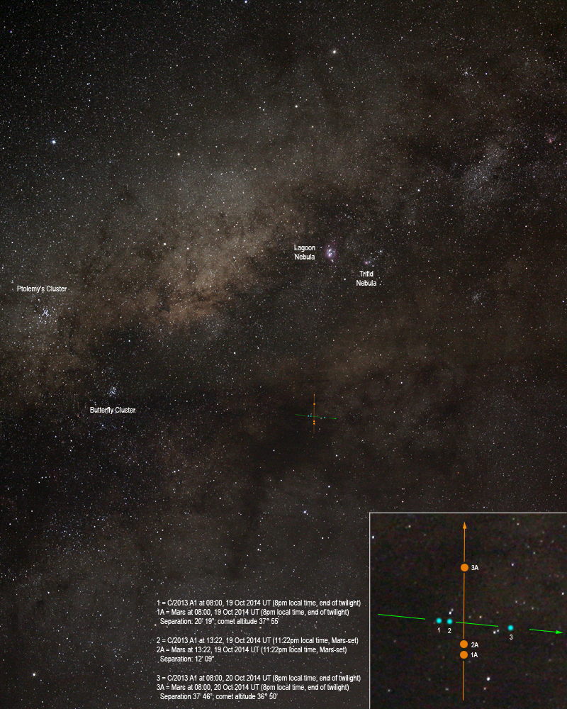
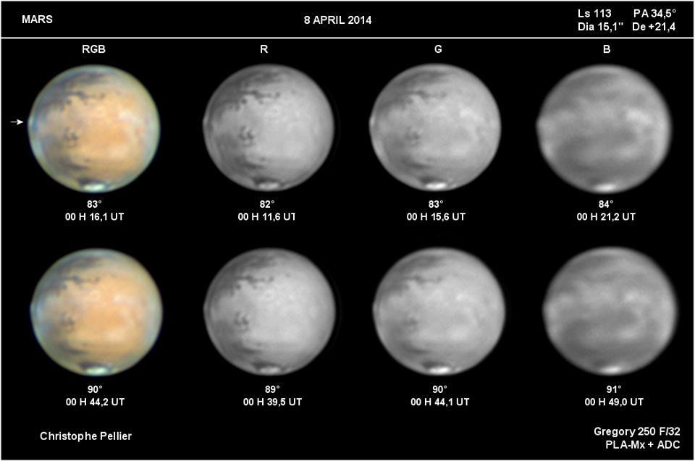
Comet/Siding Spring (2014)Flyby of Mars:
“Twofer” Campaign: Comet and Mars
(L): Network of individuals, and robotic telescope networks; telescopes ranging from small to 0.5/1-m; filters R,G,B,NIR);
(R) Rob McNaught, at Uppsala Telescope, SSO,AU. The flyby was best observed from the southern hemisphere.

Slide 9
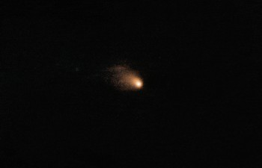
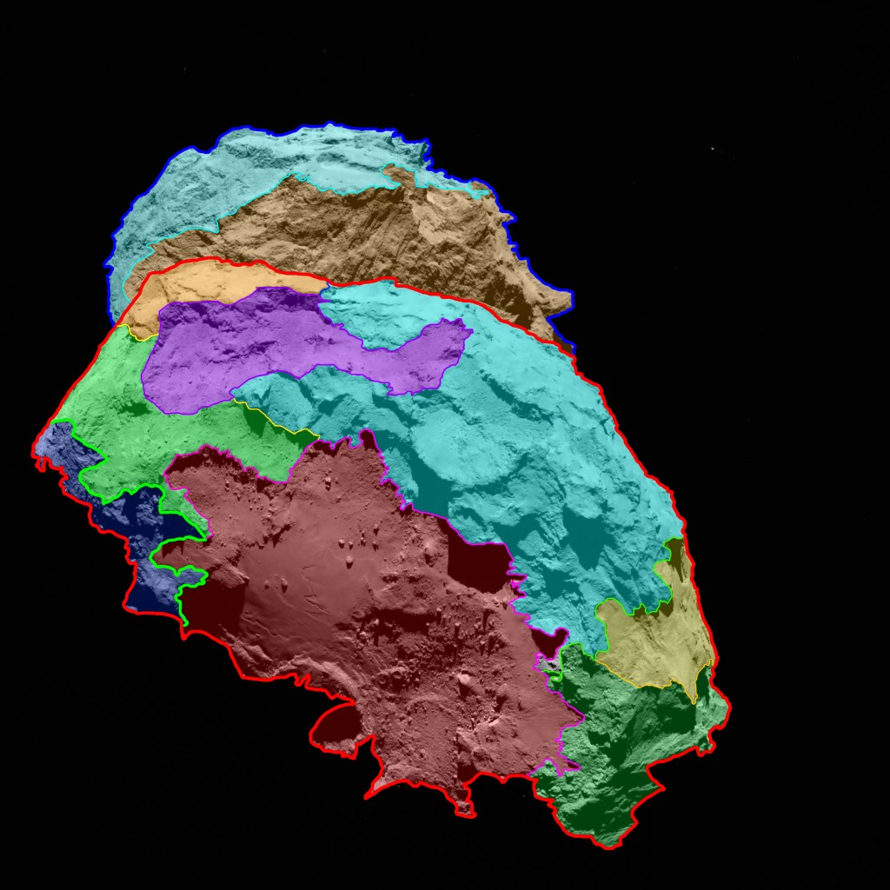
Comet 67P/CG: ESA/Rosetta Target
(2015-2016)
Facebook group established:
https://www.facebook.com/groups/paca.rosetta67p/
Flickr group started:
http://www.flickr.com/groups/paca_67p
Different challenges: periodic comet, compare w/ previous apparitions
Current apparition not very bright
Characterized by s/c close to nucleus and professionals with big telescopes
Amateur data archived in ESA/PSA (almost complete)
Comparison of amateur and professional observations of comet on 19 December 2015.
Credit : Slooh CATS Team; A. Fitzsimmons, WHT

Slide 10
TSE 2017:Four Phases of Collaboration
Science Knowledge Gap | Why is the corona hotter than the visible photosphere? What is the mechanism responsible for coronal heating?
Community | NASA; AAS; Professional –amateur solar observers; professional community of modelers; umbraphiles; media; educators; students; solar viewer manufacturers, etc.
Outreach/ Citizen Science | Social media; bloggers; star parties; 3D modeling; coordinated observations ; a new generation of observers, STEM-related influx of students; sketchers
Limelight | PRs, NASA , organized sessions at meetings (AGU, ASP, AAS), papers; other coordinated products; future eclipse campaigns – 1st Anniversary of TSE 2017; T-6yr to TSE 20204 (USA)
Notes:
So the advantages of using a multi-site are listed; as already highlighted by Citizen CATE experiment, while scientists will be involved in the modeling of the data to deliver pB maps to recover the free electron density.

Slide 11
Coronal Structure
Composite images of the corona during total solar eclipses of 2006 (left; credit SOHO/LASCO, Johnson,Brown) and 2016 (right; credit SOHO/LASCO, Vilinga,Wittich). The outer corona (red) is imaged from space by NASA/SOHO/LASCO instrument; the inner solar corona (white) is from ground-based observers and the image of the sun is shown on blue (left image) and is occulted (black in the right image).
Variety of coronal streamers. Solar max (top) and solar min (bottom) (Credit: HAO Archives)

Slide 12
Polarization of Solar Eclipse
Why is the solar corona hotter than the solar “visible” surface or photoshpere?
Inner solar corona, 1.3 to 2.2 solar radii is not probed by spacecraft (as yet; NASA/Parker Solar Probe and ESA/Solar Orbiter may help)
Inner corona is dominated by the K-corona (free electron) scattering, linearly polarized; accessible naturally during total solar eclipse (up to 7 minutes).
Observations : distribution of polarization => polarization Brightness (pB) => local electron density; coronal structures/streamers correlated with solar activity - period of low solar activity, expect

Slide 13
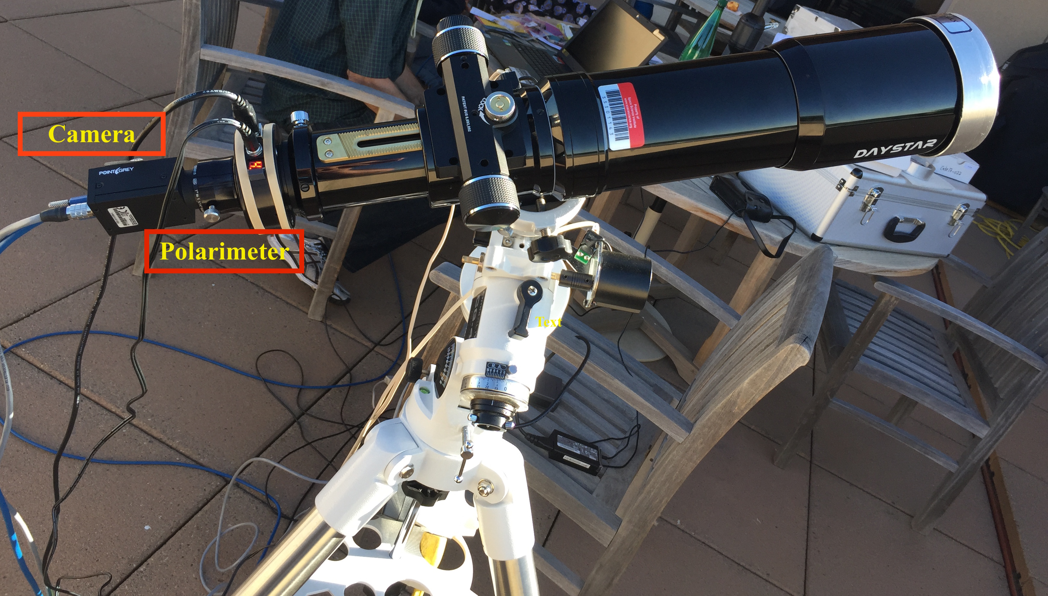
PACA_CATE Polarimeter
Characteristics
Industrial Partner: DayStar Filters
“CATE” Camera:
80-mm f/5.5 doublet refractor an equatorial mount, with a battery –powered right ascension drive, on a tripod;
4-megapixel rapid-readout detector
Polarimeter
liquid crystal variable retarder, white light linear polarizer

Slide 14
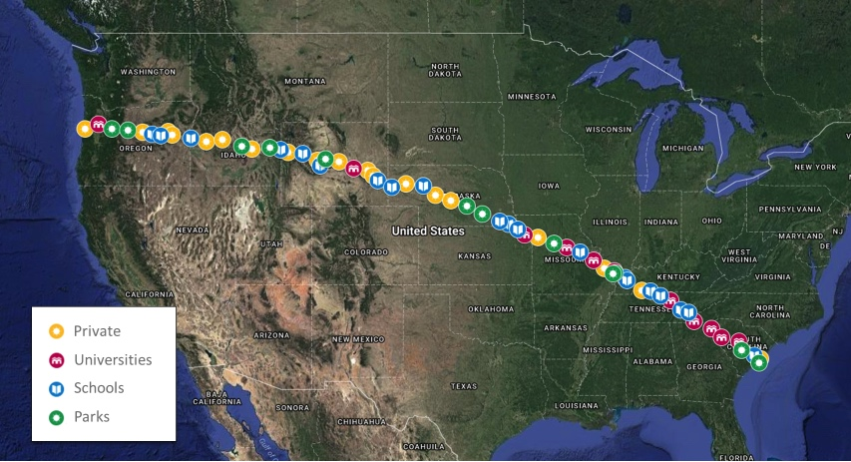
70 CATE Sites with identical equipment +
2 PACA_PolNet Sites
27 UNIVERSITIES
Boise State University, ID
Montana State University, MT
BYU Idaho Falls, ID
University of Wyoming, WY
Chadron State College, NE
University of Nebraska Kearney, NE
Benedictine College, KS
University Central Missouri, MO
University of Missouri, MO
Drury University, MO
Jefferson College, MO
Southeast Missouri State University, MO
Southern Illinois Univ. Carbondale, IL
Western Kentucky University, KY
Morehead State University, KY
Tennessee Tech University, TN
Tri-County Community College, NC
Southwest Community College, NC
Austin Peay State University
Radford University
Clemson University, SC
Lander University, SC
Coker College, SC
South Carolina State University, SC
Orangeburg-Calhoun Tech. Univ., SC
Westminster College UT
University of Michigan, MI
22 HIGH SCHOOLS
Mitchell High School
Dayville School
Grant City Schools, OR
Weiser High School ID
Bozeman High School
Teton High School, ID,
Harlem High School MT
Teton School District, WY
Dubois High School, WY
Arapahoe School District
Lander High School, WY
Laramie High School, WY
Pathways Academy HS, WY
Goshen HS, WY
Beatrice High School NE
Cienega High School AZ
Hiawatha High School KS
Unity Point Schools
Gallatin County Schools, IL
Christian County Schools, KY
Spring City HS, TN
Sequoyah HS, TN
8 INFORMAL SCI-ED
Boyce Research Foundation, CA
Nat. Space Sci & Tech Institute, CO
American Museum of Natural History, NY
The Exploratorium, CA
Pawnee City Public Library, NE
Astronomical Society of Kansas City, MO
Amateur Astronomy Assoc. of NY, NY
Amateur Telescope Makers of Boston, MA
5 NATIONAL LABS
Space Telescope Science Institute
National Radio Astronomy Observatory
NASA/MSFC
LSST/NOAO
National Solar Observatory

Slide 15
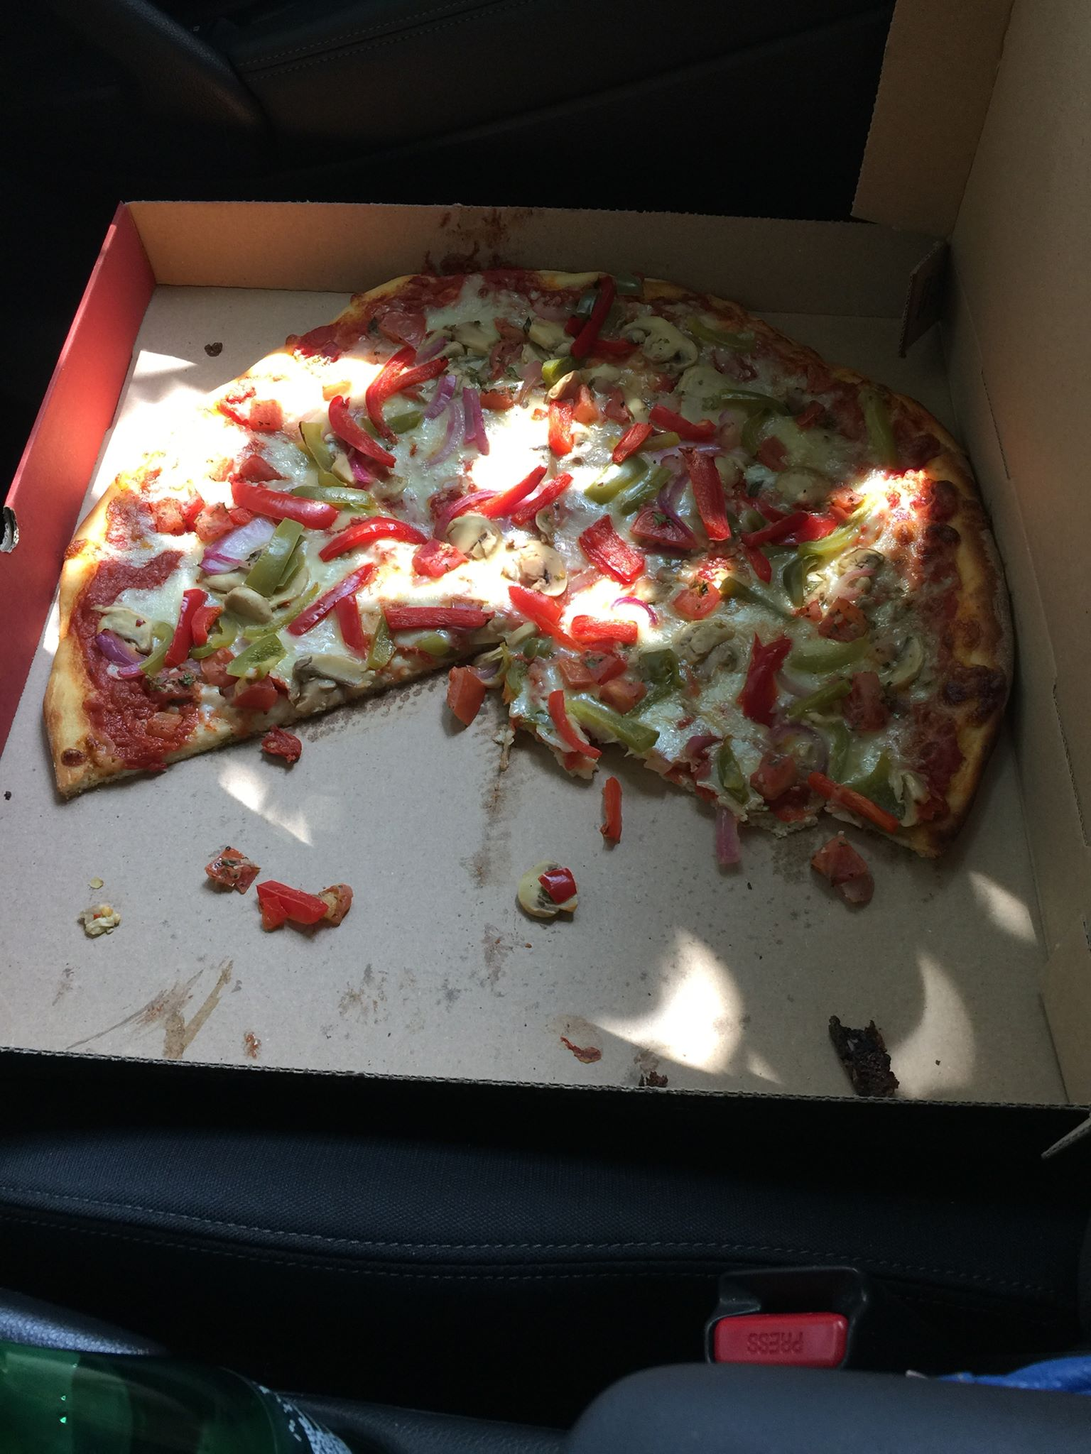
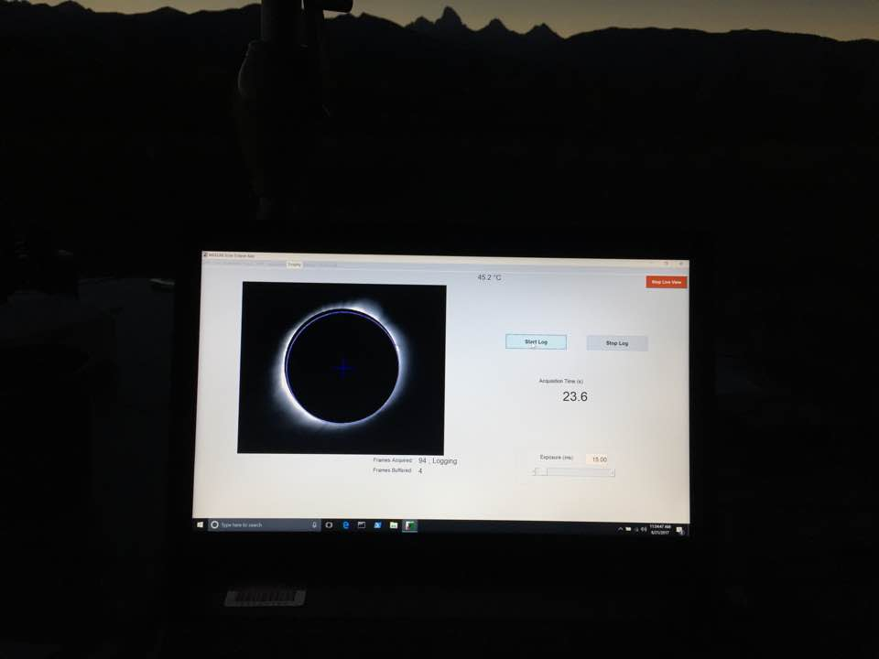
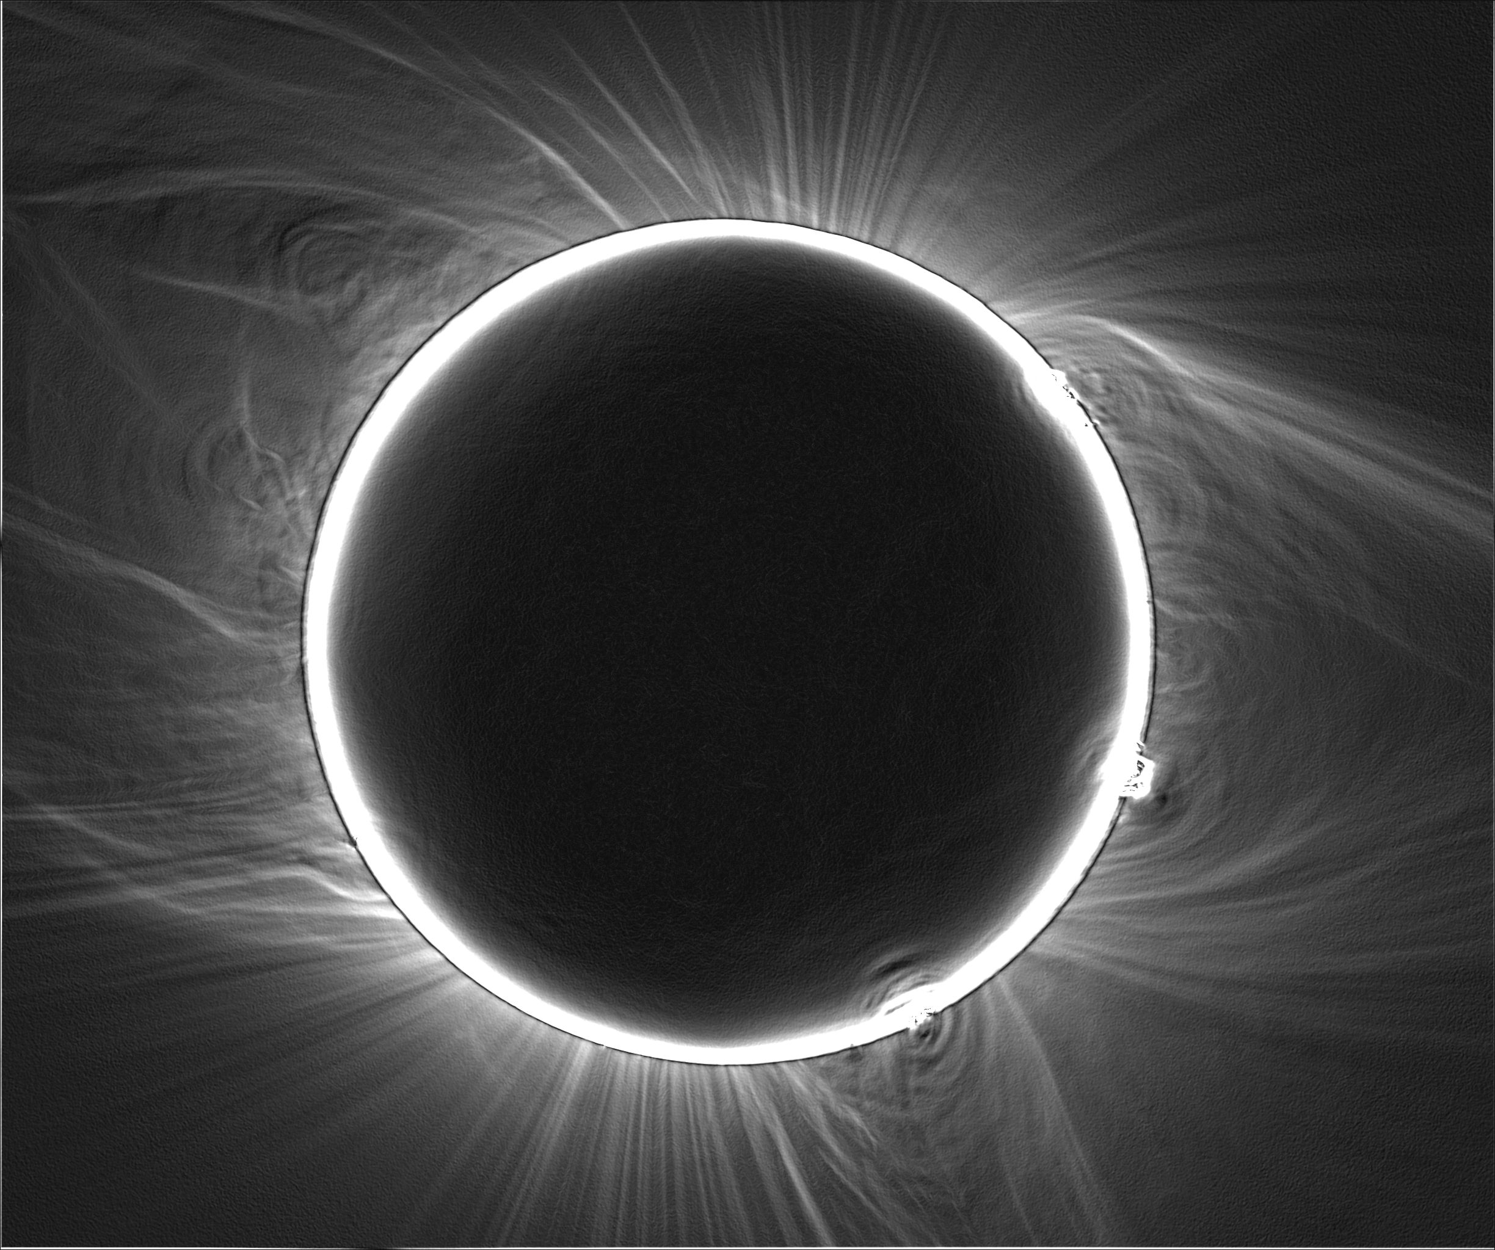






Polarimetric Observations
Preliminary (qualitative) results: Intensity (Sobel filtered); polarizationBrightness (pB) X angle of linear polarization
Notes:
So the advantages of using a multi-site are listed; as already highlighted by Citizen CATE experiment, while scientists will be involved in the modeling of the data to deliver pB maps to recover the free electron density.

Slide 16
Science - Citizen Science At its Best
Comprehensive Study of the Sun
Multiple wavelength study
Multiple geometries
Structures – sunspots, prominences
Search for sungrazer comets
Multiple modes of observation
Comparative analysis of data with legacy/previous data
The Solar Crown: the Corona: stuctures?
Response of the Earth system during a total solar eclipse
Changes in environment (temperature, clouds, etc.)
Response of flora/fauna (birds, plants, animals, etc.)
Emotional feeling of people
Auroare?
Moon mapping
“extending” the event: Citizen CATE – nearly 70 identical telescope setups along totality path to image the corona : increase the event from 2 min 40 sec to 90 min
TSE 2017 first major eclipse in digital era;
A new time domain astronomy window (TSE 2019, 2020,….2024 and beyond)

Slide 17
Successful PACA Campaigns (2013 – 2017)
Campaign/ Yr | Science | Community | Technology | Outreach/ Citizen Science
Comet ISON (2013) | Oort cloud comet; potential to be a Great Comet | Pro- amat observers global network | Social media; synergy with pros | Flickr etc., paper; conferences
Comet Siding Spring (2014) | Oort-cloud comet, close approach to Mars | Pro-am comet and Mars communities | Imaging, spectra, social media | Interaction with JPL; international meetings; collaborations
Comet 67P/CG (2014-2016) | ESA/Rosetta target | Global ground-based obs support | Robotic netwroks, etc. | Fill-in data; visualizatio; 3d models; ebooks, etc.
Total Solar Eclipse (TSE) 2017 | Polarization of K Corona | Solar community; citizen scientists | Small- aperture polarimetry | DIY-style identical set-ups; citizen science/big data

Slide 18
Going Forward…
New Modes/Potential Solutions
Imaging/polarimetric/spectroscopic observations=>”Big Data” via pro-am/citizen science
Statistical methods – PCA/ICA
Time Series
Variety of Projections
ArcGIS – cartographic mapping of pro-am data _rotate targets for evolution studies
Major challenge of data fusion; visualization; archival;
Amat use social media, free software => potential users of Jupyter notebooks (NASA requires GitHub repository)
Provide a one-stop portal that incorporaes these independent solutions for all types of data scientists
Traditional
Traditional observations; models
Increasing pro data sets
Temporal/spatial/spectral coverage
Mostly static of dynamic systems via s/c missions
Data format, reduction pipeline consistent for immediate comparison and long-term modeling,but specific to obs facility/mission/research group

Slide 19





Where is the Data Generated?
Previous modes and for the future…
Educators, Amateur Observers, Pros, Astronomy groups:
Working with your students via informal space camps:
introduce telescopes, objects in sky, how to observe and sketch; take spectra
Recent example: Space camp by Irish amateur astronomer: Dierdre Kellighan:
Sky, including comet 2017 S3 (PanSTARRS) and blog
Basic Spectroscopy – relate to known things
Preliminary images of Jupiter (intensity – above); spectropolarimetry (below). Credit: D. Elmore (AURA); Yanamandra-Fisher (SSI)
Basic observing; sketching; imaging - visual

Slide 20






Current Areas of Interest: Mars, Comets, Outer Planets; Planetary Moons
Study of a global dust storm is of interest to pro-am, as it is not known how they occur
A global dust storm started late May 2018 and enshrouded the planet

Slide 21
Variability of Planetary Atmospheres: Ex: Jupiter - Static Tools
Principal Component Analysis (PCA): Interaction of Large Vortices on Jupiter
Notes:
Good morning. I am going to talk about the new challenges facing scientific research when new dimensions are included vs. the standard accepted methods of acquiring
Data, model, minimize the residuals and repeat. Increasing collaborations with amateur astronomers; new methods and techniques to deal with the Big Data deluge,the boundaries between scientific research, outreach and data manipulation are becoming blurred, if not completely dissolved. I will focus my talk on the examples of pro-am
Collaborations over the past 5-6 years and are now almost the norm for new missions and continuity of observations when missions enc.

Slide 22

Dynamic Mapping: Ex. Jupiter
Use ArcGIS- geospatial mapping; reproject to sphere (data and results)
Applied to terrestrial cases (very popular and helpful for eclipses seen from Earth)
Initiating application to planets (Jupiter, Mars, Saturn)
Pro 5.1 – micron data reprojected onto globe – allows data mining and exploration

Slide 23



“Re-Cycling” the Pro-Am Collaboration: Toolkits: Flyby of Comet 46P/Wirtanen
Jupiter-family comet; original target of ESA/Rosetta mission
Close approach in 2018: to Sun, Earth December 2018;
Potential bright object – maybe naked eye
Brightening as predicted; coma growing rapidly; gaseous – green color
Potential spacecraft target; opportunity to characterize the comet/outburst activity
Draws upon the four pillars of pro-am campaign, cyclical
Orbit Diagram of 46P
A. Hale, Chile; 20 Oct 2018,

Slide 24



Using Mission Support

Slide 25
Opportunities to Participate
Looking for Partnerships for Portal building
padmayf@gmail.com
Data Acquisition and Analysis
  Consistent observations; good logs; databases; light curves; Afrho (other cometary features); polarimetric maps (aerosols in planetary atmospheres; inner solar corona via TSE; earthshine during lunar eclipses, etc.)
Ongoing/Future Campaigns
  “New” observational modes (polarization; spectroscopy; occultations)
  Objects: comets, planets (Jupiter, Saturn, Mars), asteroids, exoplanets (e.g., PACA_46P_Wirtanen; PACA_SaturnSolstice 2017, 2019, 2023, 2024; PACA_UrnNep; PACA_Polarization etc.)
  Outreach and Citizen Science: share, archive and publish (also increase time-domain windows, e.g., using networks of identical set-ups for observations); prepare publications.

Slide 26
Thank you!
padmayf@gmail.com

Slide 27
UV/O/NIR Astronomer’s Tool Kit
Per ASTRO2010 Decadel report (Clemens et al). three independent tools for astronomers:
Imaging – morphology and related changes -- commonly used
Spectroscopy – composition (of surfaces or atmospheric scattering media) – in practice
Polarization – optical properties of scattering media (surfical, aerosols, cometary dust, etc.) – not as advanced/in use due to lack of observations/lack of vector rt methods/lack of lab measurements/lack of s/c missions - starting to see rejuvenation of the field on all fronts

Slide 28

Timeline of a Total Solar Eclipse
First Contact – The moon begins to cover the western limb of the Sun
Light and Color Changes – About 15 minutes before totality, when 80% of the sun is covered, the light level begins to fall noticeably — and with increasing rapidity.
Changes in Nature --Animal/plant behavior; light and color of the sky;
Unusual features before and after: Shadow bands beads; Diamond ring
Second Contact Totality Begins
Corona Appearance: streamers;
prominences vary with each eclipse. Planets and Stars Visible
Third Contact Totality is over.
Fourth Contact Sun reappears; eclipse is over
Notes:
So the advantages of using a multi-site are listed; as already highlighted by Citizen CATE experiment, while scientists will be involved in the modeling of the data to deliver pB maps to recover the free electron density.

Slide 29



Other Forms of the Solar Corona
Wide field of view (left); Moonshine at mid-totality
(Credit: D. Peach, SC)
Mitchell, Oregon, USA
© 2017 Miloslav Druckmüller, Peter Aniol, Shadia Habbal
Notes:
So the advantages of using a multi-site are listed; as already highlighted by Citizen CATE experiment, while scientists will be involved in the modeling of the data to deliver pB maps to recover the free electron density.

Slide 30
Types of Solar and Lunar Eclipses
Solar
Lunar
Occurs in daytime at new moon; lasts for few minutes
Three types: total, partial, annular
Occurs in nighttime at full moon; lasts for a few hours
Three types: total; penumbral, partial
Fun Fact: Eclipses occur in pairs: the lunar eclipse of 7 August 2017 occurs approx. 2 weeks before the total solar eclipse on 21 August 2017; 2019 …

Slide 31
Coronal Structure
Why is the solar corona hotter than the solar “visible” surface or photoshpere?
Variety of coronal streamers. Solar max (top) and solar min (bottom) (Credit: HAO Archives)
Inner corona is dominated by the K-corona (free electron) scattering, linearly polarized; accessible naturally during total solar eclipse (up to 7 minutes)
Inner solar corona, 1.3 to 2.2 solar radii is not probed by spacecraft (as yet; NASA/Parker Solar Probe , projected launch date 6 Aug 2018, and ESA/Solar Orbiter will be s/c to probe lower corona)
Observations : distribution of polarization => polarization Brightness (pB) => local electron density; coronal structures/streamers correlated with solar activity -
Composite images of the corona during total solar eclipses of 2006 (left; credit SOHO/LASCO, Johnson,Brown) and 2016 (right; credit SOHO/LASCO, Vilinga,Wittich). The outer corona (red) is imaged from space by NASA/SOHO/LASCO instrument; the inner solar corona (white) is from ground-based observers and the image of the sun is shown on blue (left image) and is occulted (black in the right image).

Slide 32
STEAM -Related Activities
SCIENCE | Nature and types of eclipses (solar, lunar, planetary, exoplanetary,etc); solar physics; polarization and various types
TECHNOLOGY | Various experiments to address the collective science (see in Math/Engineering)
ENGINEERING | Appropriate instrumentation; coding; 3D-experiments; in-lab measurements
ART | Elements of sketching; community/cultural ties; models; observations of the local environment; publications for various audiences (books; activity pages; solar viewers, etc.)
MATH | Diameter of the sun; predicting future eclipses; lunar science; demonstration of bending of sunlight; etc.
Notes:
So the advantages of using a multi-site are listed; as already highlighted by Citizen CATE experiment, while scientists will be involved in the modeling of the data to deliver pB maps to recover the free electron density.

Slide 33
Factors for Successful Pro-Am Campaigns
Identify an unique astronomical event
Place in context for scientists and public, amateurs, non-science outreach
Common procedures/tools for pro- and amat-data (current, legacy and mission) – reach out to other amateur communities, public resources; partnerships for sharing resources
Inclusion of techniques common to each community to use the best of the best
Identify STE(A)M related activities, including indigenous peoples, cultures and customs
Identify potential for crowdsourcing for scientific analyses and archival of data (hardest aspect, but very helpful for citizen science)
Identify: Citizen scientists, data scientists; rules of the road for data analysis, ownership and publication ➔ very important for scientific journals/papers – ultimate goal!

Slide 34
The PACA* Project: Global Model
Creation of a global network of amateur observer
World-wide alert mechanism : social media (FB, Twitter, etc.), amateur networks, email
Immediate Outreach; certificates of participation; Google+, Flickr, Pinterest, etc.
Challenges include data collection/archival; mixed formats of data
Ongoing Campaigns:
Planets (JSUN);
Comets
Solar/Lunar Eclipses
Upcoming Campaigns:
Specific Comets (21P, etc.)
Polarization
Spectroscopy
Geo-mapping

Slide 35



How do we measure polarization?
+
=
CATE Equipment
Polarimeter
Our Setup!

Slide 36

From 2.5 min to 83 min:
46 Site Quick-Look Animation
Co-adding/registering images; Sobel-filtering for fine structure
(Credit: D. Elmore, AURA)

Slide 37






Polarization: Is it unique?
Rainbows are caused by reflection of sunlight by water droplets in the atmosphere and are highly polarized.
Haloes are produced by reflections/refraction by hexagonal ice crystals, as opposed to water droplets, and are mostly formed in colder climes.
Comets
Asteroidal Taxonomy
Moon - minearlogy
Planets and satellites
Notes:
Can one see polarization/polarimetric effects to engage the public? Yes – various atmospheric phenomena such as rainbows, glory and haloes are examples of polarization. The method of scattering is different for each of these phenomena – scattering by vey small particles for rainbows; scattering by hexagonal ice crystals vs spherical water drops. These are phenomena observed on other planets too.
polarisation is not unique to solar eclipses, but can be studied via various objects and their observation: from the moon/earthshine to identify habitability on exoplanets; mineralogy on moon, asteroids; study of cometary dust ; aurora and clouds in planetary atmospheres and plumes on planetary satellites (such as Titan, Enceladus, etc.). So, polarization is more common that one thinks. We are developing simple demonstrations to explain this concept. A simple demonstration is using two slides of polarized film, rotating one against the other and observing how the light that comes through changes.

Slide 38









Ongoing Campaigns

Slide 39


The PACA Project Global Network padmayf@gmail.com
PACA Groups
Jupiter
Saturn
Icy Giants
Mars
Comets
Polarization
Pro-Am Obs:
Imaging (Vis/Nir)
Spectra
Polarization
Pros:
+ Thermal
Retrievals
Models
Credit: T. Griener

