Slide 1
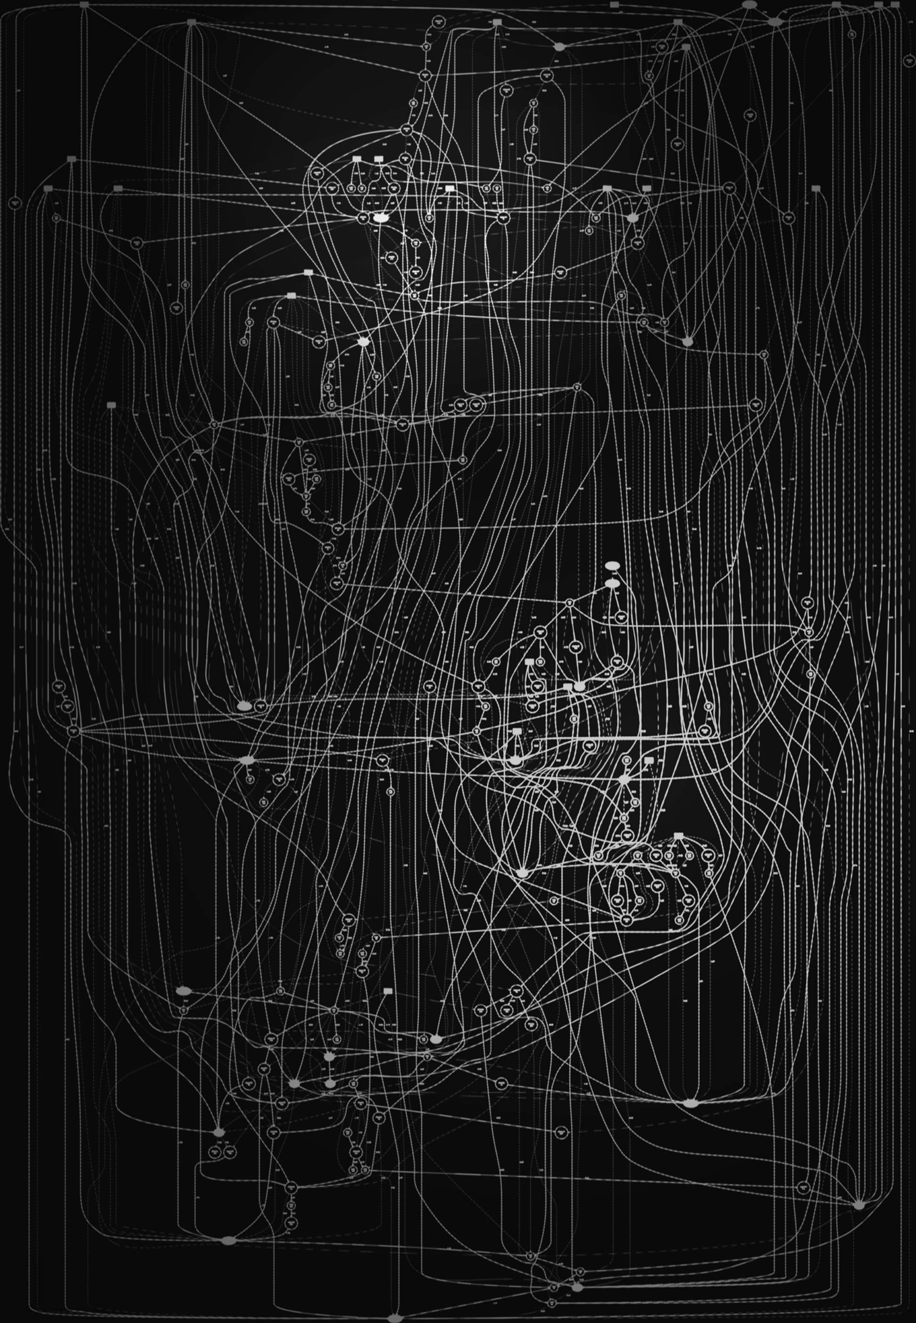

sparkcognition
TM
A Neuro-evolutionary Approach to Automated Model Building
Jeremy Ritter
Senior Data Scientist, SparkCognition
PhD Astronomy, UT Austin

Slide 2
Why automate machine learning?
Automated Machine Learning (AutoML)
1. Accessibility
Maximize efficiency of data science teams by making model building accessible to everyone
2. Scalability
Automate accurate machine learning models that solve a diverse range of problems
3. Self Maintenance
Quickly adapt to changing conditions over time with automated model retraining
Notes:
distro

Slide 3
Types of machine learning models

Slide 4
Model building pipeline
AutoML
Hyperparameter Optimization
Neural Architecture Search
PROBLEM
FORMULATION
DATA ACQUISITION
DATA PROCESSING
MODELING
DEPLOYMENT
Question
Data Sources
Data Cleansing
Model
Selection
Data Streaming
Imputation
Scaling
Balancing
Web/Runtime Engine
Insights?
Visualization & Exploration
Model Optimization
Feature Generation
Hyper-parameter Tuning
Model Monitoring
Labeling
Feature Engineering
Timeseries Features
Validation

Slide 5
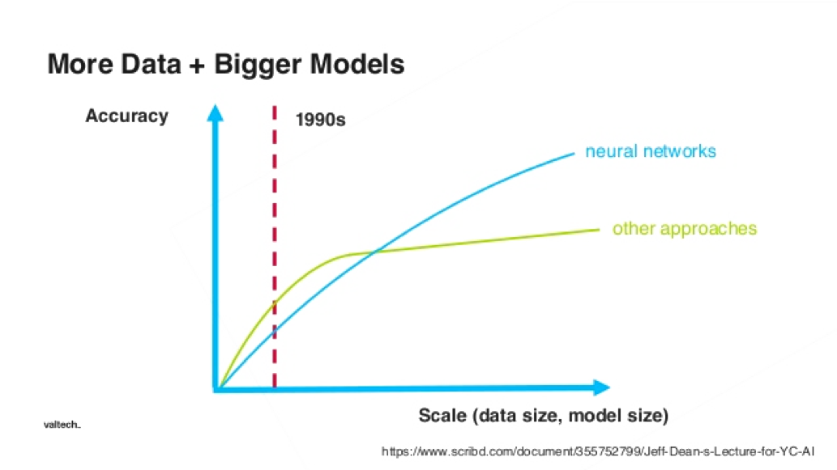
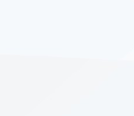
Why focus on neural architecture search?
Developing neural network-based models requires significant architecture engineering
Trial and error of human-tuned models takes significant time, and often does not follow a standard or repeatable process
Hand-tuning architectures requires significant experience

Slide 6
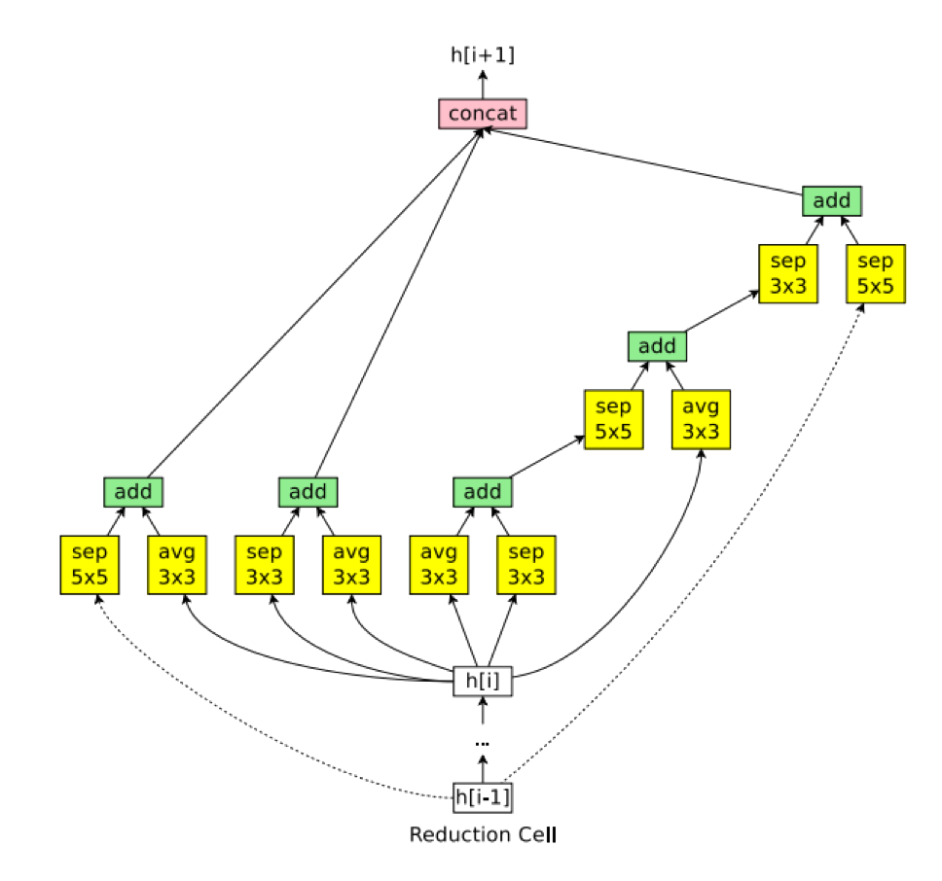
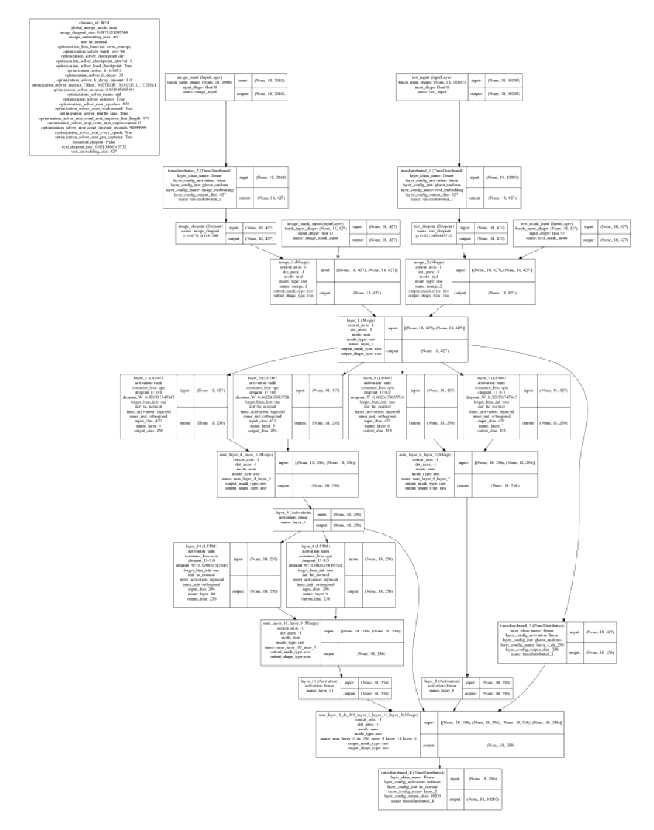
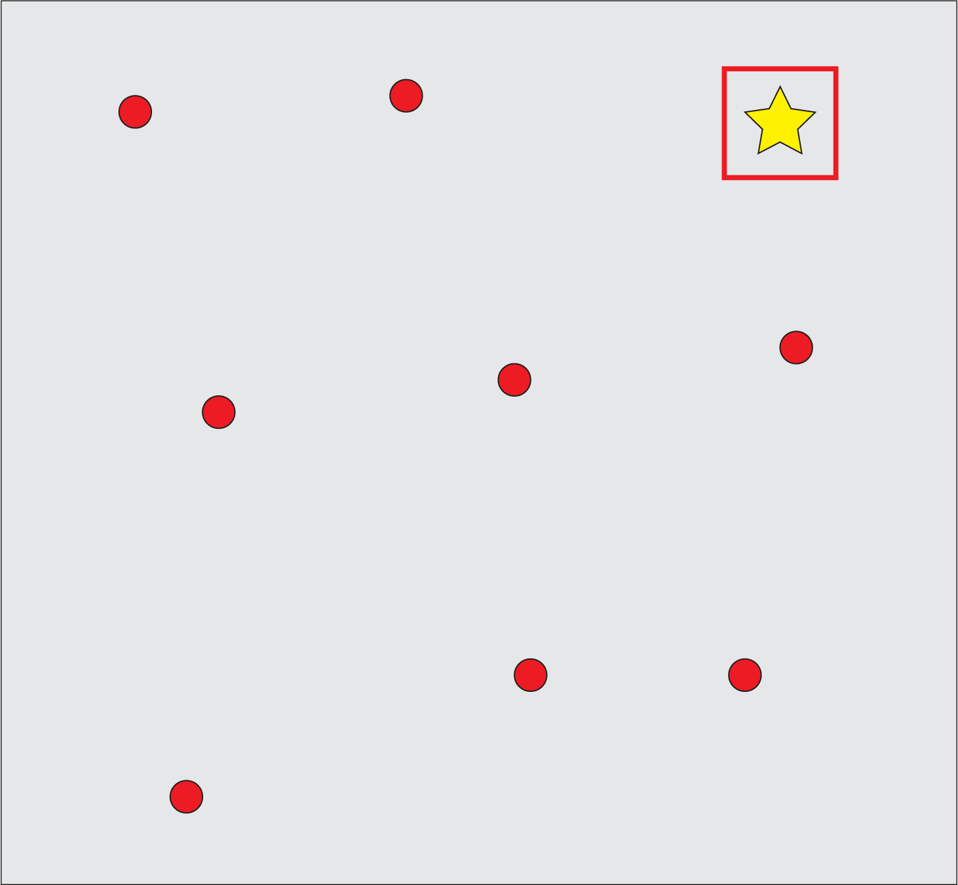
Neural architecture search methods
Random Search
Reinforcement Learning or Gradient-Based
Neuro-Evolutionary Methods
Darwin
NEAT
Optimal Architecture
Random Search
HyperNEAT
ENAS
Darts
NAS
Co-Deep NEAT
PNAS
NAO
PBT
Notes:
https://towardsdatascience.com/everything-you-need-to-know-about-automl-and-neural-architecture-search-8db1863682bf
https://arxiv.org/pdf/1902.08142.pdf <-- calls out how constrained existing RL approaches are

Slide 7
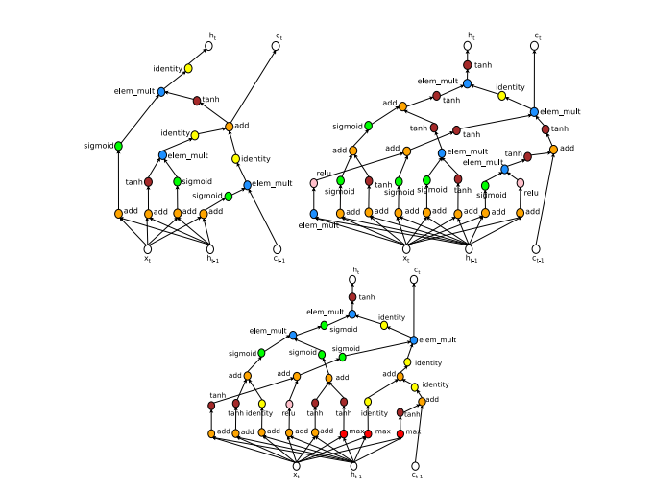
Architecture search by neuro-evolution
Step 1: Generate a new architecture
random mutation, mating …etc.
Step 2: Hyper-parameter tuning
batch size, dropout, SGD algorithm, learning rate …etc.
Step 3: Training
Zoph & Le 2017
Step 4: Validation

Slide 8
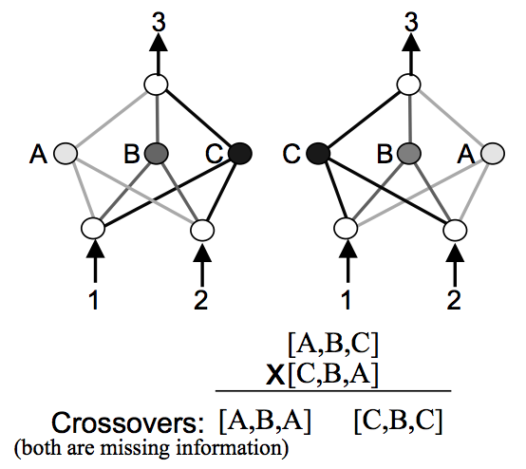
Potential pitfalls of neuro-evolution
Competing conventions/permutations
  Identical networks may be expressed in multiple ways, e.g. by changing the order of the hidden nodes
Innovation needs protection
  Adding a new node or connection is likely to reduce the network fitness in the short term, before weight optimization
Unnecessary complexity
  Purely random topologies may have dead-ends, and result in wasted effort searching a large parameter space
Stanley & Miikkulainen 2002

Slide 9
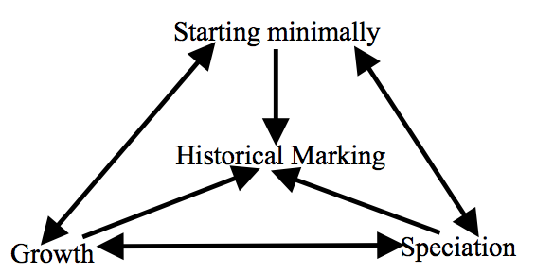

NeuroEvolution of Augmenting Topologies
NEAT - Stanley & Miikkulainen (2002)
Stanley & Miikkulainen 2002
NEAT, Stanley 2002

Slide 10
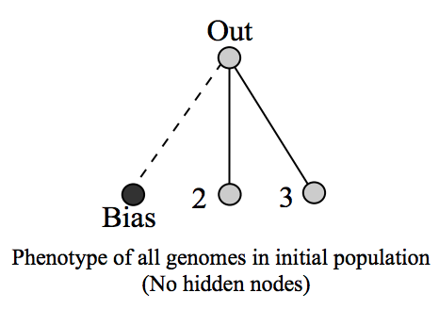
Dimensionality minimization
Minimize the search space by starting simple and evolving complexity
Stanley & Miikkulainen 2002
NEAT, Stanley 2002

Slide 11
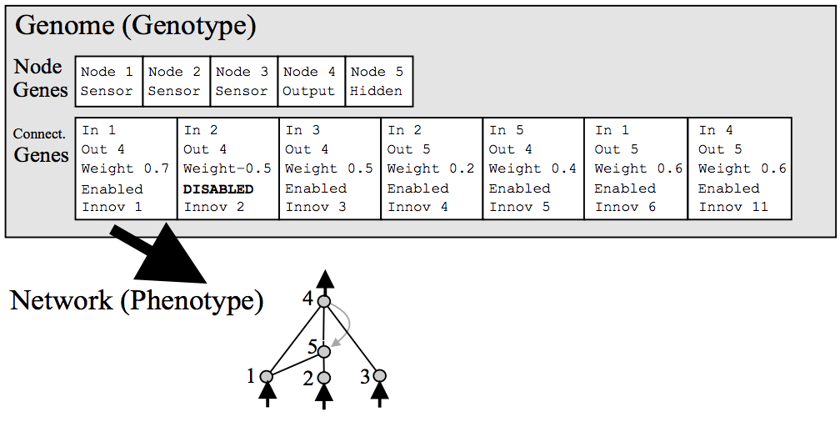
Genetic encoding
Tracking structure changes with historical markers
Stanley & Miikkulainen 2002
NEAT, Stanley 2002

Slide 12
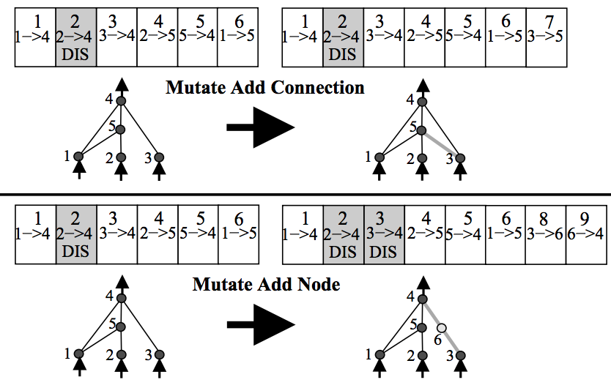
Mutation
Growing new structure through random mutations
Stanley & Miikkulainen 2002
NEAT, Stanley 2002

Slide 13
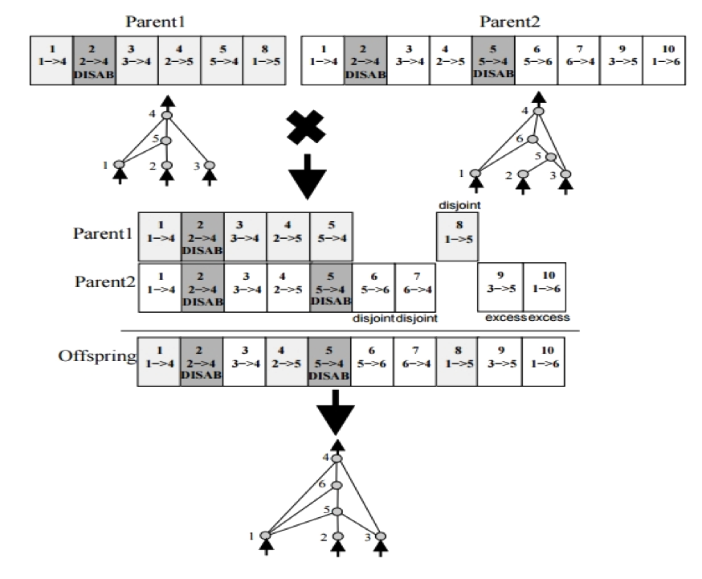
Reproduction
Optimize new structure by mating high-fitness parents
Stanley & Miikkulainen 2002
NEAT, Stanley 2002

Slide 14
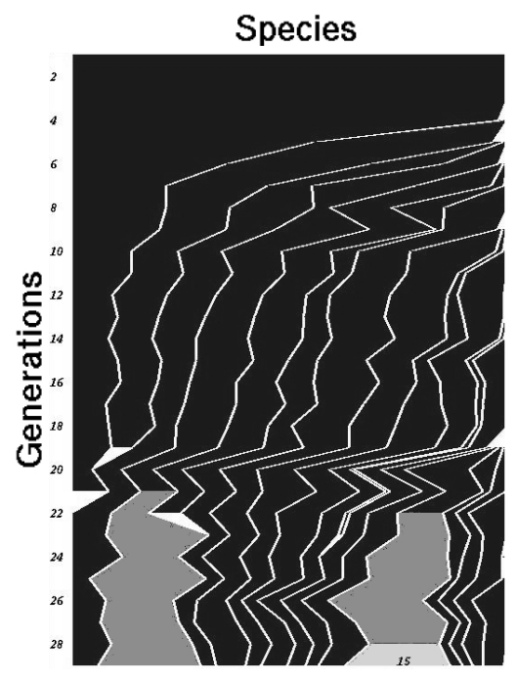

Speciation
Protect structural innovations from more mature competing networks
Separate species are distinguished by their genetic compatibility distance
  The more disjoint or excess genes, the less compatible two networks will be for reproduction
Species fitness is explicitly shared among its members
  Species with too many members are penalized, preventing any individual species from completely dominating
Individuals only compete within the species
  New innovations in young species are protected from competition with individuals of more mature species
Stanley & Miikkulainen 2002
NEAT, Stanley 2002

Slide 15
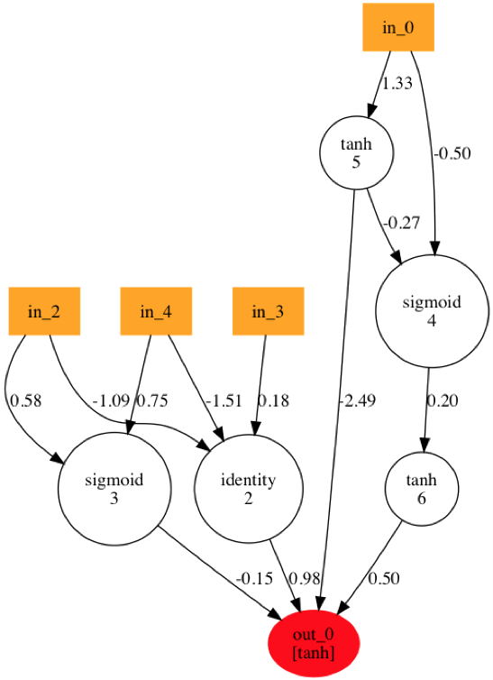
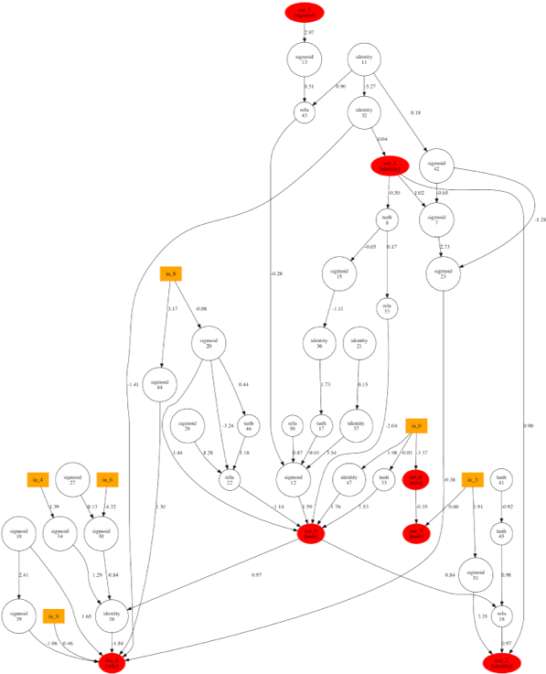
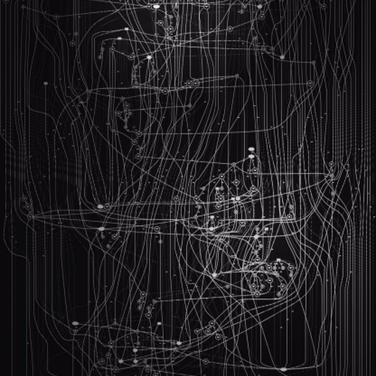
Model architecture outputs
Predicts bearing failure
(400 generations)
Flies an Airplane
(900 generations)
Trades Dow Futures
(1000s of generations)
Notes:
Node by node placement
Weight was part of the GA

Slide 16
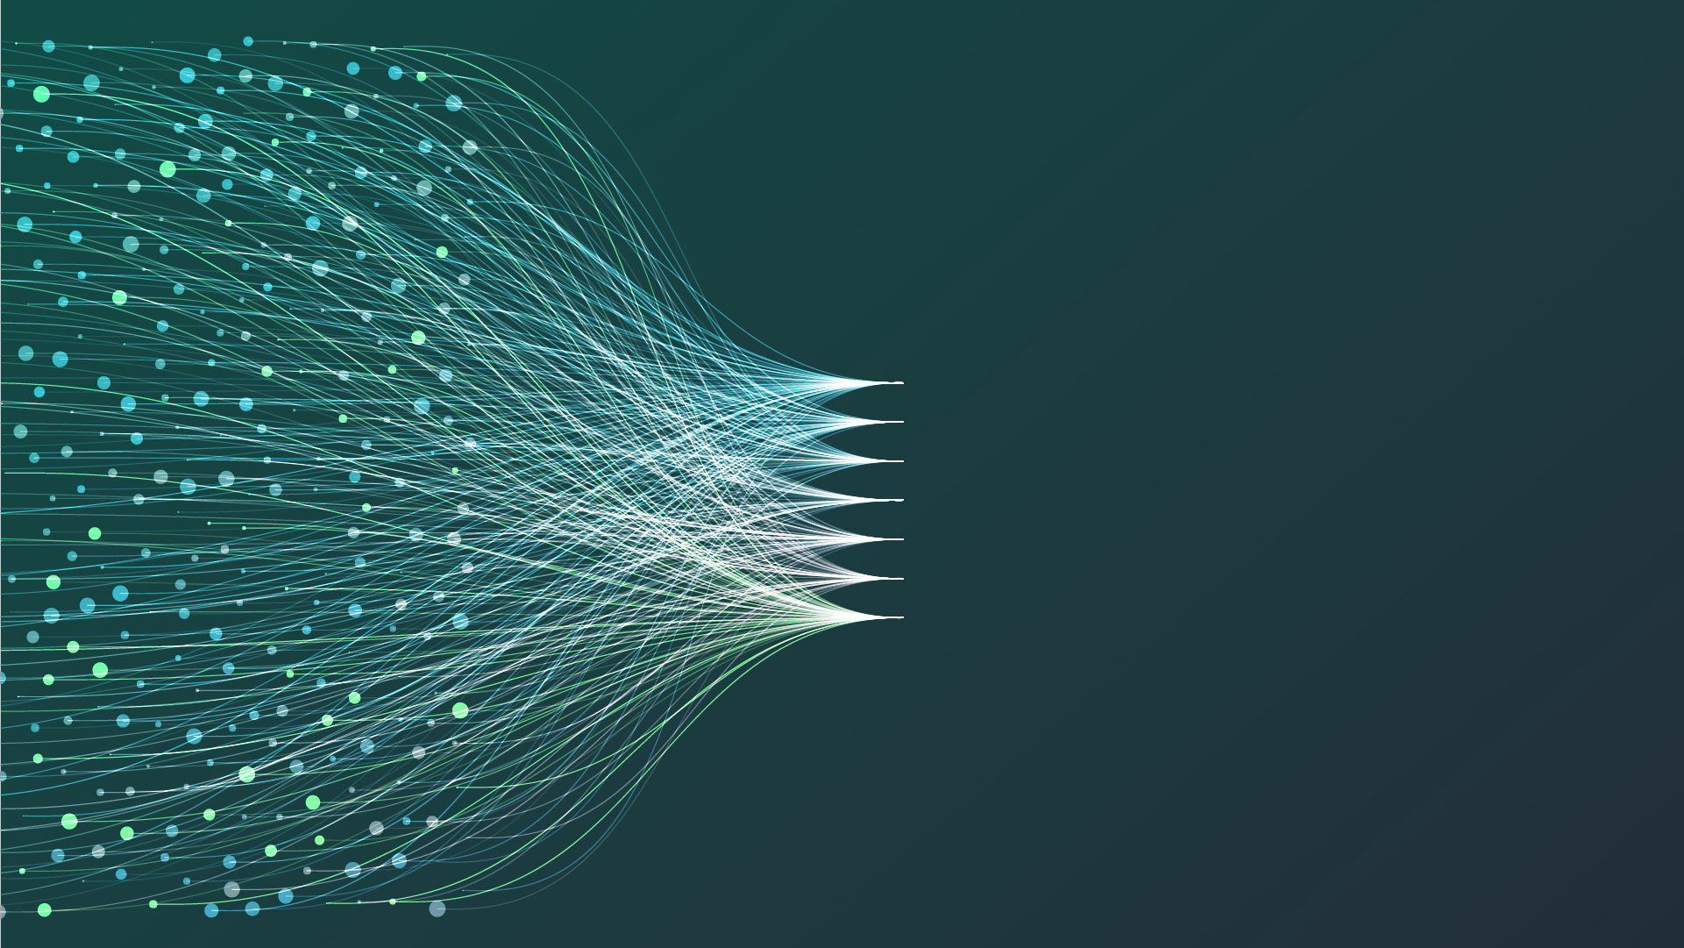
sparkcognition
TM
TM
Darwin
An Evolutionary Platform for Automated Model Building
©SparkCognition, Inc. 2018. All rights reserved.

Slide 17

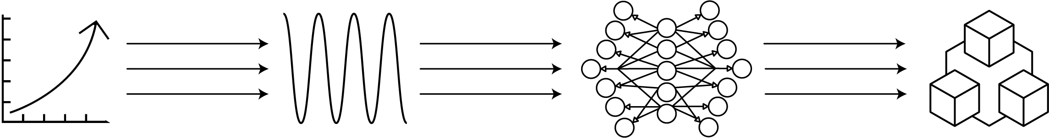
Darwin pipeline
TM
PATENTED AUTOMATED MODEL BUILDING PROCESS
Structured
Data
Preprocessing
Feature Generation
Feature Selection
Model Building
Model
Scaling
Imputation
One-Hot Encoding
Balancing
Time Domain
Fourier Domain
Raw Features
Generated Features
Classification
Regression
Clustering
Anomaly Detection

Slide 18
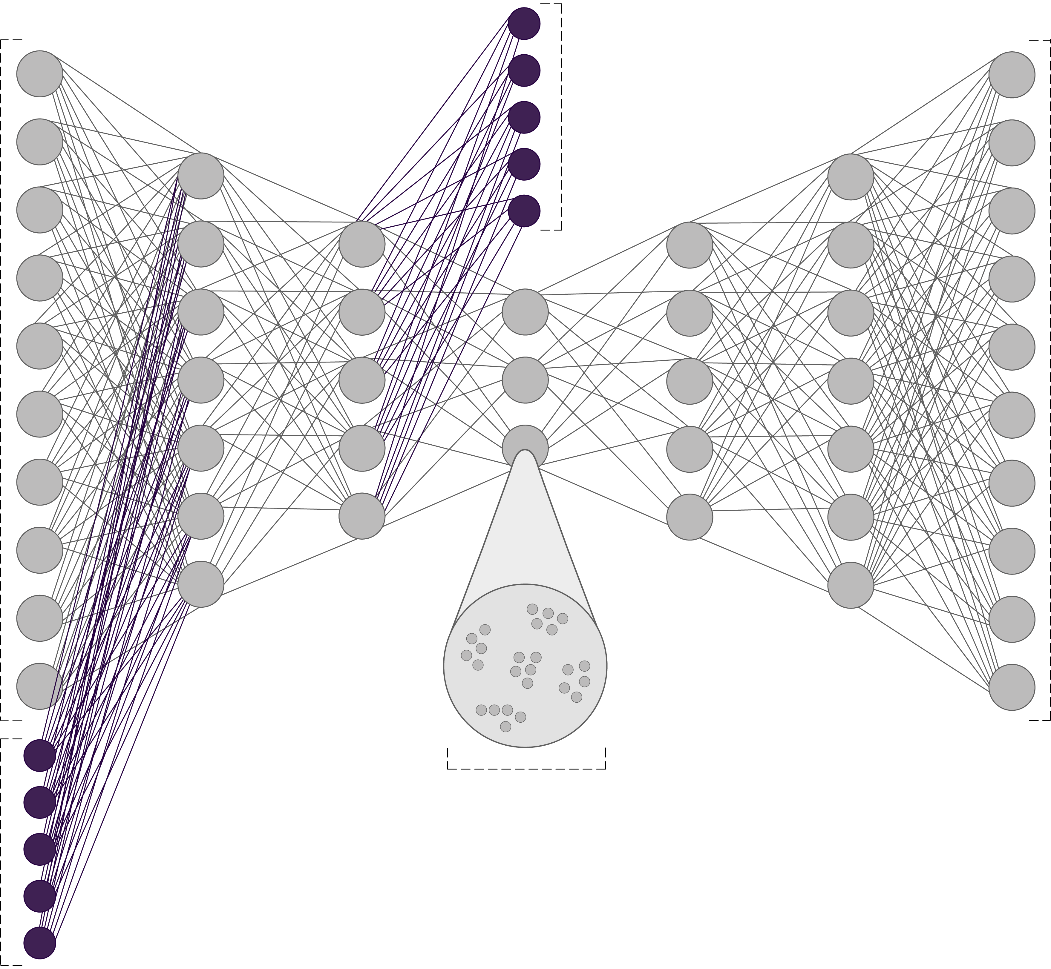
Darwin is designed to solve:
TM
Supervised Learning
  Regression
  Classification
Unsupervised Learning
  Clustering
  Anomaly Detection
Semi-supervised / Normal Behavior Modeling
  Failure Detection
  Condition Monitoring
Cluster
Classification
Input
Features
Output +
Reconstruction
Error
Gaussian Mixture
Latent Space
Clusters

Slide 19

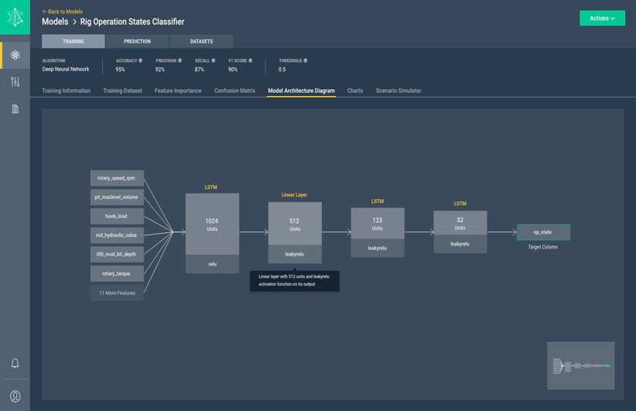
Darwin
TM
Accelerate data science. Solve problems at scale.
Darwin accelerates data science at scale by automating the building and deployment of models.
Create and Manage 1000s of Models
Quickly Build, Deploy, and Maintain all your Models
Scale your Models Across Operations
Efficiently Scale Applications in your Organization
Control the Model Building Process
Obtain Full Control of the Machine Learning Process

Slide 20
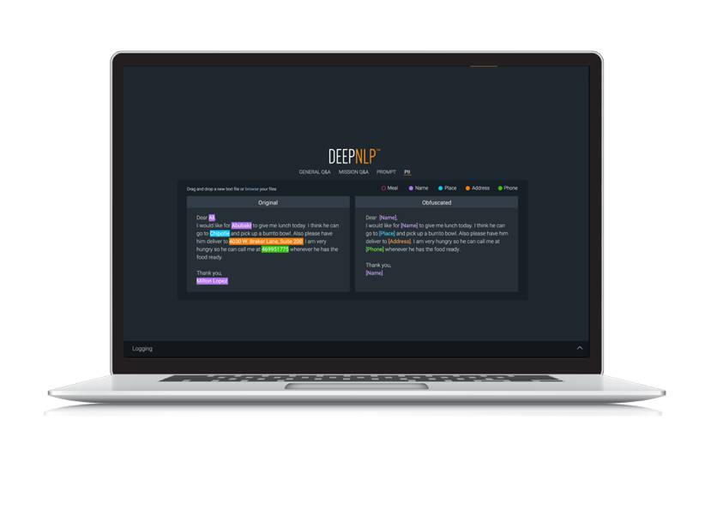
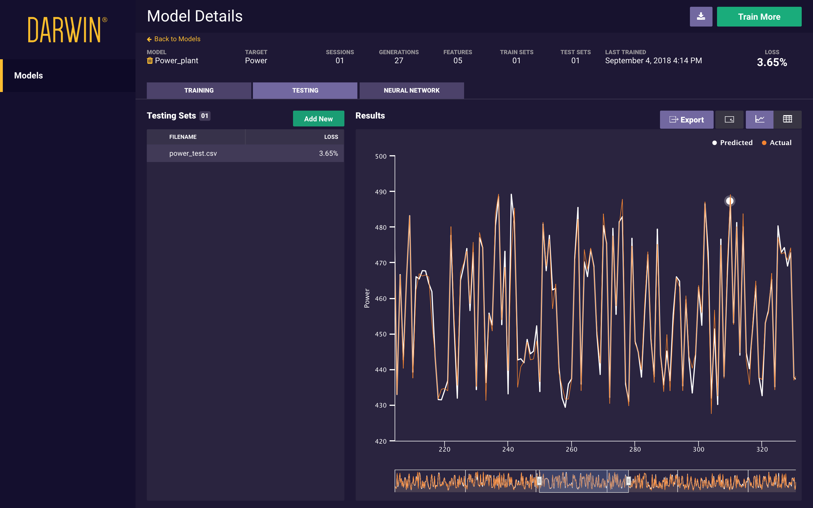
Darwin
TM
Real-life use customer use cases
Inventory Management in Aviation
Predicting supplemental cooling unit failures on aircraft using sensor data
Fraud Detection in Consumer Credit
Predicting fraudulent transactions in credit card usage
Manufacturing Quality in Automotive
Predicting manufactured product quality based o process data and input materials
Real-time Inference in Oil & Gas
Predicting real-time operating behavior of large, complex equipment based on sensor and control data
Customer Support Optimization in Energy
Predicting which organization should support a new request based on a vectorized representation of text
Notes:
Here’s why we are different
Understand your own data – detect things you did not know
Bring ou domain ontoligies to your documents - customize that
Integration and the adapter pieces
Science - Linguistics
Simplicity of use
Integration
Machine learning
Extensibility pieces
Simplicity
Extensibility
Automation – speed at which you can get started
Science
Simple, fast, extensible, cutting edge science
-----
In prem, off prem, secure, scalable,

Slide 21
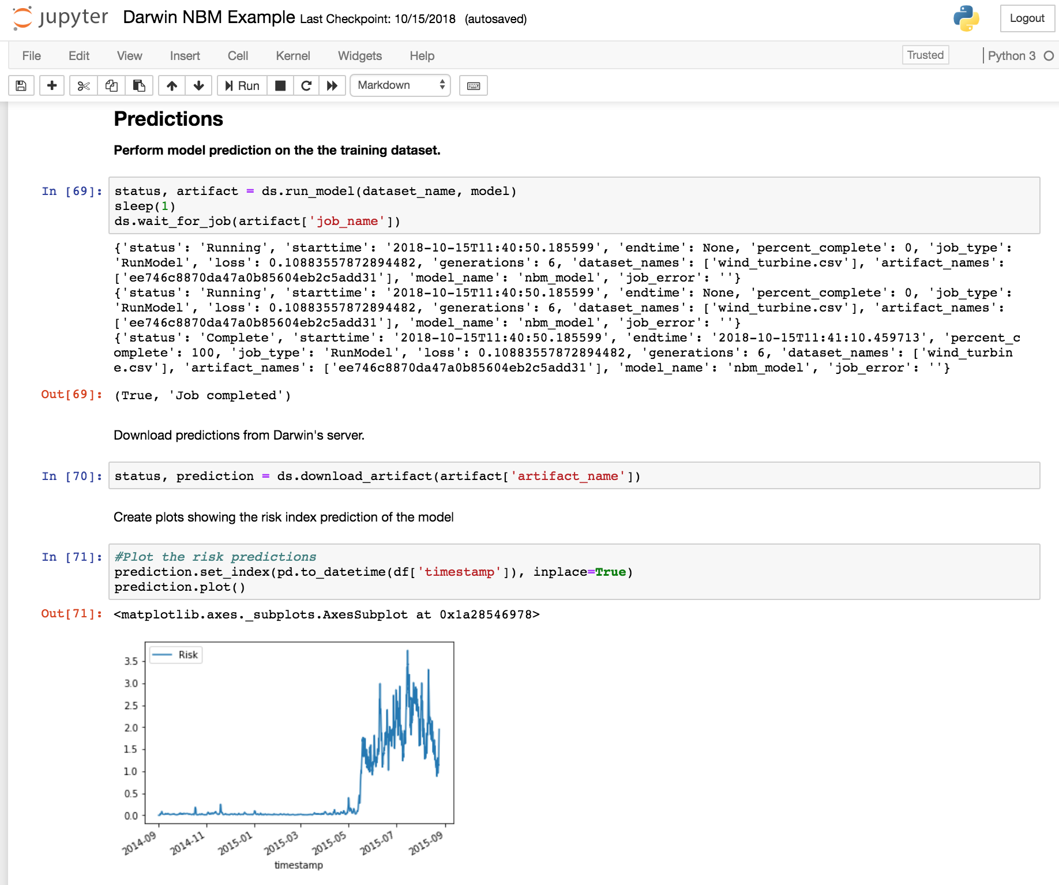
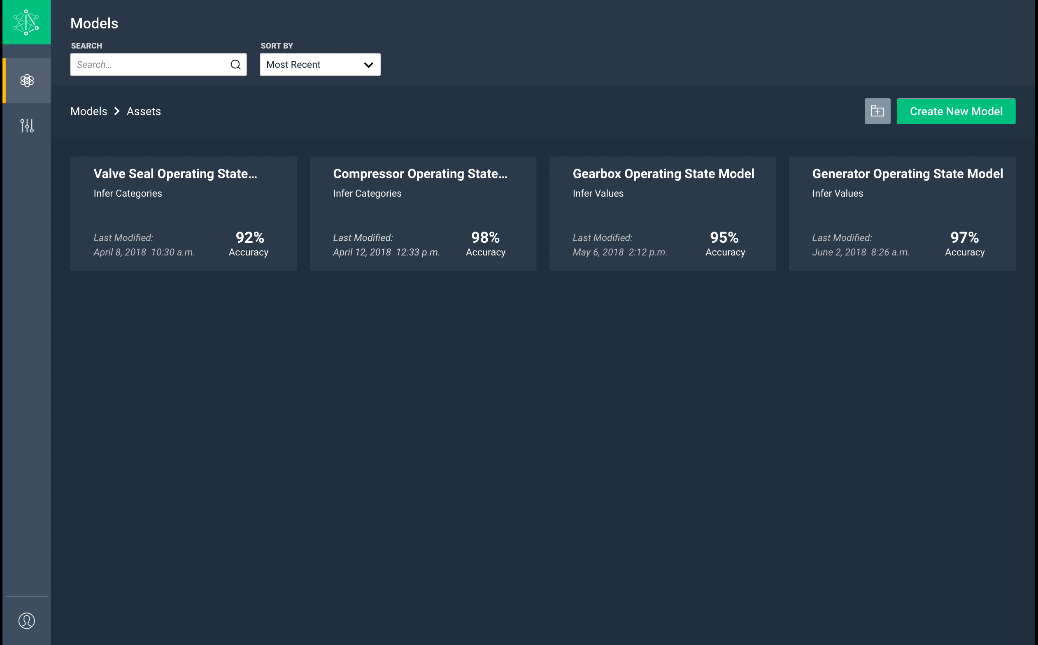
Darwin User Experience
TM

Slide 22

Thank you!
Try out Darwin at https://www.sparkcognition.com/darwin-trial/
Contact jritter@sparkcognition.com for more information!
©SparkCognition, Inc. 2019. All rights reserved.

