Slide 1
Leveraging Natural Language Processing and Understanding for Adding Value to Businesses Roozbeh Davari Data Scientist

Slide 2
Objective
A Brief History of NLP
NLP Methods and Algorithms
How it Generates Revenue

Slide 3
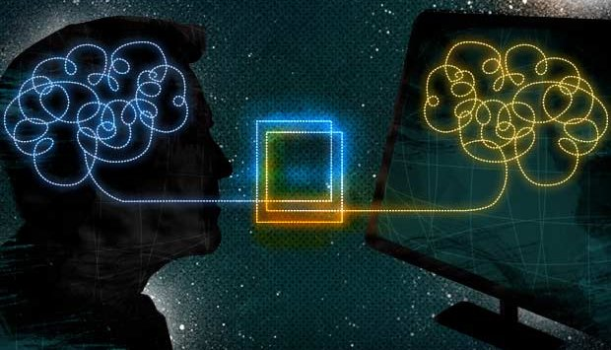
Notes:
1. The process to analyze and extract Insights from natural language (speaking and writing)

Slide 4
NLP Brief History
Turning Test (1950): Criterion of intelligence
Georgetown Experiment (1954): AI Failure in Machine Translation
Machine learning (1980s): More computational power and the gradual lessening of linguistics theories
Deep Neural Network Machine Learning (2010s): Even more data
and computational power
Notes:
https://www.slideshare.net/sumit786raj/natural-language-processingpython-17406157
Speech recognition devices all rely on NLP. The demand for it is increasing more and more.

Slide 6
Three Use Cases
Sentiment Analysis
Topic Modeling
Machine Reading Comprehension

Slide 7
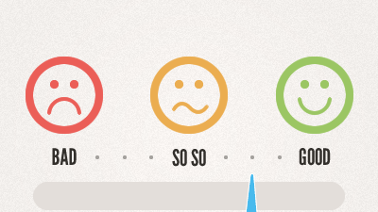
Sentiment Analysis
Notes:
Most commonly sentiment analysis refers to assigning a metric to a piece of text that details how positive or negative said text is. This metric is also called polarity, because it returns a value along a single dimension ranging from +1 (extremely positive) to -1 (extremely negative).

Slide 8
Sentiment Analysis Methods and Use Cases
Rule Base: Word Dictionary
Machine Learning
Business Application:
Netflix: Analyzing Movie Reviews
Chatbot Performance
Notes:
https://towardsdatascience.com/five-practical-use-cases-of-customer-sentiment-analysis-for-nps-a3167ac2caaa
https://deepmoji.mit.edu/
Netflix Rotten Tomatoes Reviews sentiment analysis to buy. Facebook campaign comments sentiment to evaluate your ads. Chatbot performance.

Slide 9
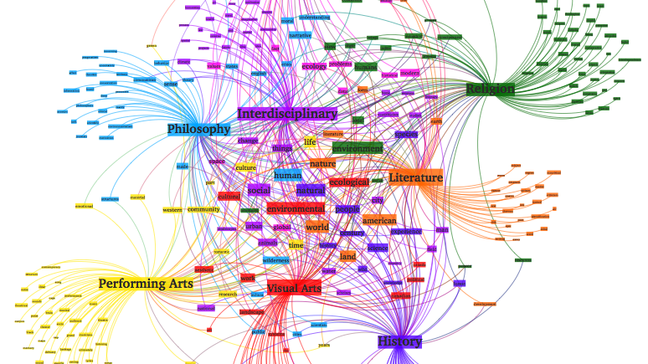
Topic Modeling
Notes:
Definition: Topic modelling, in the context of Natural Language Processing, is described as a method of uncovering hidden structure in a collection of texts.

Slide 11
Topic Modeling Use Cases
Information Retrieval: Categorizing Queries
Recommender Systems: Recommending Articles for Readers
Notes:
https://nlpforhackers.io/topic-modeling/
https://www.quora.com/What-is-so-special-about-Dirichlet-distribution
The Dirichlet distribution is sometimes called a "distribution over distributions", since it can be thought as a distribution of probabilities themselves

Slide 12
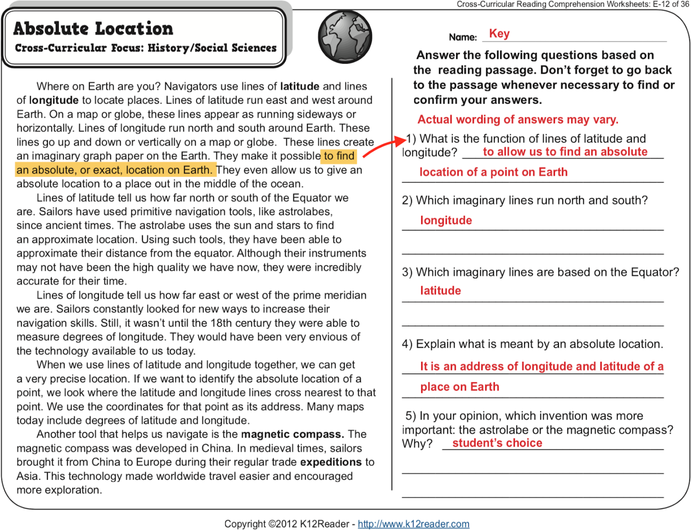
Machine Reading Comprehension
Notes:
Machine Reading Comprehension (MRC) is all about answering a query about a given context paragraph

Slide 13
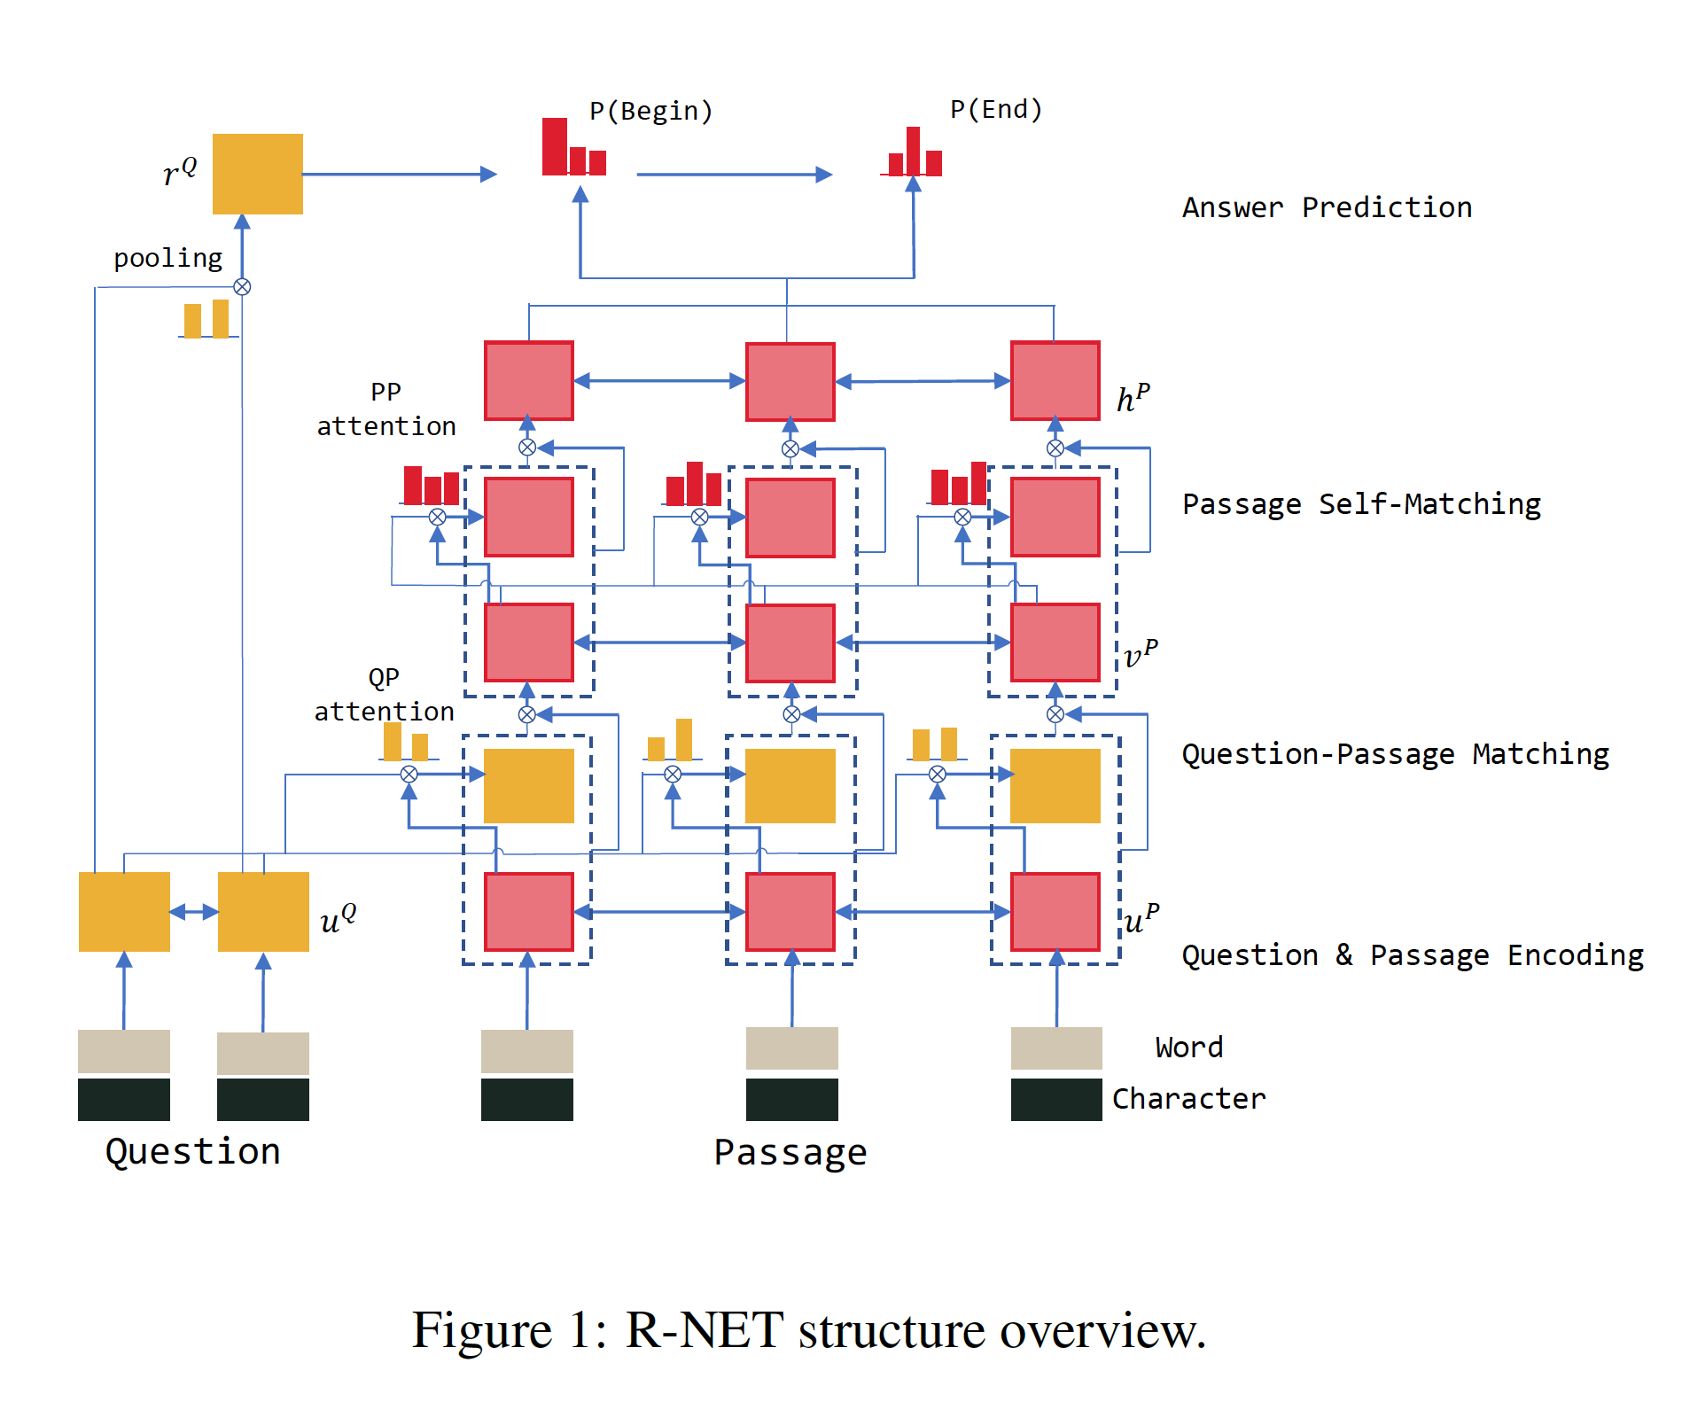
A lot of Neural Network!

Slide 14
Machine Reading Comprehension Use Cases
Google Search
Conversational AI
Notes:
https://hanxiao.github.io/2018/04/21/Teach-Machine-to-Comprehend-Text-and-Answer-Question-with-Tensorflow/

Slide 15
We are hiring! Career Networking & Job Fair roozbeh@aisera.com

