Slide 1
Creating Synthetic Control Groups to
Understand Incremental Lift from
TV Commercials
Joshua J. Miller
Bonnie Magnuson-Skeels
Sagnik Mazumder
Astronomers-Turned-Data-Scientists (ATDS) 2019 Meeting

Slide 3
Overview
Samba TV: Video Automatic Content Recognition (ACR) and Attribution
Control Groups in Digital Advertising
The Problem/Opportunity with TV Commercials
Synthesizing Control Groups

Slide 4
Video ACR and Attribution

Slide 5
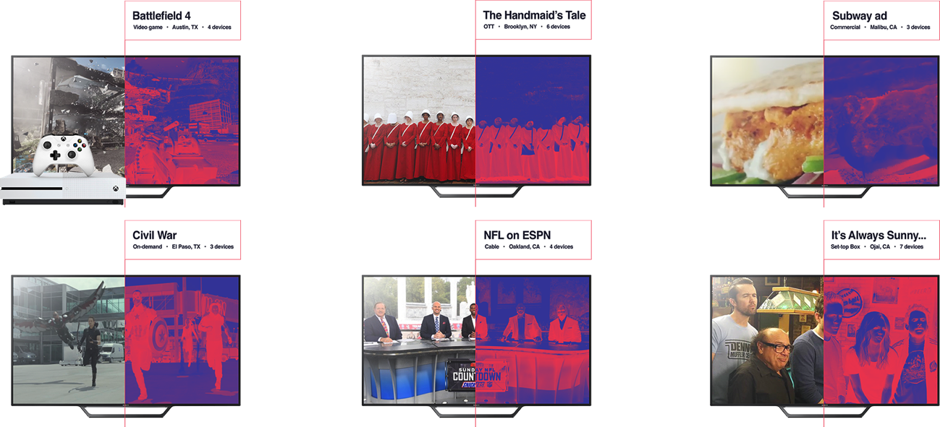
Gaming consoles
Apps & OTT
Advertising content
Video on-demand
Satellite Cable
Time-shifted
Comprehensive TV content recognition
Real-time TV content recognition uses privacy-forward hashed fingerprinting technology to detect content across linear TV, OTT content, commercials, and video games.
(No screenshots - if the hashed fingerprints do not match, we do not extract further meaning from them.)

Slide 6
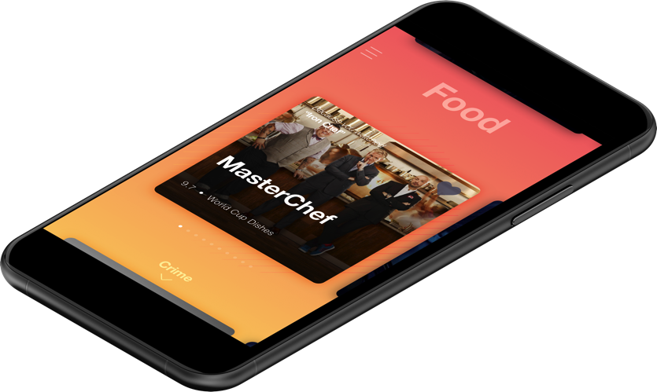
Consumer Value
Useful consumer applications to improve the TV experience
Opt-in
Recommended shows
Trending TV content
Interactive TV experience
Samba TV app
And more…

Slide 7
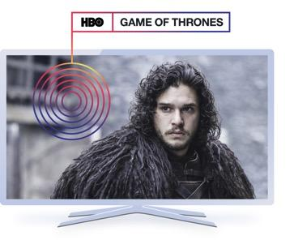
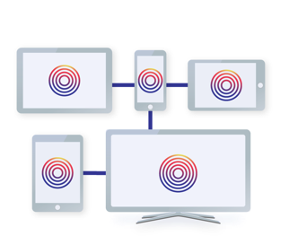
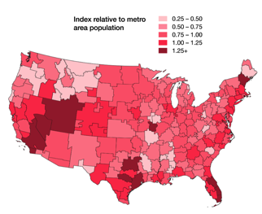
Proprietary End-to-End Samba Technology
About Samba TV
Video ACR for real-time recognition of all content on TV – linear, VOD, OTT, and video games.
Persistent 1:1 device map of all digital devices in the household, both in-home and out-of-home.
Normalized, representative, and projectable panel for measurement.
TV audience segments based on viewership for digital targeting.

Slide 8
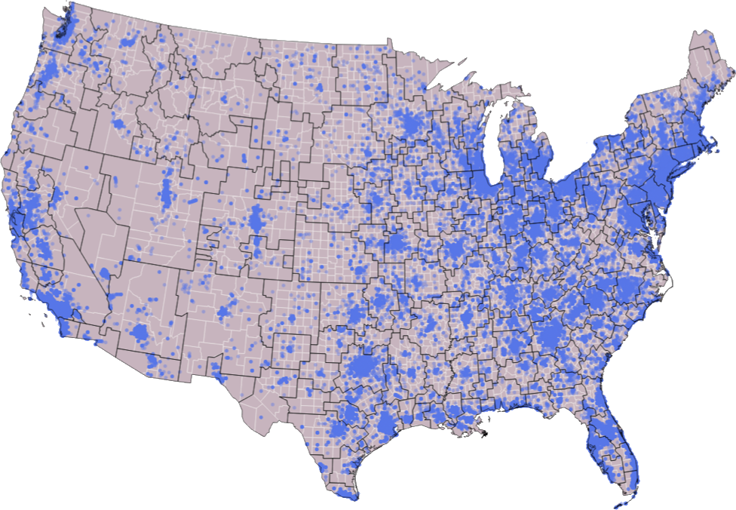
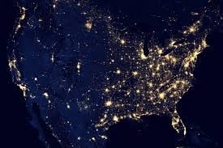
Requisite Spacey Picture

Slide 9
About Samba TV
Addressability & efficient scale
14.4M HHs
Real-time viewership data from opt-in TVs
72M devices
1:1 high fidelity device map for addressability
1B+ devices
Digital amplification for massive reach
Notes:
Our 1:1 data comes from 14.4M TVs in the US (19.4M globally) mapped to 72M digital devices (97M globally). All of this data is 1:1 and not modeled. We can scale this up to 1B device reach with our predictive audience technology which we will get into detail in the later sections.

Slide 10
Quantify with Samba TV
TV ADVERTISING
DIGITAL ADVERTISING
TUNE-IN
Verified Tune-in Rate
Analyze conversion paths to TV program tune-ins
Cross-platform exposure
Measure lift from combined cross-screen ad exposures

Slide 11
Quantify with Samba TV
TV ADVERTISING
TV ADVERTISING
DIGITAL ADVERTISING
ONLINE VISITS
Conversion
Broadcast Conversion Rate
Analyze conversion paths to websites and apps
Cross-platform exposure
Measure lift from combined cross-screen ad exposures

Slide 12
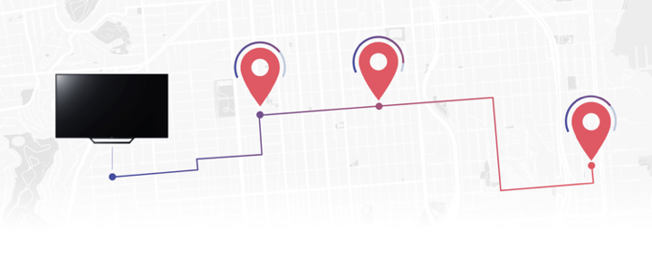
Quantify with Samba TV
Quantify the impact of cross-screen ads on store visits and offline purchases
Determine cross-screen ad effectiveness in driving foot traffic to stores or restaurants
Measure lift in traffic and increase in frequency generated as a result of an ad campaign
Get accurate results from the largest normalized and representative research panel
Be 100% privacy compliant by relying on solutions that only use opt-in third party user location data

Slide 13
How do we know if ads work?

Slide 14
Control Groups in Advertising
Alex
Bev
Charley
Targeted group
Demographics, location, behavior, etc…
Usually targeted because the advertisers believe this group already has a propensity to convert.
Untargeted
Typically unlikely to convert.

Slide 15
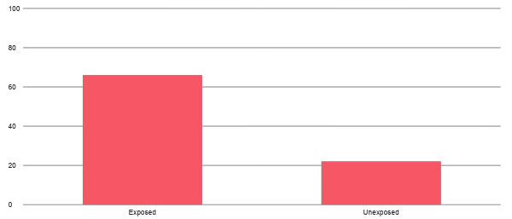
Conversion by Exposure Group
100%
80%
60%
Ad exposure?
Propensity to convert?
Conversion
40%
20%
0%
Exposed
Unexposed
We need a group that has the same propensity to convert that was not exposed to the ad.
Once we control for our targeting we can isolate and measure the true effect of the ad.

Slide 16
Control Groups in Digital Advertising
Exposed
Targeting
Data
Control
Control Group Selection
Random decision meant to minimize bias.
We want the groups to be similar.
Targeting
Deliberate filtering based on demographics, location, behavior, etc. We want the groups to be different.
Unexposed

Slide 17
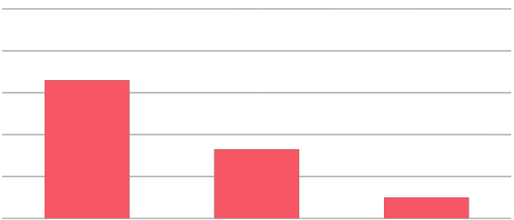
Conversion by Exposure Group
100%
80%
60%
Ad exposure
Conversion
40%
Propensity to convert
20%
0%
Exposed
Control
Unexposed

Slide 18
Control Groups for TV?
Exposed
“Targeting”
Data
Exposed
Control Group Selection
In most cases, everyone watching the program watches the same commercials.
Selection
Did they watch the show(s) and associated commercial(s)?
Unexposed
We need a way to synthesize a control group that did not see the commercial
but also looks like and behaves the same way as the exposed group.

Slide 19
What if Bev missed her show that day?
Exposed
“Targeting”
Data
Selection
Unexposed
Did they watch the show(s) and associated commercial(s)?
We need a way to synthesize a control group that did not see the commercial
but also looks like and behaves the same way as the exposed group.

Slide 20
Consumer Value
Useful consumer applications to improve the TV experience
Opt-in technology
Recommended shows!
Trending TV content
Interactive TV experience
Samba TV app
And more…

Slide 21
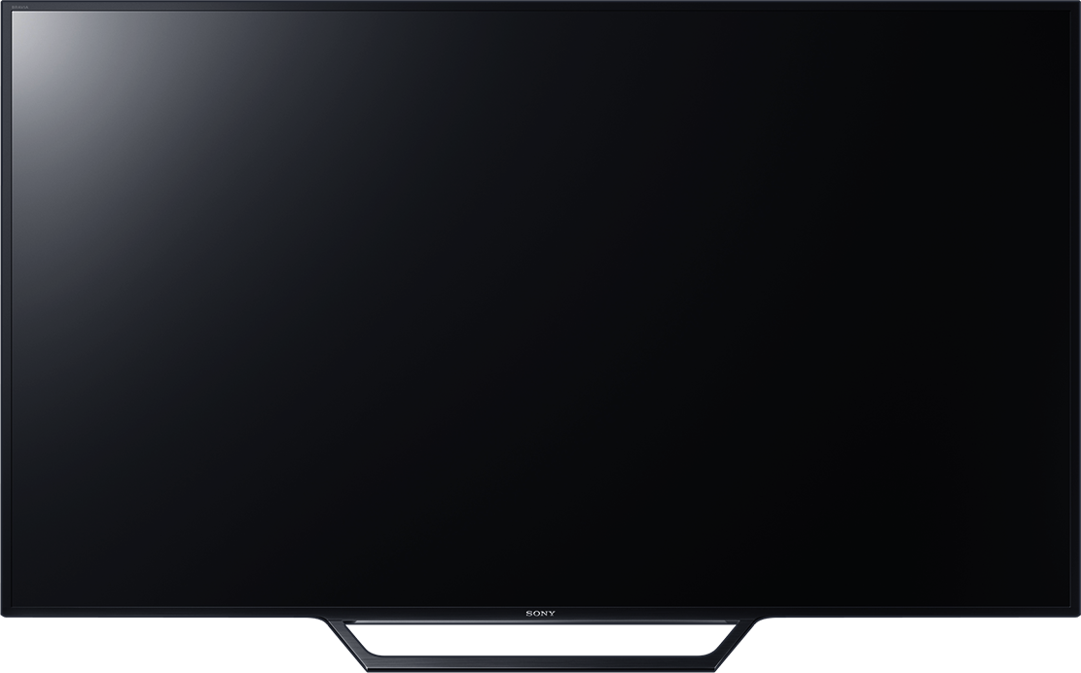
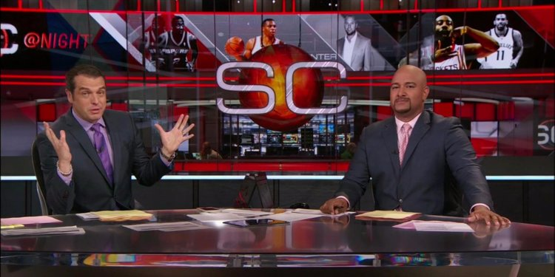
Recommendations
Alex
Bev
Charley

Slide 22
Synthetic Control Groups
Exposed
Did they watch?
Viewing
Data
Control
Viewing Behavior Based Modeling
Does the model predict that you would watch this show based on your previous TV viewing history, demographics, location, and other behaviors?
Unexposed

Slide 23
Synthetic Control Groups

Slide 24
Synthetic Control Groups
Exposed
SCG
Unexposed

Slide 25
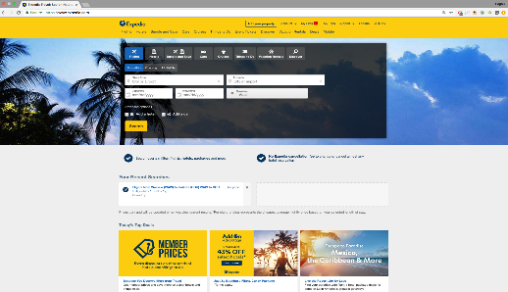
Synthetic Control Groups
Exposed
SCG
Unexposed

Slide 26
Conversion by Exposure Group
100%
80%
60%
Ad exposure
Conversion
40%
Propensity to convert
20%
0%
Exposed
Control
Unexposed

Slide 27
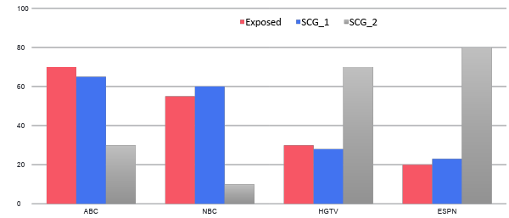
How do we know it works?
We have a lot of viewership behavior data models at our disposal!
Collaborative Filtering
Feature-based
Both...
We’re more concerned about missing households that should have watched than accidentally including ones ones that shouldn’t have been included.
When we run the model on the entire population, how many households that watched the program/commercial make it into the SCG?
Distance measurements/cosine similarities between SCG and Exposed
Demographics
Location
Viewership behavior data
etc...
?

Slide 28
Patent Pending :-)

Slide 29
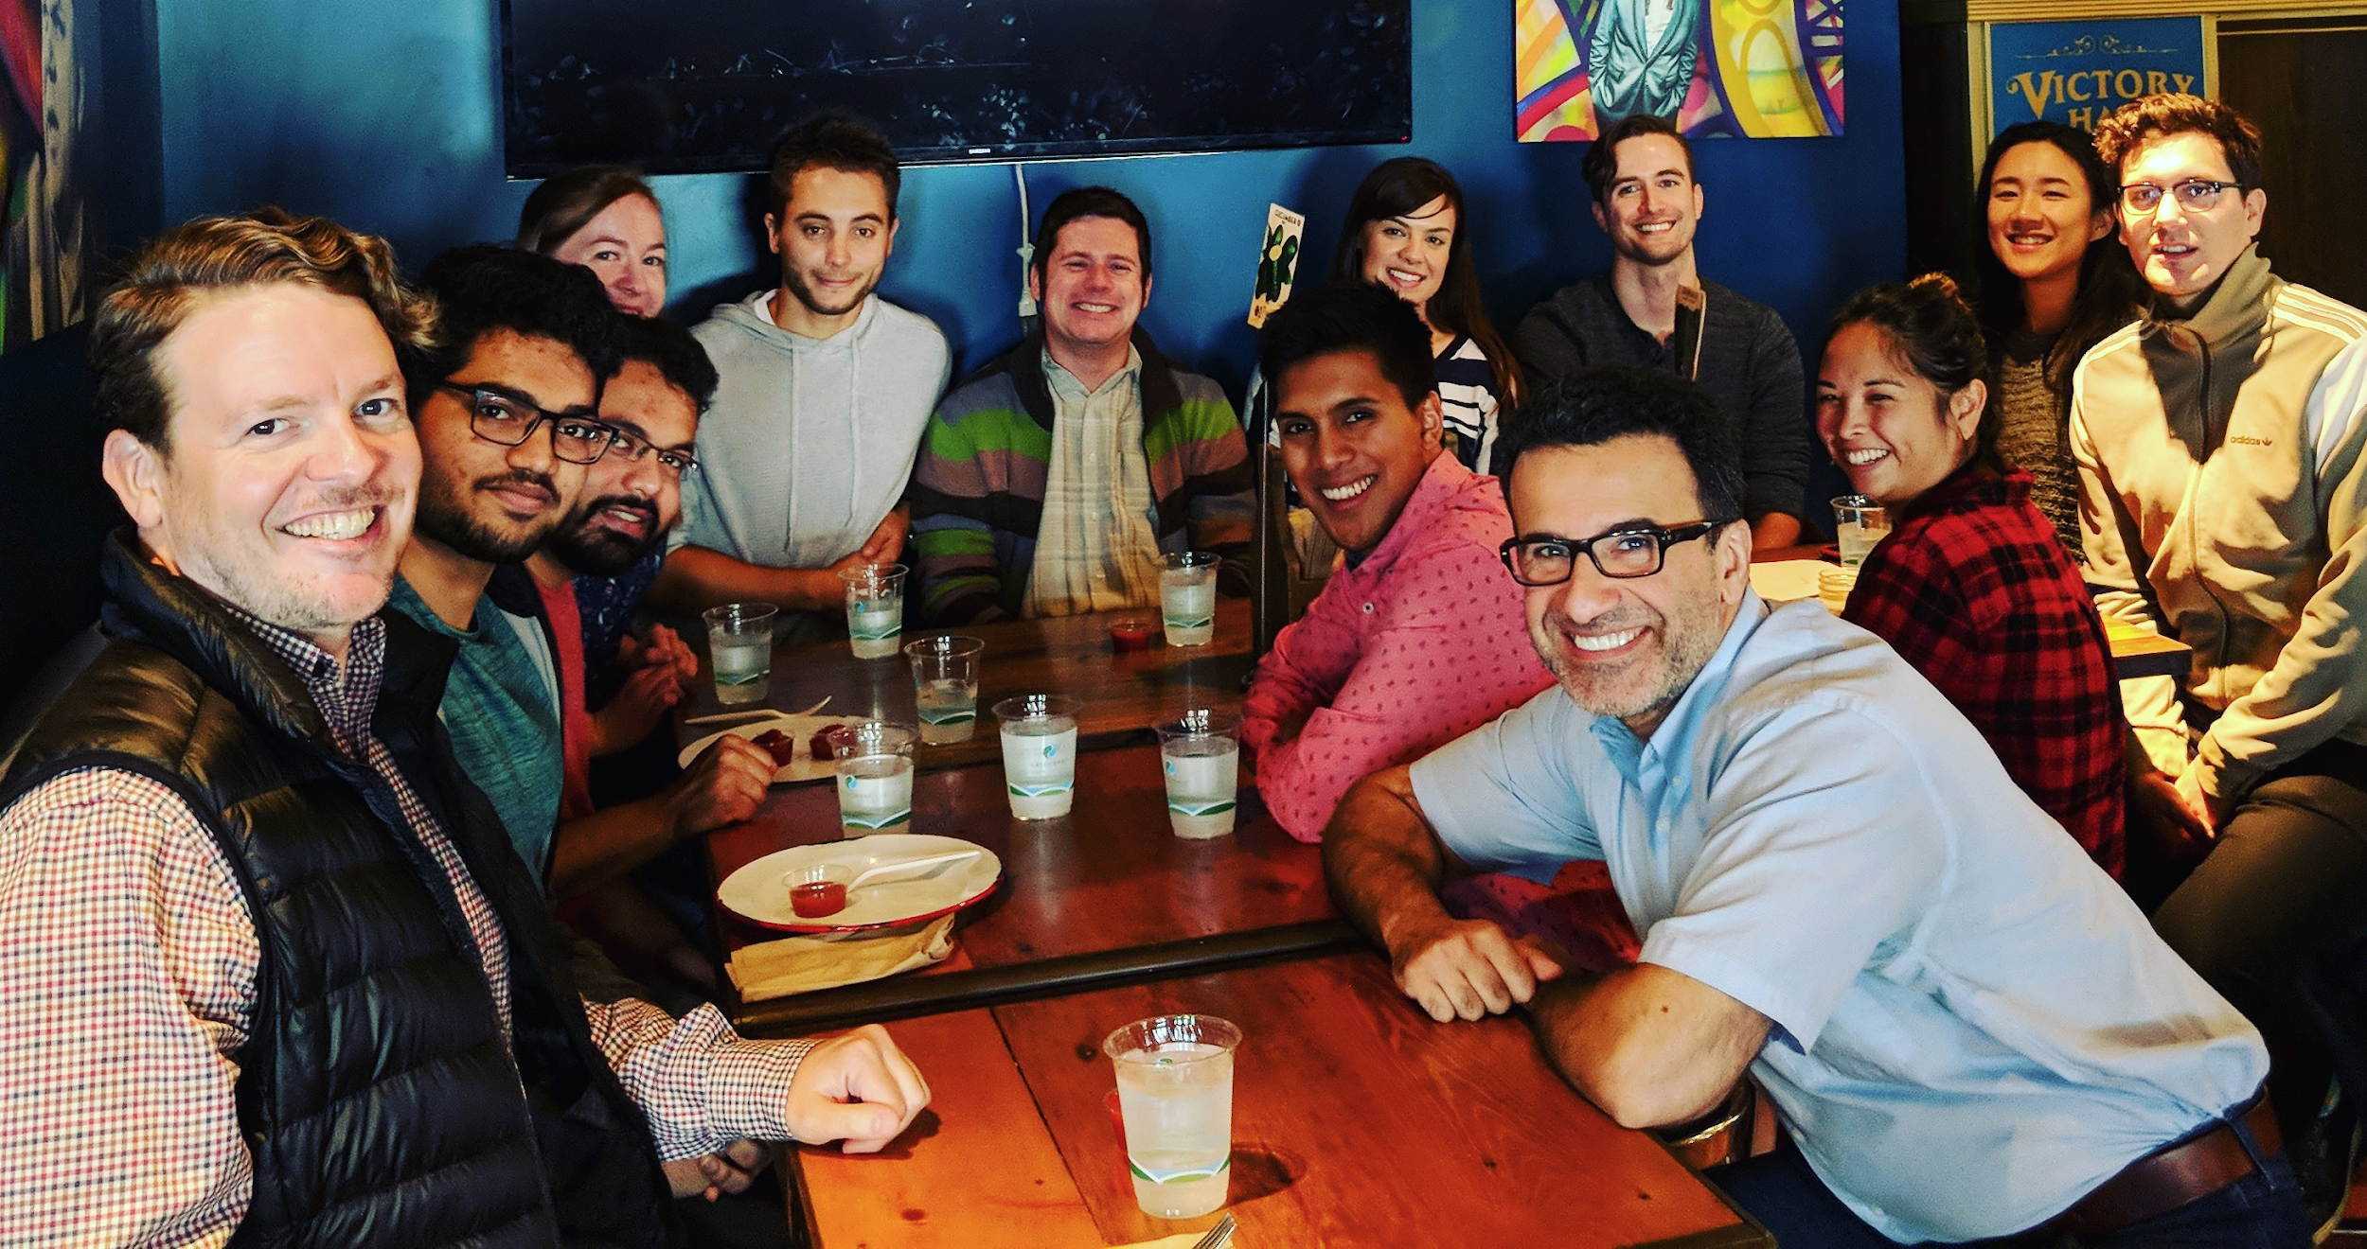
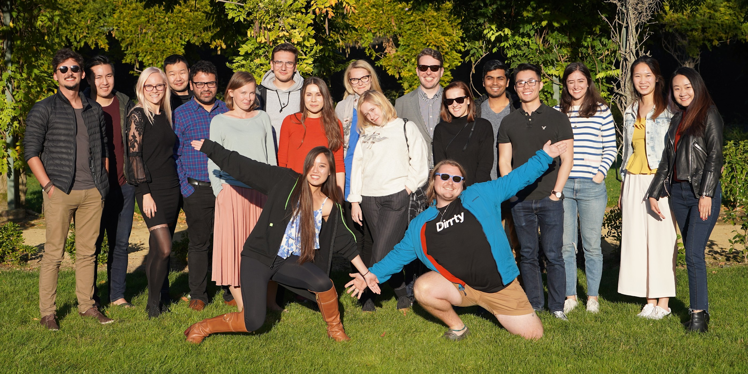
Thank you!
Bonnie Magnuson-Skeels
Sagnik Mazumder
Josh Miller
miller@samba.tv
/joshuajamesmiller
We’re hiring!

