Slide 1
Product(ive) Data Science
Julie Hollek @jkru

Slide 2
Summary
Data Science
Product Data Science
Communication

Slide 3
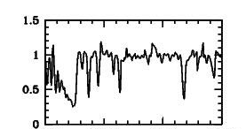

Slide 4
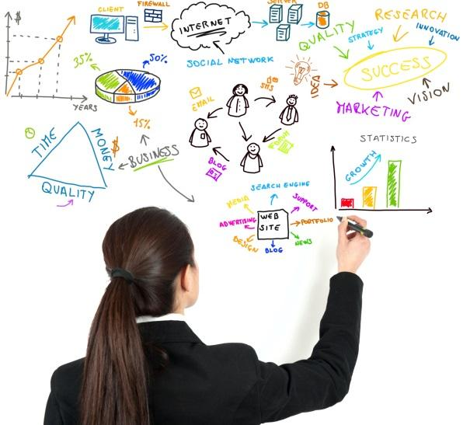
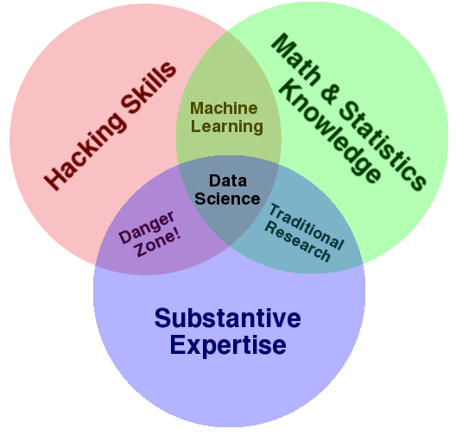
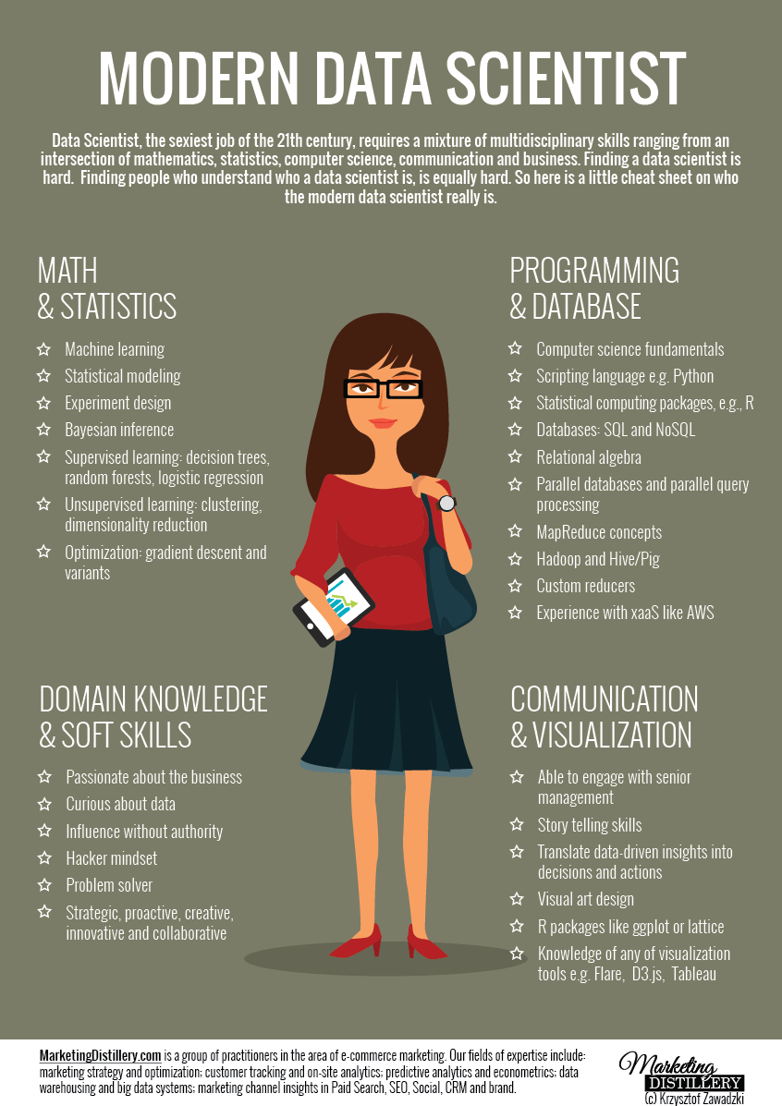
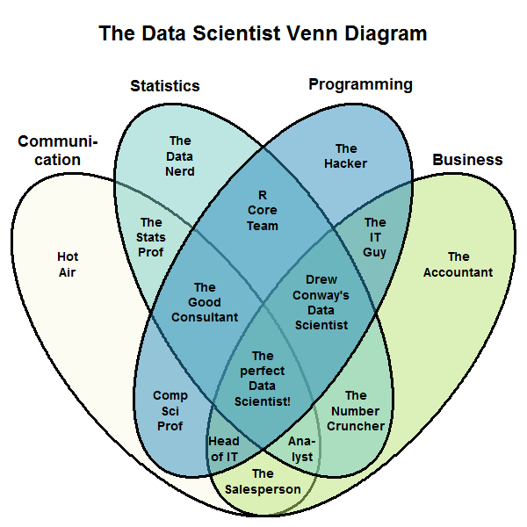
So, what do you do all day?

Slide 5
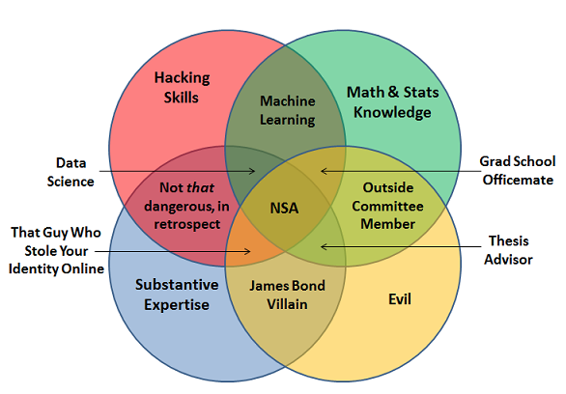
So, what do you do all day?

Slide 6
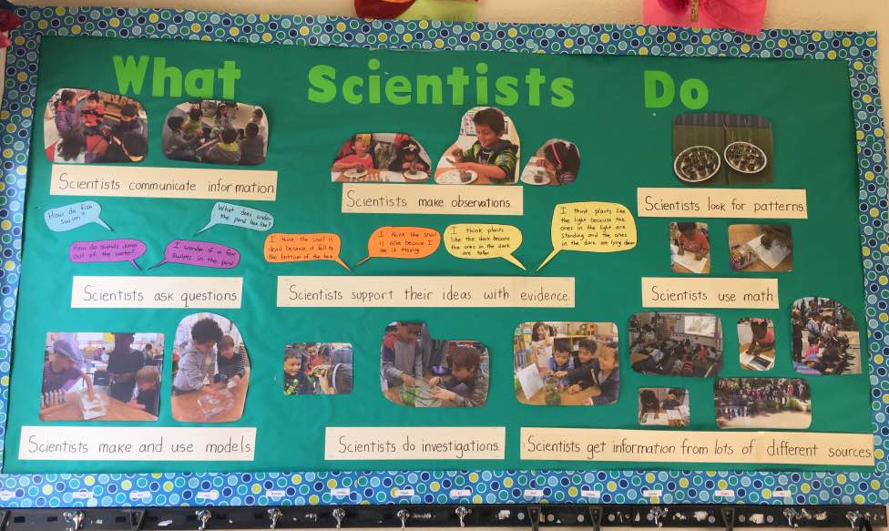

Slide 7
Data Science @ Twitter
User Behavior, Health, and Top Line Metrics
Experimentation
Data Visualization (@TwitterData) https://interactive.twitter.com/
Product Data Science

Slide 8
Product Data Science
Enables your company to make data-driven decisions around engineering, product, and design for its core product.

Slide 9
Product Data Science
Enables your company to make data-driven decisions around engineering, product, and design for its core product.

Slide 10
Product Data Science
Enables your company to make data-driven decisions around engineering, product, and design for its core product.

Slide 11
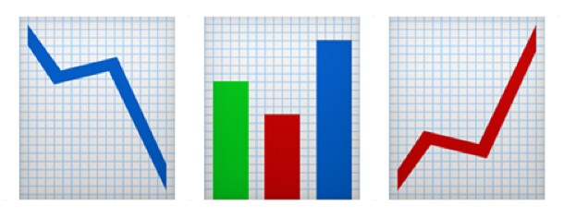
Product Metrics & Investigations
Metrics frame how your company views your product
Provide insight into your customers’ experiences
Measure successes and failures
Monitor the health of the product

Slide 12
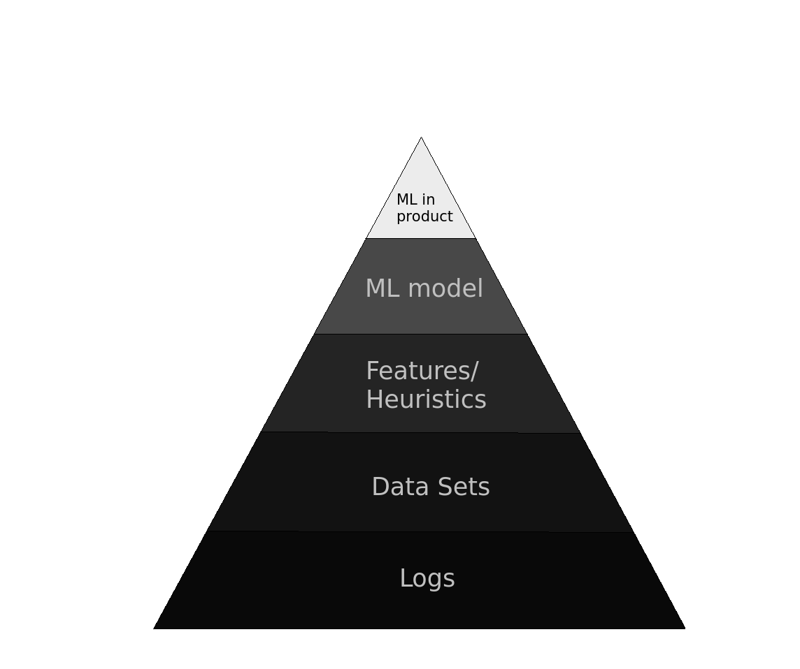
Science at Data: Machine Learning
Create data sets from logs
Explore the data set to generate insights, heuristics, features, labels
Train machine learning models from these features
Use relevance engineering to understand how to best use ML in the product

Slide 13
Science at Data: Idea Exploration
Opportunity Sizing/Prototyping
Test to see if there’s an audience for a new product, feature, policy
Use existing data sets or create new ones from logs
Experimentation
Test hypotheses and find causal impact with A/B tests
Impact Analyses
Find correlational trends
Useful for when you can’t A/B test

Slide 14
Product Data Science
Setting company goals
Prioritization
Your role as a product data scientist is to make the people around you better at their jobs.

Slide 16
Data Scientist: Wearer of Hats
Sales
+
Full stack engineering
+
Marketing
+
Product Management
Networking
+
Problem Solving
+
Communication
+
Grit
Notes:
Transition academia to industry

Slide 17
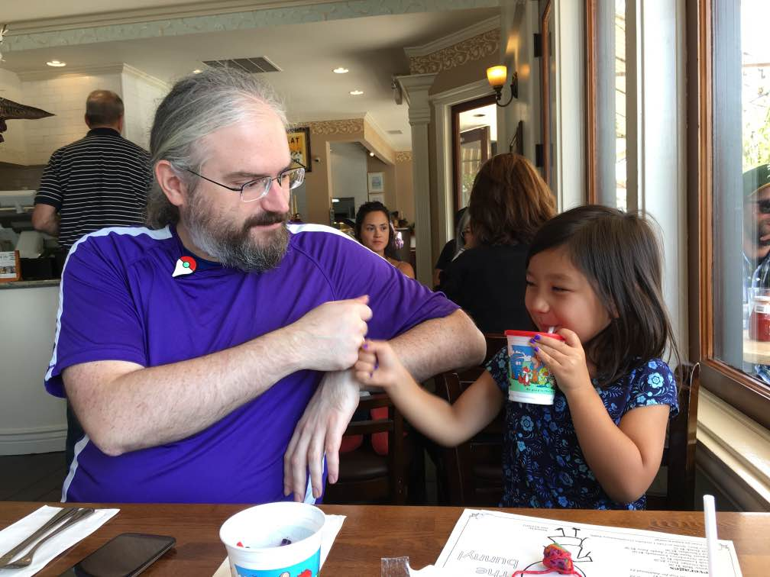
Communication
Communication

Slide 18
Communication - Why?
You translate business questions into data questions
Your audience has a wide range of talents
You are the driver of data-backed decisions

Slide 19
Communication - How?
Visualize
Empathize
Simplify

Slide 20
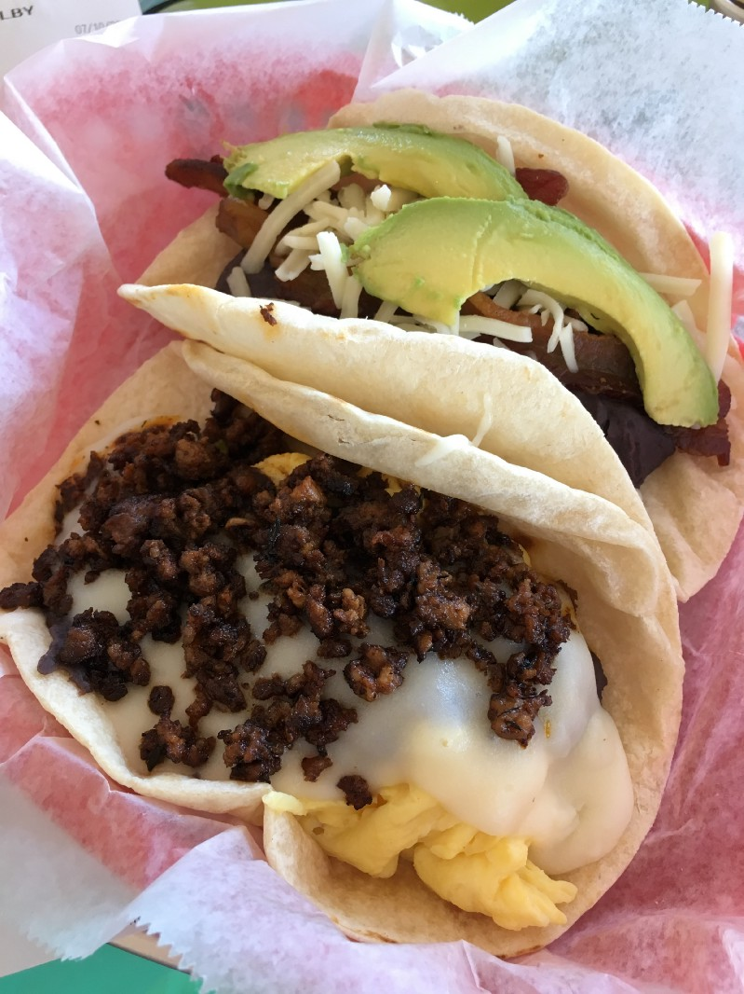
Visualize

Slide 21
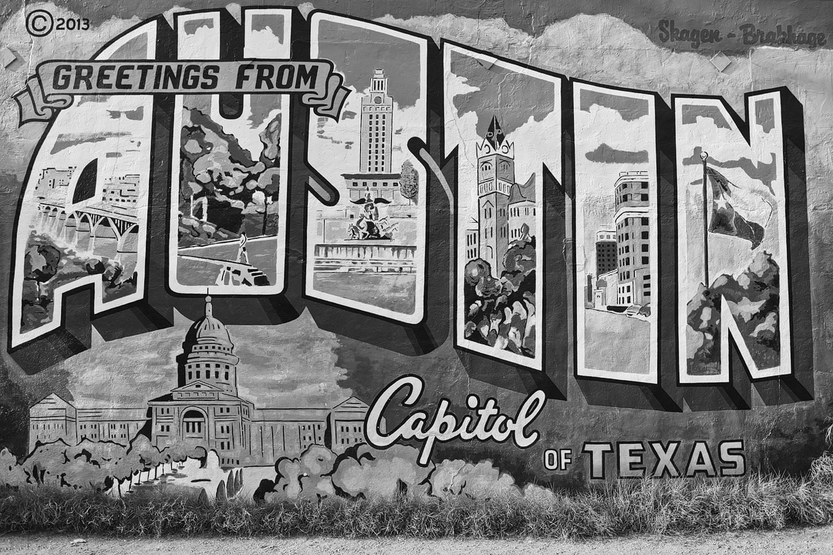

Slide 22
How many Doña Bertha’s do you see?

Slide 24
Did the color make it better?

Slide 26
Visualize
Translate your work into images, tables, graphs to tell a story
Provide context through text or visuals
Use data visualization best practices
Pre-attentive processing
@zanstrong @datachloe

Slide 27
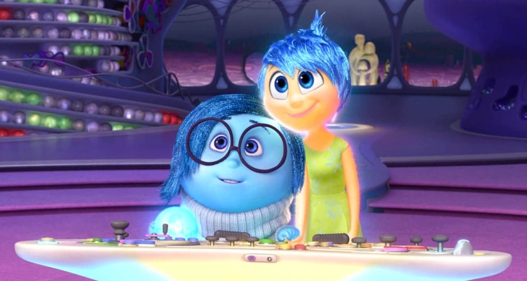
Empathize
Meet people where they’re at...

Slide 28
Empathize
...and take them on a journey.
S: | Simple | Elaborate
Q: | Quality | Quantity
V: | Vision | Execution
I: | Individual | Comparison
D: | Difference | Now

Slide 29
#Simplify

Slide 30
Questions?
Contact: jhollek@twitter.com @jkru
Full Time: careers.twitter.com Interns: university.twitter.com

