Slide 1
What is a Data Scientist, Where do they come From?
Exploring the field of Data Science with Job Market Data
Chris Lindner, Ph.D.
Product Science Manager, Indeed

Slide 2
Who am I?
≅2011
Started thinking about DS
August 2017 Began work at Indeed
Oct 2014
Began work at Civitas Learning
+ Interviewed people in DS
+ Started DS Study Group
+ Education technology startup
+ Promoted to DS manager
+ Hired as a product science manager
+ Grew team from 5 to 25 in 1.5 years!
2008
Started @ UT Austin
Astronomy
July 2014
Ph.D.
May 2017 Left Civitas Learning
+ Didn’t apply to any academic jobs
+ Took ~3 months to finish interview processes and get hired
Knew I 100% was going to be a professional astronomer.
+ Took a 3 month travel / poker sabbatical

Slide 3
Who is Indeed?
Indeed is the world’s #1 Job Site
250 million unique visitors each month across 60+ countries
20 million active job postings
120 million resumes
Basically, we have a ton of data on jobs

Slide 4
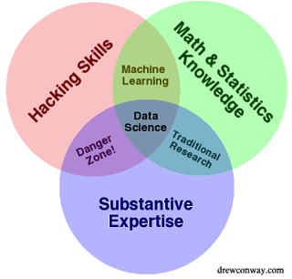
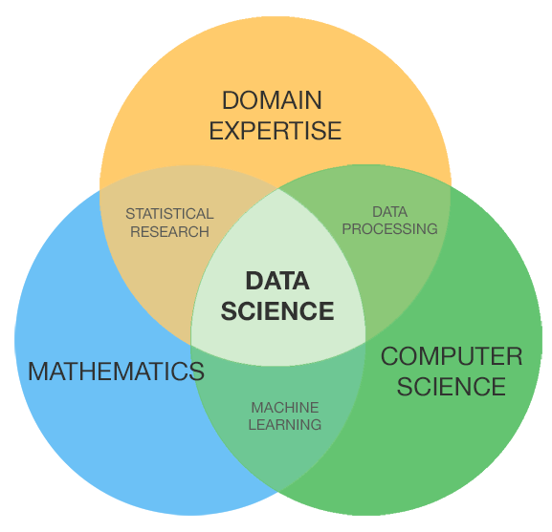
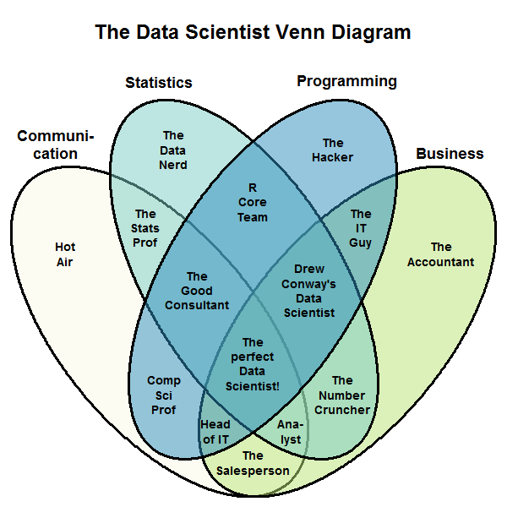
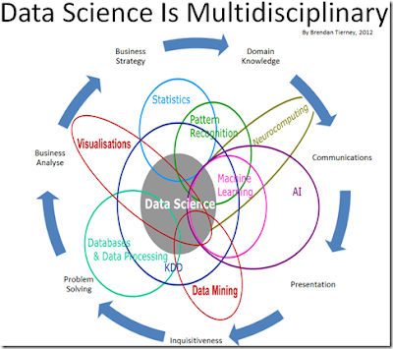
What is a data scientist?
“Data Science” became an industry buzzword in the early 2010s
While many university programs now offer a data science degree, there exists no consensus on a definition or suitable curriculum contents. - Wikipedia
A number of distinct jobs seem to fall under the job title “Data Scientist”

Slide 5
What do Employers Say?
We conducted qualitative interviews with 10 Data Science employers working with Indeed
We found many employers have simply renamed what used to be called a Data Analyst, Business Analyst, or a Business Intelligence Analyst to “Data Scientist”
In other cases, “Data Scientist” indicates a need for more advanced skills, including predictive analytics, data modeling, natural language processing, and data visualization.
“Sometimes I think [hiring managers] are just throwing that title [data scientist] out to make it a sexy title so people will apply to it. What they really need is a business intelligence type of role.”

Slide 6
Can we use Indeed’s job market data to better define what different roles fall the umbrella of “data science?”

Slide 7
For this investigation, we collected search queries for all users who had searched for “data scientist” in a given month.
We then looked at the other searches these users performed.

Slide 8
We calculated the search term frequencies across all users and built a sparse matrix with the counts:
We then clustered the data to see if there were clear distinctions in the types of data science jobs users searched for.
Notes:
Collaborative filtering approach

Slide 9
Business Intelligence | Machine Learning Engineer | Statistician | Natural Scientist
analyst | artificial intelligence | accounting | bioinformatics
analytics | c# | actuarial | biology
bi developer | c++ | biostatistics | biotech
business analyst | deep learning | data mining | chemical engineer
business analytics | devops engineer | economics | chemistry
business intelligence | etl developer | epidemiology | electrical engineer
data analyst | front end developer | finance | engineer
data architect | full stack developer | mathematician | environmental
data entry | java developer | mba | mechanical engineer
data management | machine learning engineer | operations research | phd
data visualization | mobile developer | public health | physics
database administrator | natural language processing | quantitative analyst | process engineer
marketing analyst | python developer | r programming | research scientist
r | software engineer | sas | science
research analyst | spark | statistical programmer | scientist
sql | systems engineer | statistician | teacher
tableau | tensorflow
Four natural clusterings of data science related search terms were found
We hand labeled these Business Intelligence, ML Engineer, Statistician, and Natural Scientist

Slide 10
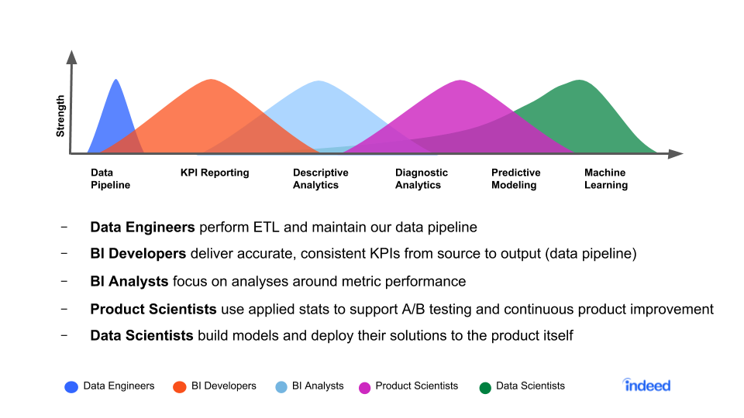
These distinctions turned out to be similar to our division of data roles at Indeed
Our Data Scientist role is more in line with ML engineering
Our Product Scientist role spans the gap between BI and ML engineering
Similar distinctions show up across other tech companies
Data Science Titles in Industry

Slide 11
Where do Data Scientists come From?
Next, we wanted to understand the educational and career backgrounds of various DS job titles.
We studied the resume data of real job seekers that held jobs as data scientists, ML engineers, software engineers, data engineers, or business intelligence / data analysts.

Slide 12
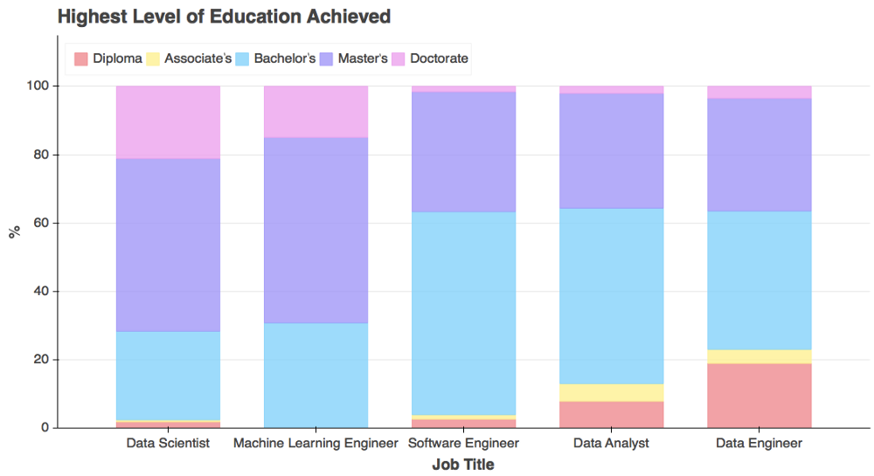
Education
Data Scientists have the most PhDs and the most graduate degrees (20% PhD, 55% Masters)
ML Engineers are similar to DS in degree level
Software Engineers, Data Analysts, and Data Engineers primarily have Bachelor’s degrees

Slide 13
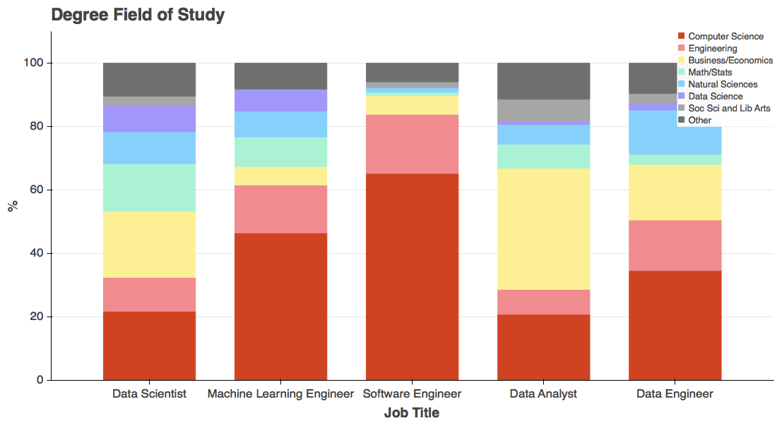
Field of Study
Data Scientists have the most diversity in backgrounds, and the most natural scientists (10%)
ML, Data, and Software Engineers predominantly hold CS degrees
Data Analysts largely come from Business backgrounds, but have some representation from other fields

Slide 14
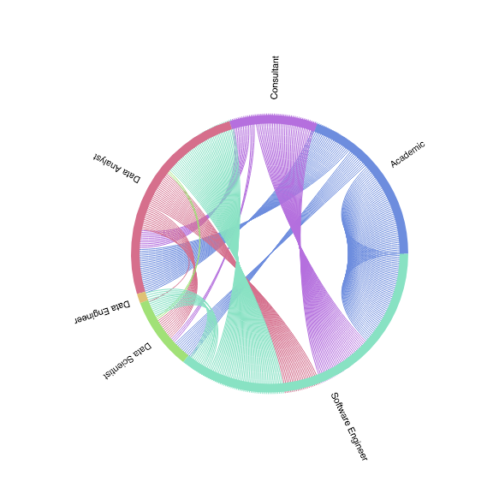
Previous Career
Academics (e.g., teaching assistants) tend to move directly into DS, Data Analytics, or Software Engineering
Data Engineers are largely former Software Engineers
Data Science is fed equally by data analysts, academics, and software engineers
Few people are leaving Data Science
Color indicates origin

Slide 15
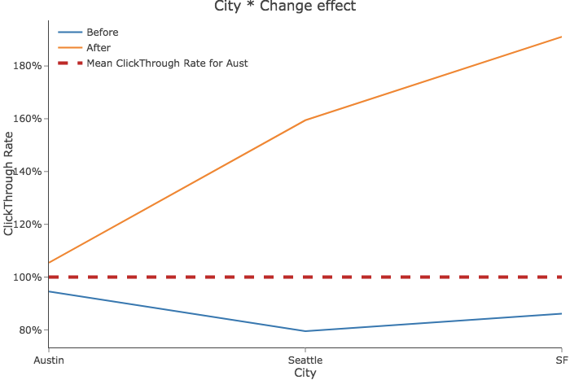
Do non-standard job titles make jobs less attractive?
At Indeed, we use the less common “Product Science” job title
When we kept the job listing the same, but changed the job title from “Product Scientist” to “Data Scientist,” clicks, applies, and candidate quality improved substantially
While less common job titles might make your role more specific, it may also make it less attractive

Slide 16
Conclusions
“Data Scientist” is an ambiguous inter-disciplinary job title
There are clear distinctions in the backgrounds and educations of users with more engineering-focused roles versus analytics-focused roles
Generalist “data scientists” typically hold graduate degrees, and come from a wide variety of backgrounds
Having a more specific job title might help understand your role better, although it might also make your job less attractive

Slide 17
We’re hiring!
clindner@indeed.com
Indeed is hiring data scientists, product scientists, software engineers, and pretty much everything else
Offices in Austin, Seattle, San Francisco, Tokyo, and Hyderabad
I have experience interviewing over 200 candidates for DS roles - come talk to me!

Slide 18
There’s No Such Thing as a Data Scientist by Clint Chegin
Does Your Job Title Matter? By Zhuying Xu
Where Do Data Scientists Come From? By Chris Lindner
Hiring Data Scientists By Michelle Peterson
And Qualitative + Quantitative By Robyn Rap and Vicky Zhang

